Slide 1
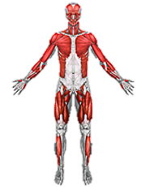
2012 Anatomy practice test
Mission Middle School

Slide 2
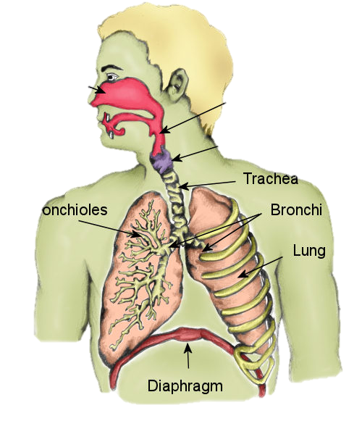
1.
Nasal cavity
pharynx
LARYNX
trachea
Primary bronchi
Alveoli
Technically its bronchioles….
lung
diaphragm

Slide 3
2.
What are the five functions of the nose?
Serves as a resonating chamber for speech
gives tone to voice
filters air
warms air
detects odors in the airstream
Provides an airway for respiration

Slide 4
3.
Where would you find stratified squamous epithelium cells?
In the respiratory system: the oropharynx and laryngopharynx

Slide 5
4.
What are the three functions of the larynx.
Sound production
passageway for air and food KEEPS FOOD AND DRINK OUT OF THE AIRWAY
ACTS AS A SPHINCTER

Slide 6
5.
What is the difference between the true vocal chords and the false vocal chords? And when do you use each of them?
True vocal cords produce sound when air passes through, false vocal cords do not. The true vocal cords are used whenever you talk, and the false are used when you swallow to help stop food from entering the trachea (the epiglottis is also used, but truthfully it isn’t as useful as most people believe.)

Slide 7
6.
What helps stabilize the trachea and prevent it from collapsing?
C-rings of hyaline cartilage.

Slide 8
7.
What is the path of the air after it enters the bronchi?
Bronchi – secondary bronchioles – tertiary bronchioles - alveoli
Left and right primary bronchi→ Secondary bronchi (one for each lobe) → tertiary bronchi → bronchioles → terminal bronchioles → respiratory bronchioles → alveolar ducts → alveolar sacs

Slide 9
8.
Why does the LEFT lung only have 2 lobes and what is the space called?

Slide 10
9.
What is a condition that affects divers when they surface too fast?
Not completely sure, but somehow hypoxia came to mind...
Actually its nitrogen narcosis…

Slide 11
10.
What are the 9 patterns of breathing explained in the anatomy handout?
Eupnea- normal, relaxed quiet breathing
Hyperventiation- when the body releases more CO2 faster than it’s produced
Hypoventiation- breathing is vey slow, CO2 builds up.
Orthopnea- difficulty breathing when lying down in a sleeping position
Dyspnea- labored breathing
Respiratory arrest- permanent stop of breathing
Forgot the rest…
THE REST ARE APNEA ,HYPERNIA ,AND TACHYPNEA

Slide 12
11.
How do you find vital capacity?
Isn’t it something like TV + IC?
TV+IRV+ERV

Slide 13
12.
How do you find Inspiratory capacity?
TV + IRV ?

Slide 14
13.
How do you find Functional residual capacity?
VC – IRV?
ERV+RV

Slide 15
14.
How do you find Total lung capacity?
RV + IRV?
VC+RV

Slide 16
15. match the description and the disease
DESCRIPTIONS:
a) the common cold
b) a malignant clump of pulmonary tissue
c) lower respiratory that causes a build of fluid
d) caused by allergens
e) inflammation of the pleura
f) inflammation of the vocal chords
g) excess fluid in the lungs
h) caused by Mycobacterium tuberculosis
I) long term obstruction of the airways
j) an inherited disease
k) cessation of breathing while asleep
L) oxygen deficiency
m) alveolar walls break down
n) mucus clogging the airway
o) oxygen toxicity
COPD -- I

Slide 17
16.
Asthma -- D

Slide 18
17.
Emphysema -- m

Slide 19
18.
Pneumonia – C
G

Slide 20
19.
Sleep apnea -- K

Slide 21
20.
Cystic fibrosis -- j

Slide 22
21.
Tuberculosis -- h

Slide 23
22.
Pulmonary edema – g
C

Slide 24
23.
Pleurisy -- e

Slide 25
24.
Lung cancer -- B

Slide 26
25.
Hypoxia -- L

Slide 27
26.
Oxygen toxicity -- o

Slide 28
27.
Chronic bronchitis -- n

Slide 29
28.
Acute rhinitis -- a

Slide 30
29.
Laryngitis -- f

Slide 31
30.
What is the interaction of the muscular and respiratory system?
The muscular system helps the respiratory system during inhalation by moving the diaphragm down, and skeletal muscles help keep the lungs from collapsing during exhalation.

Slide 32
31.
What are some effects of exercise on the respiratory and the digestive systems?
Exercise helps strengthen the lungs and increases lung capacity, and exercise basically pauses the digestive system.

Slide 33
32.
What is the alimentary canal?
The digestive system
IT IS THE CONTINOUS HOLE THAT RUNS FROM THE MOUTH TO THE ANUS. DOES NOT CONTAIN THE ACCESORY ORGANS.

Slide 34
33.
What organs make up the alimentary canal?
Mouth, esophagus, stomach, small intestine, large intestine.
INCLUDES THE PHARYNX

Slide 35
34.
What is the digestive process?
Process of digestion: food enters mouth, swallowed and travels down esophagus to stomach, is then taken to small intestine, then large, and finally waste is ready for removal

Slide 36
35.
Name the types of teeth and how many are found in a normal human.
Cuspids, bicuspids, eye-teeth, and then another type that I forgot… Is it molars? I believe that the average person has 36 teeth.
I WAS ASKING MORE FOR INSCISORS-8 ect… and its 32.

Slide 37
36.
What is the main process by which food moves through the esophagus?
Peristalsis

Slide 38
37.
What kind of cells produce the hydrochloric acid in the stomach?
Anaerobic?
PARIETAL CELLS.

Slide 39
38.
True or false?
Most of the absorption in the digestive system takes place in the stomach.
False, most absorption takes place in the large intestine
SMALL INTESTINE!!!!!!!!!!!!!!!
LEARN THIS!!!!!!!!!!!! ☹

Slide 40
39.
What are the three parts of the small intestine? And write them in order.
Duodenum, jejenum, illuem

Slide 41
40.
What are the accessory organs to the intestines?
Appendix, gall bladder, pancreas, liver, kidneys.

Slide 42
41.
What are the three parts of the large intestine?
Ascending, transverse, descending
I WAS LOOKIG FOR COLON RECTUM AND ANUS…..

Slide 43
42.
What is the function of the salivary glands?
Makes food moist using saliva produced in them, starts chemical breakdown of food.

Slide 44
43.
What is the function of the liver?
Produce bile

Slide 45
44.
What is the function of the gall bladder?
Stores bile

Slide 46
45.
What is the function of the pancreas?
Produces amylase or pepsin? Or an enzyme of some sort .

Slide 47
46.
What is the scientific name of the bacteria that causes stomach ulcers?
No clue.
Heliobacter pylori

Slide 48
47.
Where are some places you can find cancer in the digestive system?
Mouth, esophagus, stomach

Slide 49
48.
True or false?
Diarrhea is extremely harmful in infants if its prolonged.
True

Slide 50
49.
What sugar are you unable to digest if you are lactose intolerant?
Lactose

Slide 51
50.
Are they ways to prevent lactose intolerance symptoms?
Yes, anti-diarreals should work.
You can also avoid drinking animal milks….

Slide 52
51.
How many types of hepatitis are there? And what are their names?
3; Hepatitis a, b and c.

Slide 53
52.
What is the treatment for appendicitis?
Remove the appendix

Slide 54
53.
What is Celiac disease?
Not exactly sure, but judging from the name it has to do with the celia in the large intestine.
YOU CAN’T DIGEST GLUTEN
THIS A NATIONALS DISEASE FYI….

Slide 55
55.
What is the function of insoluble fiber in the diet?
Regulates digestion

Slide 56
56.
What is the role of soluble fiber in digestion?
Provides vitamins
STABALIZES BLOOD SUGAR LEVELS

Slide 57
57.
List and explain the four processes of the respiratory system.
Provide O2 for the blood – that’s why we inhale
Expel CO2 from the blood – That’s why we exhale
Balance pH of blood – Acidity of the blood rises(?) with the CO2 level in it
Allows for sound production – without air, we wouldn’t be able to talk due to the structure of our larynx.

Slide 58
58.
What is the glottis?
Part of the larynx, basically the collective name of the vocal cords and false vocal cords together.

Slide 59
59.
What is the function of the epiglottis?
Helps to block the trachea so food does not enter it.

Slide 60
60.
List and explain the two gas laws.
Boyle’s Law— ?
Charles’s Law-- ?
60. Boyle’s law - at constant temperature, the pressure of a given quantity of gas is inversely proportional to its volume. Charles’ Law - the volume of a given quantity of gas is directly proportional to its absolute temperature As the inhaled air is warmed, it expands and inflates the lungs.

