Slide 1
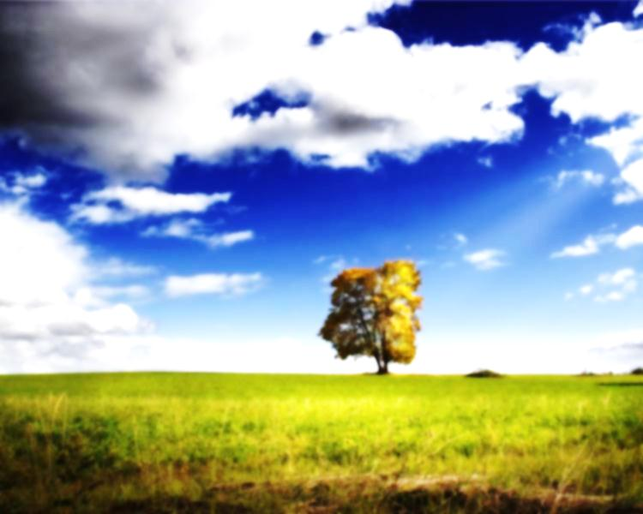
FORESTRY
Practice Test (PowerPoint)
Use the corresponding answer sheet.
Slides are automatic – do not click while presentation is in progress.

Slide 2
Disclaimer/Notice
This test is based on the 2004-2005 rules. The creator of this test is not responsible for anything that happens due to not understanding that rules may change significantly for the 2011-2012 Science Olympiad season.
This slide is 10 seconds.

Slide 3
Please Read The Following
This practice test is run automatically. Do not click while the presentation is in progress.
Use the corresponding answer sheet (scioly.org).
The test is timed. For ID questions, you will have 1 minute to identify the tree and 1 minute and 45 seconds to answer questions.
For other questions, you will have 15 seconds to answer one question.
The questions on this test are based on the 2004 National Forestry Specimen List.
This slide is 22 seconds.

Slide 4
Please Read The Following
Note: If you are able to answer the question quickly and prefer not to wait, you may change the slides before they change automatically.
This test may be very time-consuming. Make sure you have at least 20-40 minutes to complete the test although it may not take the full time given to you.
There will be 12 ID questions and then some basic questions about trees.
This slide is 15 seconds

Slide 5
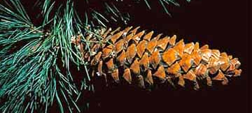
1. Identify this specimen.

Slide 6
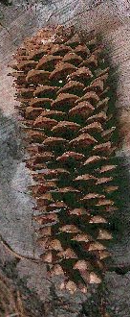
A. In which states would you most likely find this tree?
Minnesota and Wisconsin
Vermont and Maine
New Mexico and Arizona
California and Oregon
B. Which statement is true about this tree?
It is the tallest pine
It is the only broadleaf pine tree
It has no spreading branches
The tree’s seed itself is larger than the wing of the seed.
© Gary A Monroe

Slide 7
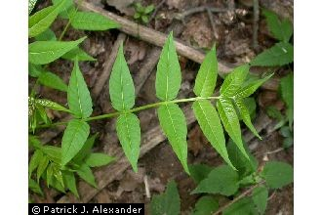
2. Identify this specimen.
© Patrick J. Alexander

Slide 8
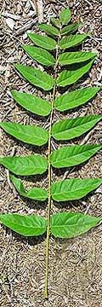
A. What is this tree commonly called?
Poison Sumac
Tree of Heaven
The Coffeetree
Cantaloupe Tree
B. Which statement is true about this tree?
It grows very slowly compared to other trees.
It can tolerate pollution better than most trees.
Its fruit looks similar to an apple.
Its crown gets wider near the top.

Slide 9
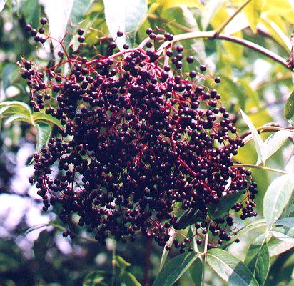
3. Identify this specimen.

Slide 10
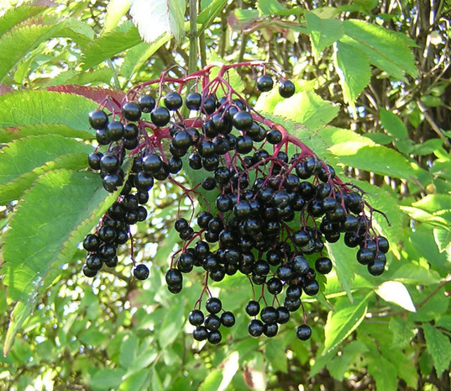
A. Which photo (I, II, III, or IV) is a picture of the bark of this plant?
Photo I
Photo II
Photo III
Photo IV
I II III IV
B. Which geographic region is this plant native to?
Alaska and Northwestern Canada
Northeastern Canada
Around the Gulf of Mexico
The East Coast and the Midwest

Slide 11
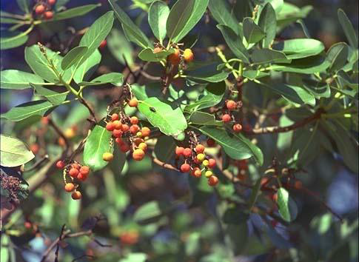
4. Identify this specimen.

Slide 12
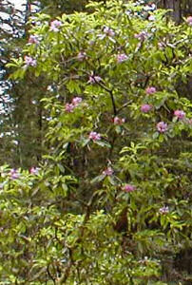
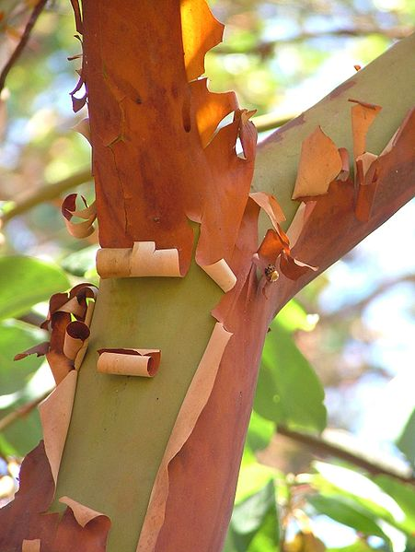
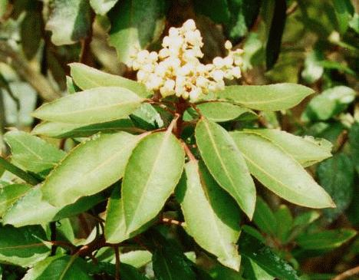
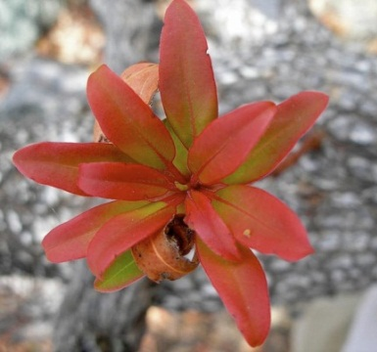
A. What type of leaf arrangement does this plant have?
(a) Opposite (b) Whorled
(c) Alternate (d) Simple
Photo I Photo II
B. Which of the photos (I, II, III, IV) are of this plant?
Photo I
Photo II
Photo III
Photo IV
Photo III Photo IV

Slide 13
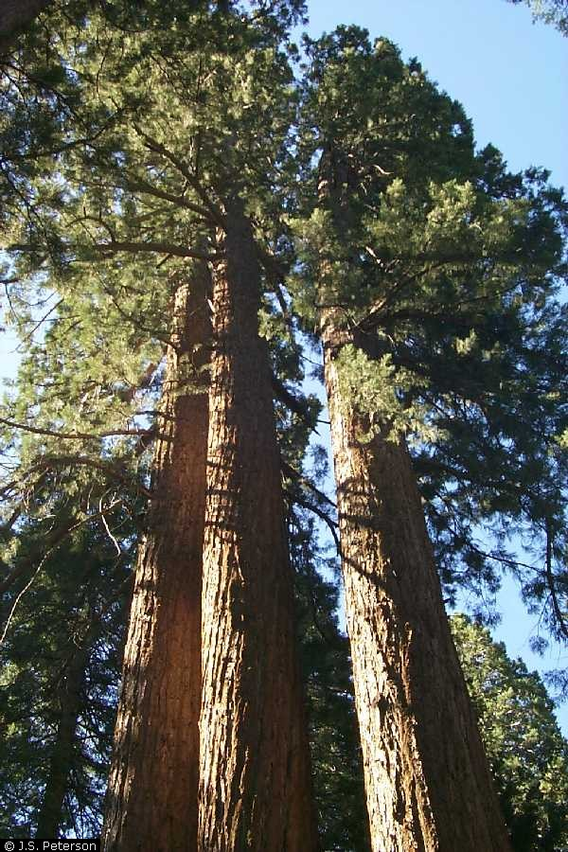
5. Identify this tree.

Slide 14
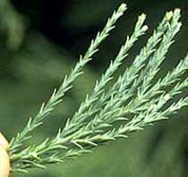
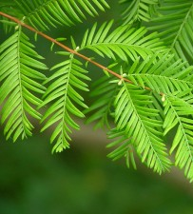
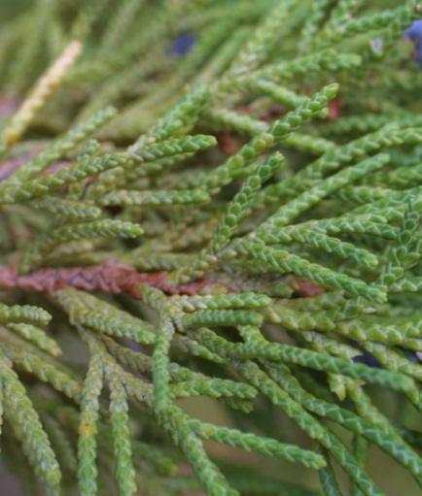
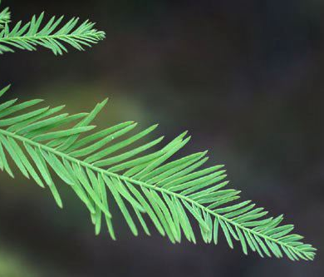
A. Which photo (I, II, III, IV) is a photo of this plant’s leaves?
Photo I
Photo II
Photo III
Photo IV
Photo I Photo II
B. What family is this tree from?
Cypress Family
Sequoia Family
Redwood Family
Pine Family
Photo III
Photo IV

Slide 15
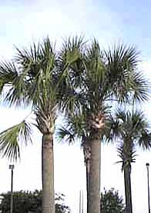
6. Identify this tree.

Slide 16
A. Where is this plant mainly found?
California
Virginia and Kentucky
Lesser Antilles
Florida
B. Which statement is true about this tree?
Its bark smoothens with age.
Its fruit was used to make medicine in the early ages.
Most of the tree’s leaves fall off in the early summer.
The tree’s is coniferous.

Slide 17
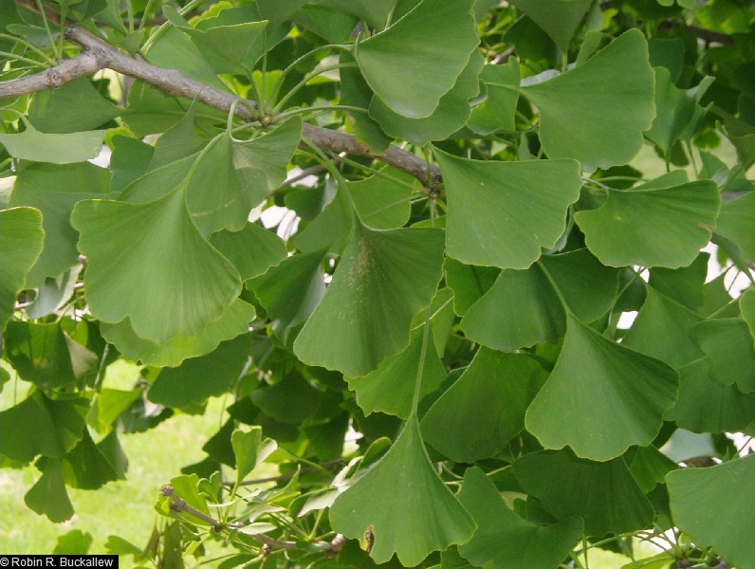
7. Identify this tree.

Slide 18
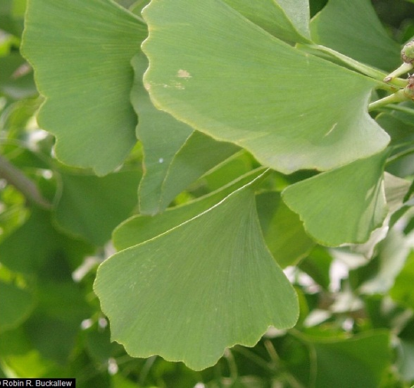
A. What is this plant NOT used for?
Treating asthma and tinnitus
Making paper
Making tea
Preventing Alzheimer’s Disease
B. What is the conservation status of this species?
Extinct in the Wild
Endangered
Not concerned/Least concern
Conservation dependent/Near threatened

Slide 19
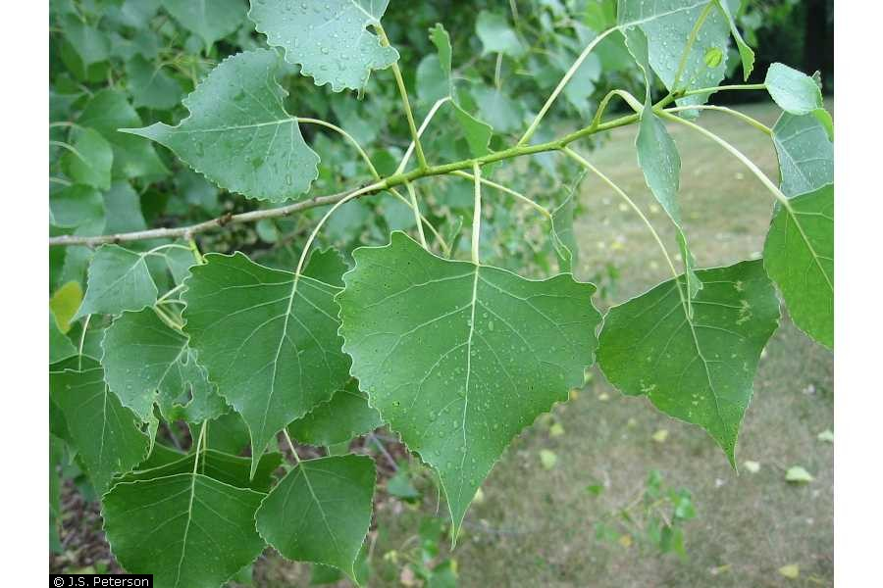
8. Identify this tree.

Slide 20
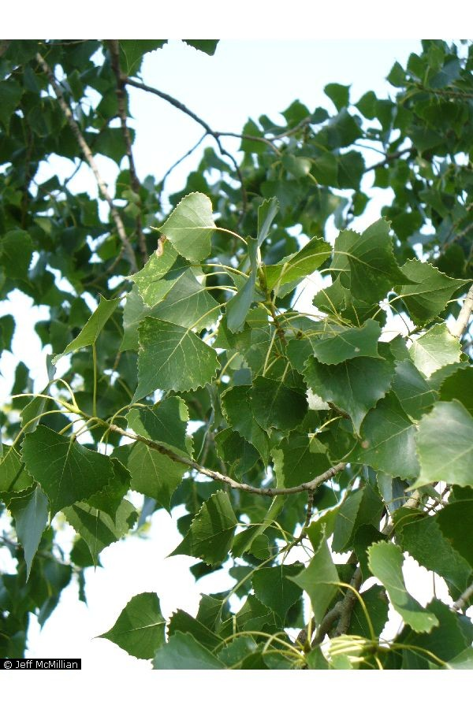
A. Where is this plant found?
Hudson Bay
East Coast
Central USA
Northwest USA and Canada
B. What problems/disadvantages are there about this tree?
They can be seriously damaged by wood-boring insects.
They do not provide good shade.
Its wood is difficult to cut, split, or bend due to its hardness.
It grows at a very slow rate.

Slide 21
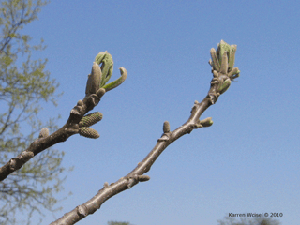
9. Identify this tree.

Slide 22
A. What type of fruit does this plant have?
An apple-sized purple fruit that tastes bitter.
This plant has no fruit.
An oblong husk with a sweet meat inside.
A grape-sized yellow-brown fruit.
B. Which description of this plant’s leaf fits the best?
Needles 2-5 inches long.
Un-toothed circular leaf.
A long egg-shaped green/yellow leaf.
A toothed lance-shaped leaf.

Slide 23
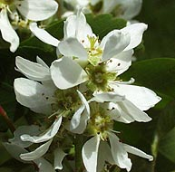
10. Identify this tree.

Slide 24
A. Where is this plant most likely to be found?
British Columbia
New York
Georgia
Belize
B. Why are the fruits of this plant eaten by animals?
They are rich in copper and iron.
They are low in cholesterol.
They provide nectar.
They are the only thing that the animals can find.

Slide 25
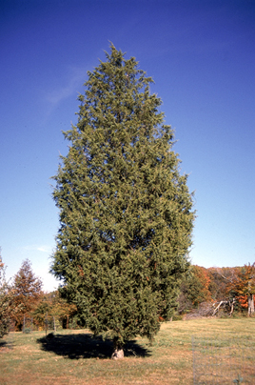
11. Identify this tree.

Slide 26
A. What is this plant’s primary habitat?
Near the coastline of an ocean or lake.
Dry or rocky areas, open woods, or fields.
Temperate rainforests in the northwest.
Swampy and marshy areas in northern USA and Canada.
B. What type of tree is this?
Pine
Juniper
Walnut
Magnolia

Slide 27
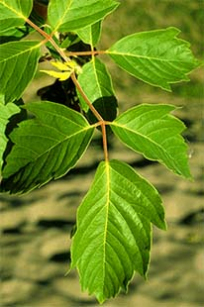
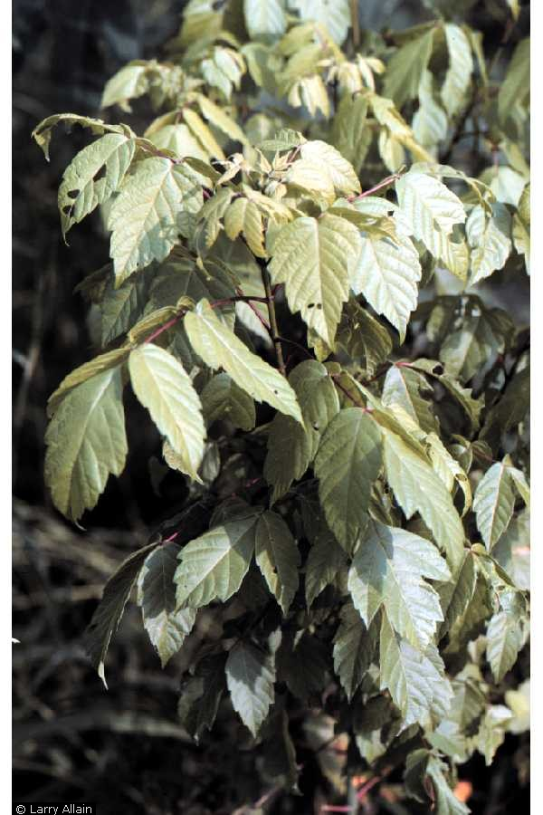
12. Identify this tree.

Slide 28
A. Where is this plant mainly found?
Coniferous forests.
Stream banks and floodplains.
Sandy or rocky desert areas.
Cold and dry tundra/taiga areas.
B. Name the bug that is attracted by this tree.

Slide 29
13. What feature in a plant cell is not normally found in an animal cell?
Nucleus
Deoxyribonucleic acid
Mitochondrion
Cell Wall
14. What does photosynthesis mainly help create?
Light energy
Adenosine triphosphate (ATP)
Kinetic energy
Nutrients in the soil

Slide 30
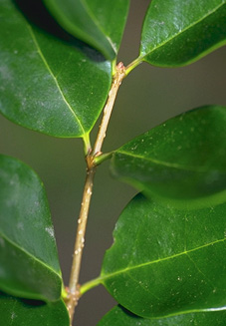
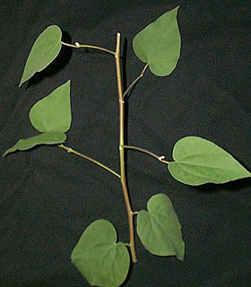
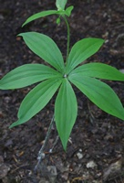
15. Which picture shows a plant with opposite leaves?
Left
Center
Right

Slide 31
This is the end of the Forestry practice test.
You can check your answers on the answer key.

