Slide 1
Ornithology Practice Test
Created by Abby Golder

Slide 2
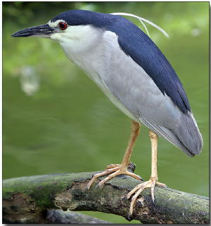
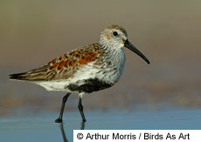
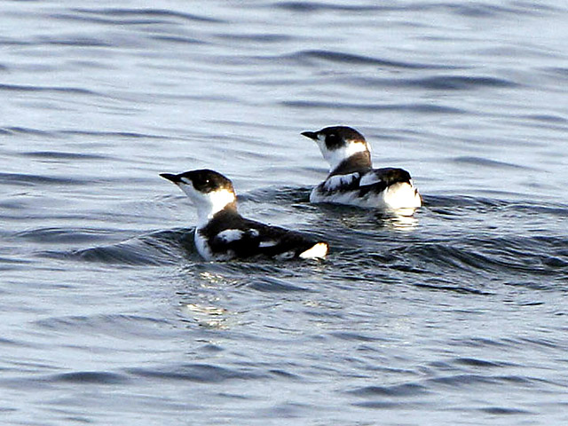
1. Give the common name and the conservation status for the birds below.
A)
B)
C)

Slide 3
2. What two muscles are most essential to flight?

Slide 4
3. Which of these birds do not nest in a tree?
Greater Roadrunner
Blue Jay
Wood Thrush
Northern Cardinal

Slide 5
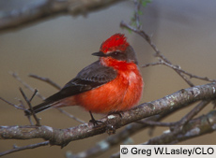
4. What is the scientific name for this bird?
Piranga olivacea
Pyrocephalus rubinus
Uria aalge
Cardinalis cardinalis

Slide 6
5. Which of these birds consume insects? (list all that apply)
Phainopepla
Acorn Woodpecker
Evening Grosbeak
Anhinga
American Kestrel
Chimney Swift
Black-billed Magpie

Slide 7
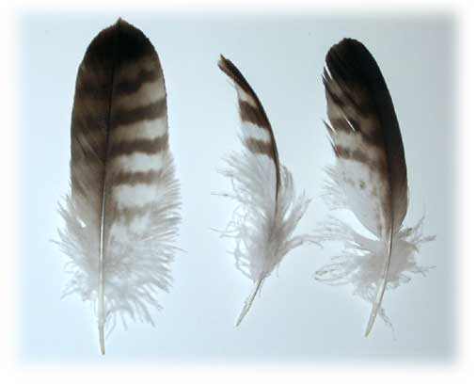
6. Give 2 differences between filoplumes and semiplumes.

Slide 8
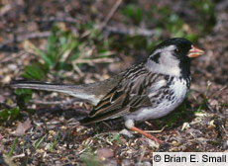
7. Migration patterns
Give the common name of this bird
Where does it migrate to in the winter?
What is its flyway route?

Slide 9
8. What bird is more closely related to the common paraque?
Thryothorus ludovicianus
Podiceps grisegena
Scolopax minor
Molothrus ater

Slide 10
9. Explain an adaption to the respiratory system that birds have, but mammals do not.

Slide 11
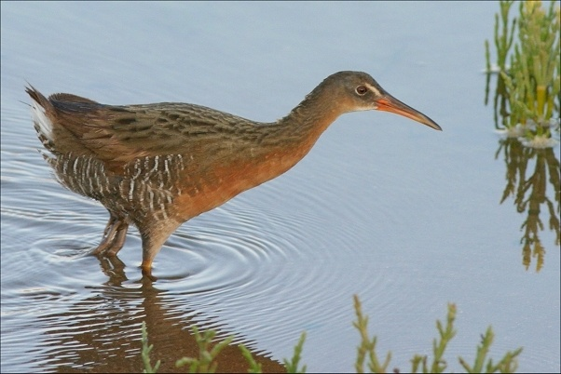
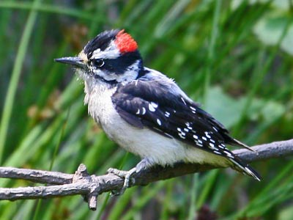
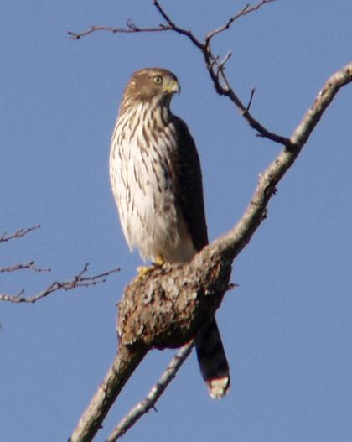
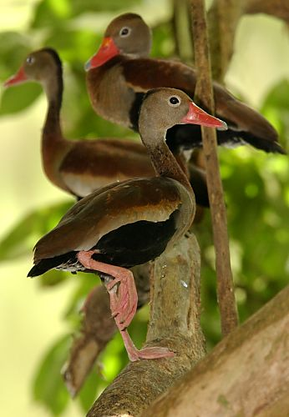
10. Determine if the birds below are altrical or precocial.
a)
b)
c)
d)

Slide 12
11. What family of bird would most likely live in a grassland habitat?
Apodidae
Threskiornithidae
Icteridae
Odontophoridae

Slide 13
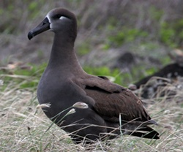
12. Give the common name of the bird below and name the materials it uses to build its nest.

Slide 14
13. What is the difference between carpals and metacarpals?

Slide 15
14. Give the common name for each bird listed.
Dolichonyx oryzivorus
Plectrophenx nivalis
Fratercula cirrhata

Slide 16
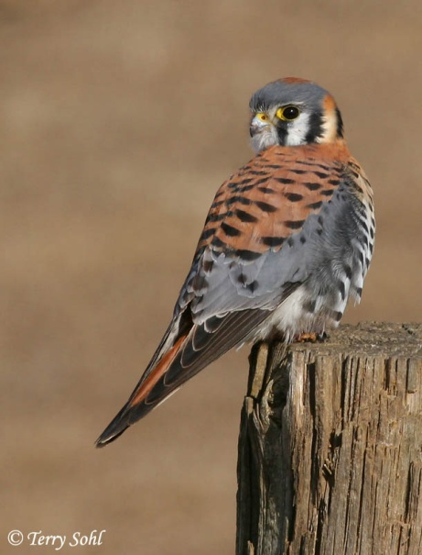
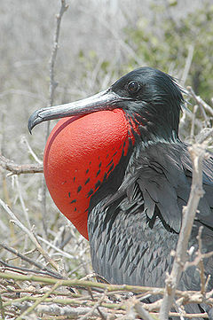
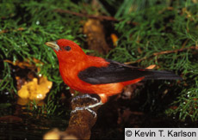
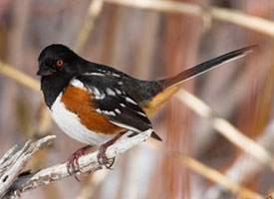
15. Which of these birds feeds the female bird while attempting to mate with them?
a)
b)
c)
d)

Slide 17
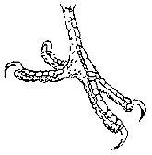
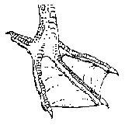
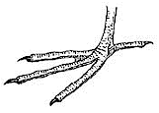
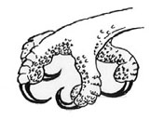
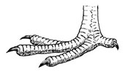
16. Match the birds to their correct feet.
a)
b)
c)
d)
e)
1) Ring-necked Pheasant
2)Green Heron
3) Pileated Woodpecker
4) Aix sponsa
5)Pandion haliaetus

Slide 18
17. Birds’ mating systems are usually
Polygynous
Monogamous
Polygamous
Promiscuous

Slide 19
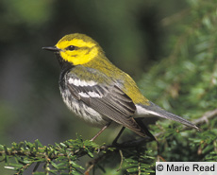
18. Give the scientific name for this bird.

Slide 20
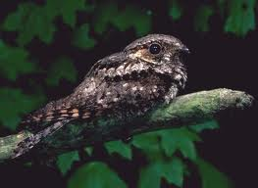
19.
Give the common name
Where does it migrate to in the winter?

Slide 21
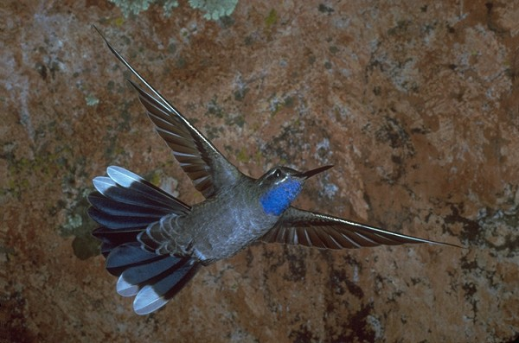
20. Describe three abilities unique to the hummingbird.

Slide 22
21. State birds
What is the Minnesota state bird?
What is the North Dakota state bird?

Slide 23
22-27. Bird Calls
22. http://macaulaylibrary.org/audio/50249
23. http://macaulaylibrary.org/audio/22852
24. http://macaulaylibrary.org/audio/94271
25. http://macaulaylibrary.org/audio/10291
26. http://macaulaylibrary.org/audio/2383
27. http://macaulaylibrary.org/audio/50111

