Slide 1
Herpetology Division C
Westinghouse Invitational

Slide 2
Event Notes
Each team will have 3 and ½ minutes at each station.
After each team has visited each station, any team may revisit any station for the remaining 4 minutes of time.
Tie Breaker #1 – Column #1 from Answer Sheet Score
Tie Breaker #2 – Column #2 from Answer Sheet Score
Tie Breaker #3 – Column #3 from Answer Sheet Score

Slide 3
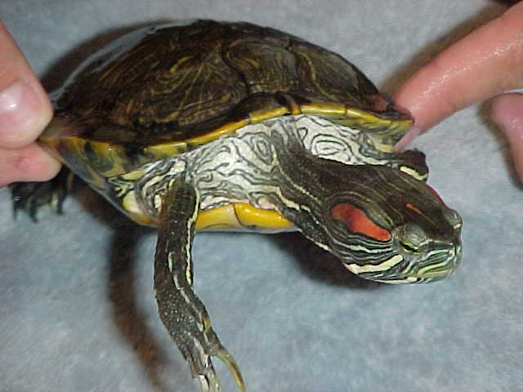
Station 1
1. To which genus does this animal
belong?
2. To which family does this animal
belong ?
3. What is the commercial
use of the animals in this genus?
This genus of animals are:
Herbivores
Omnivores
Carnivores

Slide 4
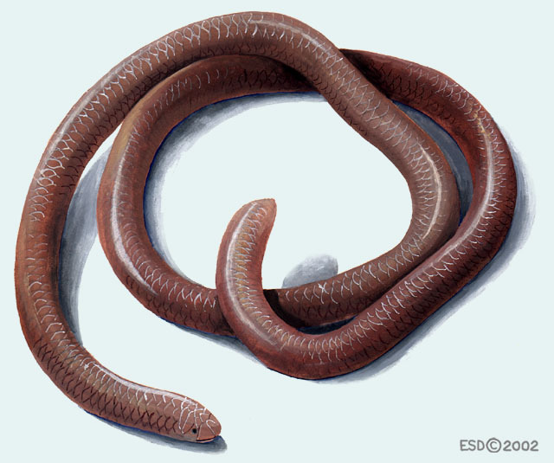
Station 2
5. To which family does this animal
belong?
6. In which type of climate is this
family of animals found?
What is unique about the
eyes of this animal family?
Why do owls let some of
these animals live in their nests?

Slide 5
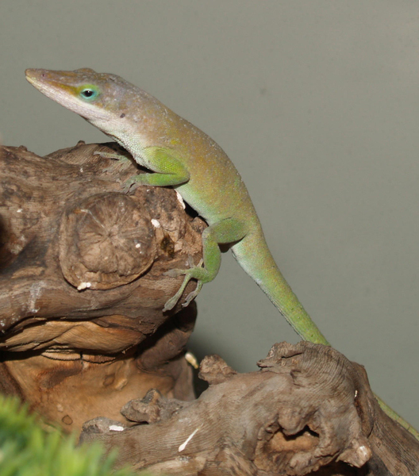
Station 3
9. To which genus does this animal belong?
What is the name of the cells that cause
a color difference in this genus of animals?
True or False – The animals in this genus
have a higher reproduction rate during
warmer months.

Slide 6
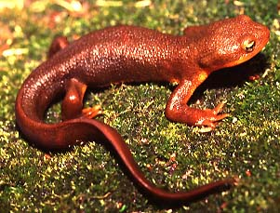
Station 4
To which family does this belong?
What three continents does this
family live on?
14. What is the defense mechanism
of these animals?
15. What about the skin of this family makes it different from all of the other families within its order?

Slide 7
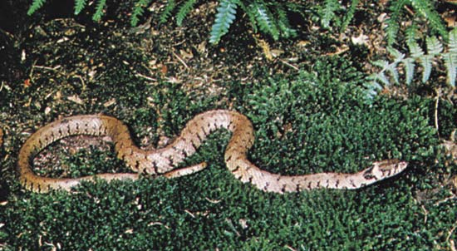
Station 5
To which genus does this
animal does this animal
belong?
What is the reproductive
difference between the
Old World and New World species in this genus?
What is the main diet of this genus?
True or False – The animals in this genus are venomous.

Slide 8
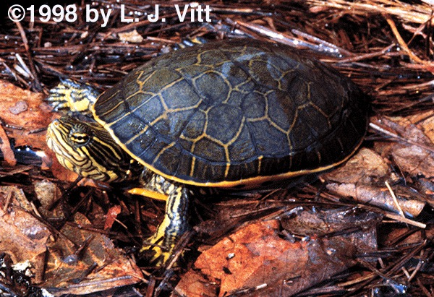
Station 6
To which genus does this
animal belong?
True or false – You can find
animals in this genus in Illinois.
How do the males of this
genus court females of this genus?
23. In what seasons do the animals of this genus nest?

Slide 9
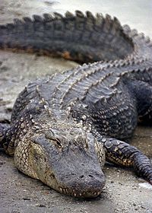
Station 7
To which family does this animal belong?
To which order does this animal belong?
What features of this family make it
different from other animals in this order?
27. What is the main predator of this family?

Slide 10
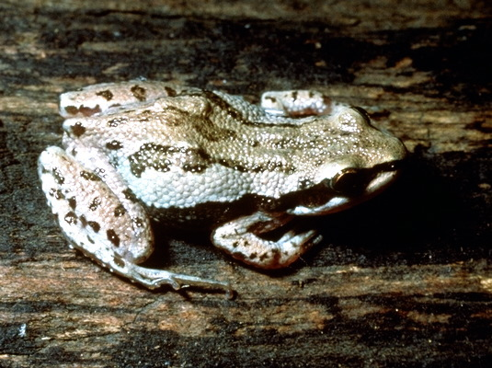
Station 8
28. To which genus does this animal
belong?
To which family does this animal
belong?
What continent does this genus
live on?
31. What is one ecological contribution of the animals in this genus?

Slide 11
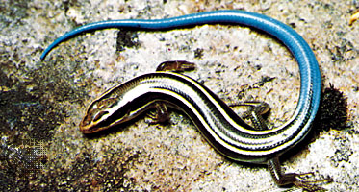
Station 9
To which family does this animal
belong?
What do animals in this family
eat?
True or False – Some members of this family have placentas as developed and complex as mammal placentas.
What is the name of the sensory organ located in the roof of the mouth in the males of this family?

Slide 12
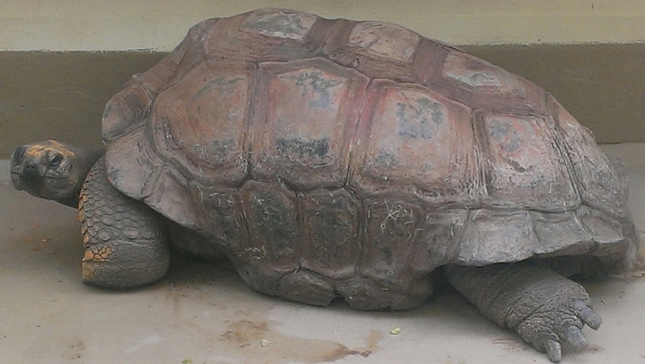
Station 10
To which family does this animal
belong?
37. What is one adaptation this genus
has for terrestrial life?
38. What do animals in this genus rely on in order to find food, find potential mates, and to find appropriate nesting places?
39. What is the name of the top outer part of these organisms’ shell?

Slide 13
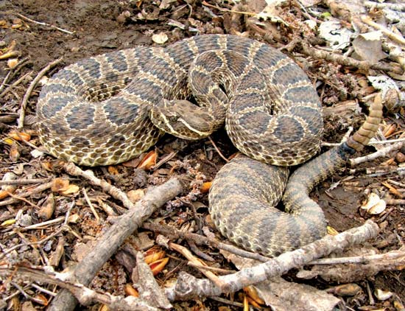
Station 11
40. To which genus does this animal
belong?
41. To which family does this animal
belong?
42. What physical feature makes this
genus distinctive and recognizable?
43. The venom in these animals are poisonous because it destroys what type of body tissue?

Slide 14
Station 12
44. Herpetology is the study of:
Amphibians
Reptiles
Amphibians, reptiles, and fish
Amphibians and reptiles
45. Name two tools or pieces of equipment that herpetologists use to collect information about animals.
46. How would you accurately weigh (mass) a salamander or frog?

Slide 15
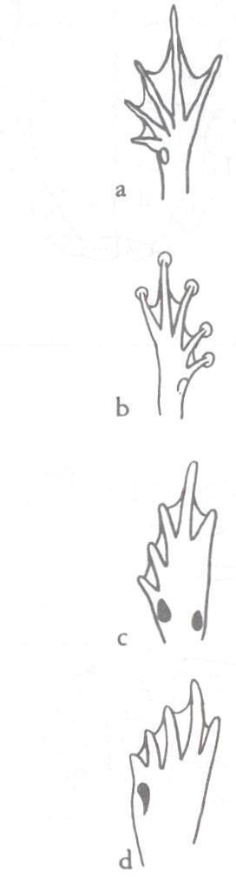
Station 13
For each of the following, write down the letter of the hind
foot that matches each type of amphibian:
47. Toads
48. Tree Frogs
49. Spadefoot Toads
50. True Frogs

Slide 16
Photo Sources
Alligatoridae. (1/19/09). New World Encyclopedia. Accessed January 25, 2018 at http://www.newworldencyclopedia.org/p/index.php?title=Alligatoridae&oldid=906004
Ast, J.C. (2003). “Leptotyphlopidae." Animal Diversity Web. Accessed January 24, 2018 at http://animaldiversity.org/accounts/Leptotyphlopidae/
Crawford, C. (2011). "Anolis carolinensis.“ Animal Diversity Web. Accessed January 24, 2018 at http://animaldiversity.org/accounts/Anolis_carolinensis/
Dewey, T. (2006). "Deirochelys reticularia.“ Animal Diversity Web. Accessed January 25, 2018 at http://animaldiversity.org/accounts/Deirochelys_reticularia/
Lancour, K. (2018). “2018 Herpetology B/C.” Science Olympiad.
Landry, K. (2018). "Pseudacris triseriata.“ Animal Diversity Web. Accessed January 25, 2018 at http://animaldiversity.org/accounts/Pseudacris_triseriata/
Larson, A., Wake, D., and Devitt, T. (2007). “Salamandridae- Newts and ‘True Salamanders.’” Tree of Life Web Project. Accessed January 24, 2018 at http://tolweb.org/Salamandridae/15445/2007.01.24in
Pecor, K. (2003). "Testudinidae." Animal Diversity Web. Accessed January 25, 2018 at http://animaldiversity.org/accounts/Testudinidae/
Rhudy, R. (1/21/12). "Sliders.“ Accessed January 24, 2018 at http://www.fishpondinfo.com/turtles/sliders.htm
Vitt, L. (1/10/18) “Skink.” Encyclopedia Britannica. Accessed January 25, 2018 at https://www.britannica.com/animal/skink
Wallach, V. (10/24/17). “Rattlesnake.” Encyclopedia Britannica. Accessed January 25, 2018 at https://www.britannica.com/animal/rattlesnake
Wallach, V. (4/17/17). “Water Snake.” Encyclopedia Britannica. Accessed January 25, 2018 at https://www.britannica.com/animal/water-snake-reptile

