Slide 1

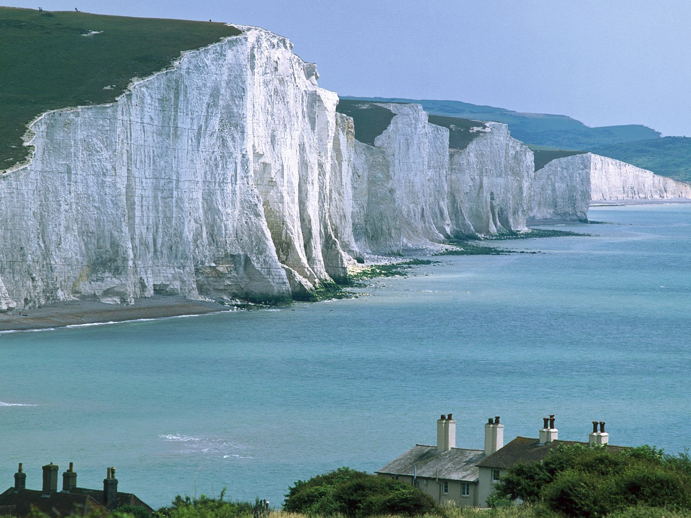
Rocks and Minerals
Practice Test (Powerpoint)
Please use corresponding answer sheet.
Slides are automatic- do not click while presentation is in progress.

Slide 2
Disclaimer/Notice
This practice test was composed using rules from the 2012 season. All items included are listed in either the rules, or the official lists released on the SO website. Credit goes to Nylhvsso for test format and design. Please make sure your study materials are up to date!
This slide is 10 seconds

Slide 3
Consider the Following
This practice test is run automatically. Do not click while the presentation is in progress.
Use the corresponding answer sheet (scioly.org).
The test is timed. For ID questions, you will have 1 minute to identify the rock/mineral and 1 minute and 30 seconds to answer questions related to the specimen.
The questions on this test are based on the 2012 National Rocks and Minerals Specimen List.
This slide is 30 seconds.

Slide 4
Consider the Following
Note: If you are able to answer the question quickly and prefer not to wait, you may change the slides before they change automatically.
This test may be very time-consuming. Make sure you have at least 20-40 minutes to complete the test although it may not take the full time given to you.
There will be 13 ID questions, with questions about each specimen following afterwards
Good Luck!
This slide is 15 seconds

Slide 5
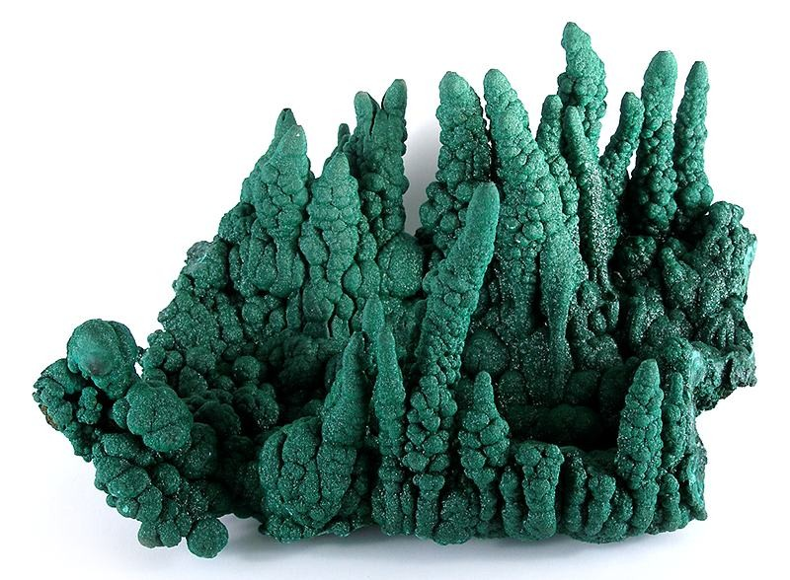
1. Identify the specimen below

Slide 6
2. What is the chemical formula?
3. What is the crystal structure of this mineral?
a) Orthorhombic
b) Monoclinic
c) Tetragonal
d) Triclinic
4. Which element gives this mineral its green color?
a) Manganese
b) Antimony
c) Copper
d) Tin

Slide 7
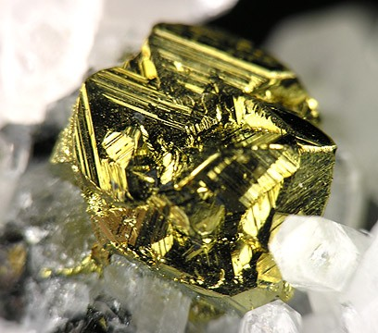
5. Identify the specimen below

Slide 8
6. To what mineral group does this specimen belong to?
a) Sulfides
b) Halides
c) Nitrates
d) Phosphates
7. What is the crystal structure of this mineral?
Monoclinic
Triclinic
Tetragonal
Cubic
8. True or False: When heated, this mineral becomes magnetic.

Slide 9
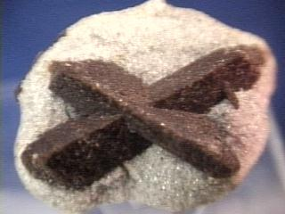
9. Identify the specimen below

Slide 10
10. To what class of minerals does this specimen belong to?
Silicates
Sulfates
Halides
Sulfides
11. What is the famous nickname of this mineral?
“Fairy Stone”
“Fools Gold”
“November’s Rich”
“Morning Star”
12. Which of these statements is NOT correct?
This mineral is the state mineral of Georgia.
This mineral is used as an index mineral to determine metamorphic conditions.
This mineral was once used to ward of witchcraft and disease.
This mineral is used as an index mineral to determine the crystallization temperature of intrusive igneous rock

Slide 11
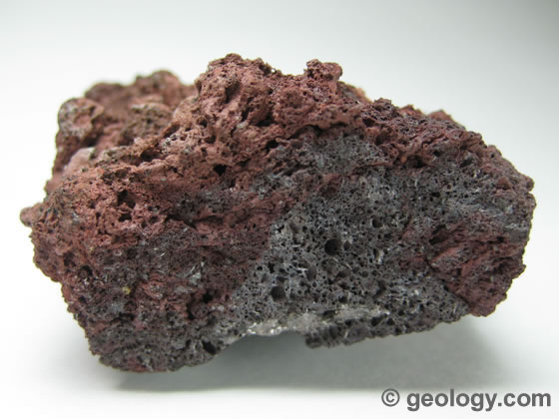
13. Identify the specimen below

Slide 12
14. How is this rock classified?
Clastic
Extrusive
Chemical
Intrusive
15. True or False: This specimen is strictly andesitic in composition.
16. Which of these statements is correct?
The specimen has many air pockets, so it floats in water
The specimen has air pockets, meaning it cooled underwater at a very fast rate.
The specimen has air pockets, but because of it’s specific gravity is more than 1, it sinks.
The specimen has air pockets, but because it was intruded, heavier crystals have formed at its center. Because of this, it sinks.

Slide 13
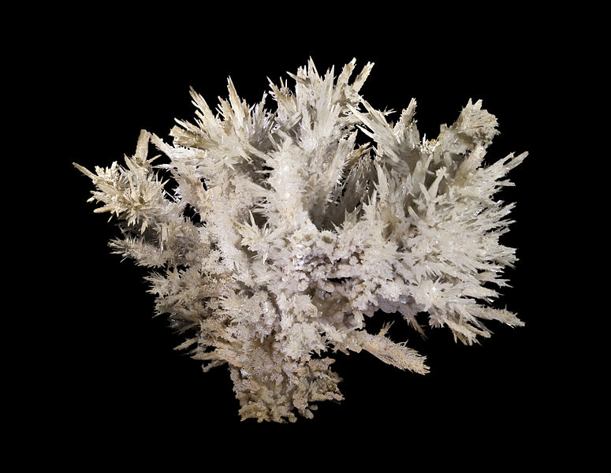
17. Identify the specimen below

Slide 14
18. What is the chemical formula?
19. What other mineral shares this chemical formula?
Dolomite
Calcite
Halite
Hornblende
20. What kind of crystal structure does this specimen have?
Triclinic
Monoclinic
Orthorhombic
Tetragonal

Slide 15
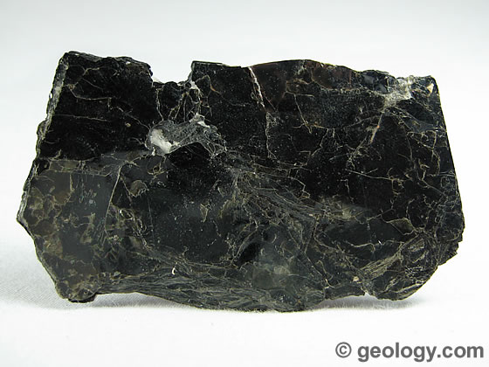
21. Identify the specimen below

Slide 16
22. Which of these best describes this specimen’s cleavage?
Basal
Singular
Prismatic
None of the above
23. What precedes this mineral on Bowen’s Reaction Series?
Olivine
Pyroxene
Orthoclase
Amphibole
24. What is the hardness of this mineral?
1-2
2-3
3-4
4-5

Slide 17
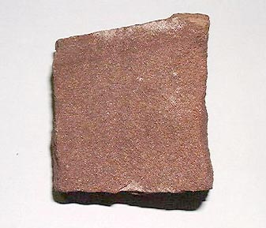
25. Identify the specimen below

Slide 18
26. How is this rock classified?
Organic
Inorganic
Clastic
Chemical
27. What is the grain size in this rock?
Gravel
Sand
Silt
Clay
28. True or False: This rock would not be good material for an aquifer, as it is not very porous.

Slide 19
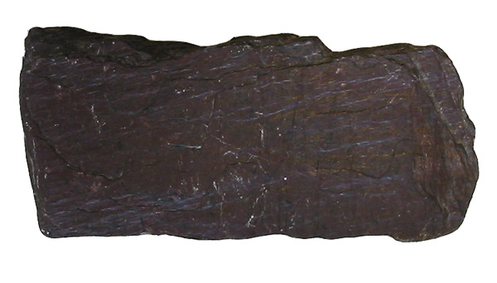
29. Identify the specimen below

Slide 20
30. What degree of metamorphosis does this specimen exhibit?
Low grade metamorphosis
Medium grade metamorphosis
High grade metamorphosis
No metamorphosis
31. Which of these is the specimen’s parent rock?
Gneiss
Slate
Calcite
Shale
32. Which of these statements is correct?
The specimen is foliated, but due to the low grade metamorphosis, it is invisible to the naked eye
The specimen is not foliated because the rock is sedimentary. It is clastic.
The specimen is foliated, but due to very fine grains, foliation is very thin and wavy
The specimen is foliated. However, due to high grade metamorphosis, the organic materials have changed the structure of the rock, making foliation hard to see.

Slide 21
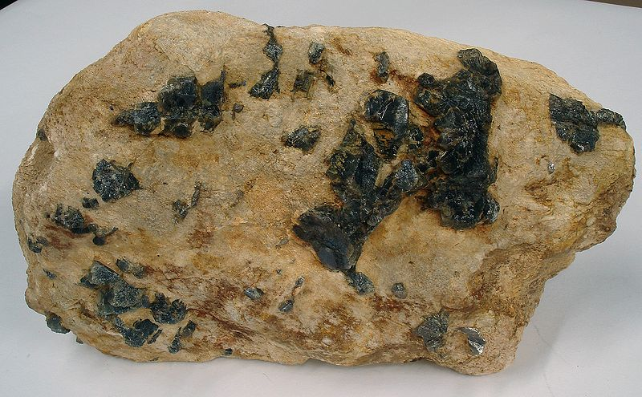
33. Identify the specimen below

Slide 22
34. Which of the following statements is false?
It is hard to define the specimen’s mineralogy, as each sample varies greatly.
The specimen has a composition very similar to granite.
Feldspar is a common mineral found in this specimen.
This specimen has a composition very similar to rhyolite.
35. Which of these terms describes a rock with large crystals?
Rhyolitic
Porphyritic
Dioritic
Basaltic
36. What is the classification of this specimen?
Extrusive
Intrusive
Clastic
chemical

Slide 23
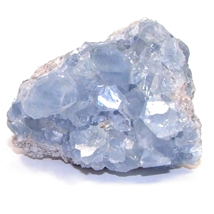
37. Identify the specimen below

Slide 24
38. What is the chemical formula?
39. What group of minerals does this specimen belong to?
Nesosilicates
Sulfates
Halides
Tectosilicates
40. Which of these statements best describes the specimen’s fracture?
Earthy
Concoidal
Splintery
Uneven

Slide 25
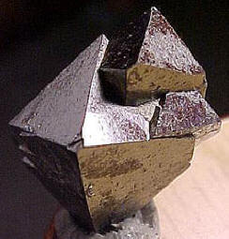
41. Identify the specimen below

Slide 26
42. What is the chemical formula?
43. What is the crystal structure of the specimen?
Triclinic
Monoclinic
Isometric
Cubic
44. This specimen can be used as a sorbent to remove what harmful element from polluted water?
Mercury
Arsenic
Antimony
Lead

Slide 27
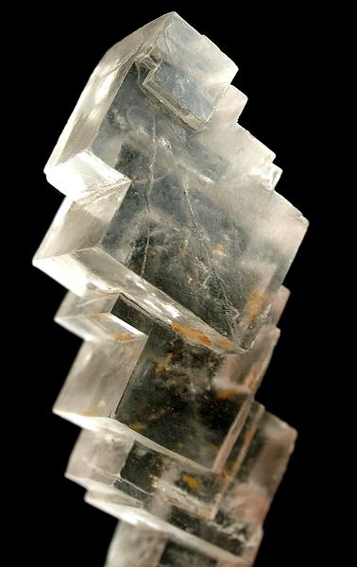
45. Identify the specimen below
Provided Info: HCl has limited effect.

Slide 28
46. What is the chemical formula?
47. What is the crystal structure of this specimen?
Orthorhombic
Monoclinic
Cubic
Isometric
48. What is the fracture of the specimen?
Concoidal
Uneven
Earthy
Splintery

Slide 29
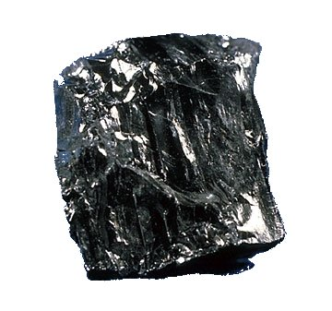
49. Identify the specimen below

Slide 30
50. What is the most prevalent element in this rock, and how much of it is there?
Magnesium, 50-65%
Carbon, 50-65%
Magnesium, 93-98%
Carbon, 93-98%
51. What is this rock classified as?
Extrusive
Chemical
Organic
Clastic
52. Which of these terms accurately describes the luster of the rock?
Vitreous
Silky
Submetallic
Resinous

Slide 31
The test is now over. Check your work!

