Slide 1
First section: Open-ended
Instructions: explain what you know about the references bolded in the poem (give and explain nicknames, notable events during periods of time (and what happened), when references happened). Each reference is worth one point.

Slide 2
Evolution
Langdon Smith

Slide 3
When you were a tadpole and I was a fish
In the Paleozoic time,
And side by side on the ebbing tide
We sprawled through the ooze and slime,
Or skittered with many a caudal flip
Through the depths of the Cambrian fen,
My heart was rife with the joy of life,
For I loved you even then.

Slide 4
Mindless we lived and mindless we loved
And mindless at last we died;
And deep in the rift of the Caradoc drift
We slumbered side by side.
The world turned on in the lathe of time,
The hot lands heaved amain,
Till we caught our breath from the womb of death
And crept into life again.

Slide 5
We were amphibians, scaled and tailed,
And drab as a dead man's hand;
We coiled at ease 'neath the dripping trees
Or trailed through the mud and sand.
Croaking and blind, with our three-clawed feet
Writing a language dumb,
With never a spark in the empty dark
To hint at a life to come.

Slide 6
Yet happy we lived and happy we loved,
And happy we died once more;
Our forms were rolled in the clinging mold
Of a Neocomian shore.
The eons came and the eons fled
And the sleep that wrapped us fast
Was riven away in a newer day
And the night of death was passed.

Slide 7
Then light and swift through the jungle trees
We swung in our airy flights,
Or breathed in the balms of the fronded palms
In the hush of the moonless nights;
And oh! what beautiful years were there
When our hearts clung each to each;
When life was filled and our senses thrilled
In the first faint dawn of speech.

Slide 8
Thus life by life and love by love
We passed through the cycles strange,
And breath by breath and death by death
We followed the chain of change.
Till there came a time in the law of life
When over the nursing sod
The shadows broke and the soul awoke
In a strange, dim dream of God.

Slide 9
I was thewed like an Auroch bull
And tusked like the great cave bear;
And you, my sweet, from head to feet
Were gowned in your glorious hair.
Deep in the gloom of a fireless cave,
When the night fell o'er the plain
And the moon hung red o'er the river bed
We mumbled the bones of the slain.

Slide 10
I flaked a flint to a cutting edge
And shaped it with brutish craft;
I broke a shank from the woodland lank
And fitted it, head and haft;
Than I hid me close to the reedy tarn,
Where the mammoth came to drink;
Through the brawn and bone I drove the stone
And slew him upon the brink.

Slide 11
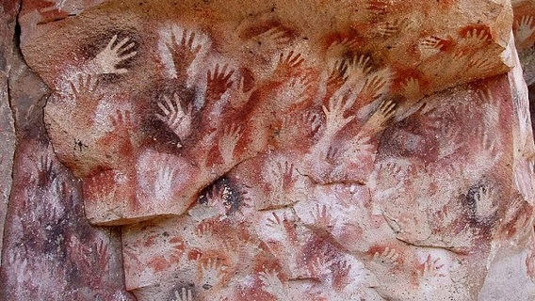
Loud I howled through the moonlit wastes,
Loud answered our kith and kin;
From west to east to the crimson feast
The clan came tramping in.
O'er joint and gristle and padded hoof
We fought and clawed and tore,
And cheek by jowl with many a growl
We talked the marvel o'er.

Slide 12
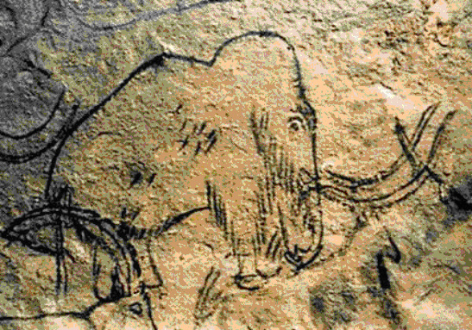
I carved that fight on a reindeer bone
With rude and hairy hand;
I pictured his fall on the cavern wall
That men might understand.
For we lived by blood and the right of might
Ere human laws were drawn,
And the age of sin did not begin
Til our brutal tusks were gone.

Slide 13
And that was a million years ago
In a time that no man knows;
Yet here tonight in the mellow light
We sit at Delmonico's.
Your eyes are deep as the Devon springs,
Your hair is dark as jet,
Your years are few, your life is new,
Your soul untried, and yet --

Slide 14
Our trail is on the Kimmeridge clay
And the scarp of the Purbeck flags;
We have left our bones in the Bagshot stones
And deep in the Coralline crags;
Our love is old, our lives are old,
And death shall come amain;
Should it come today, what man may say
We shall not live again?

Slide 15
God wrought our souls from the Tremadoc beds
And furnish’d them wings to fly;
He sowed our spawn in the world's dim dawn,
And I know that it shall not die,
Though cities have sprung above the graves
Where the crook-bone men made war
And the ox-wain creaks o'er the buried caves
Where the mummied mammoths are.

Slide 16
Then as we linger at luncheon here
O'er many a dainty dish,
Let us drink anew to the time when you
Were a tadpole and I was a fish.

Slide 17
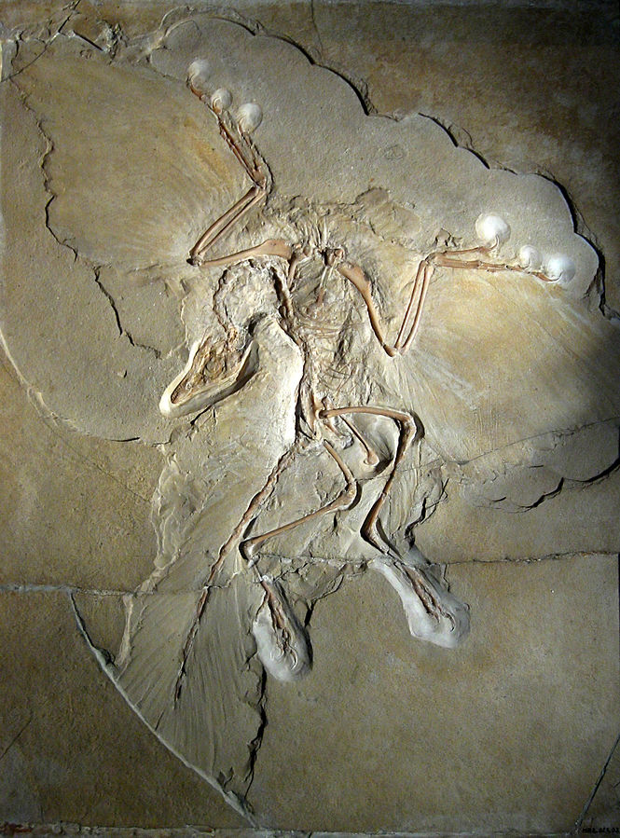
Fossil Identification
Identify (2pts); when did this fossil live (2pts); what’s the importance of this fossil? (2pts)

Slide 18
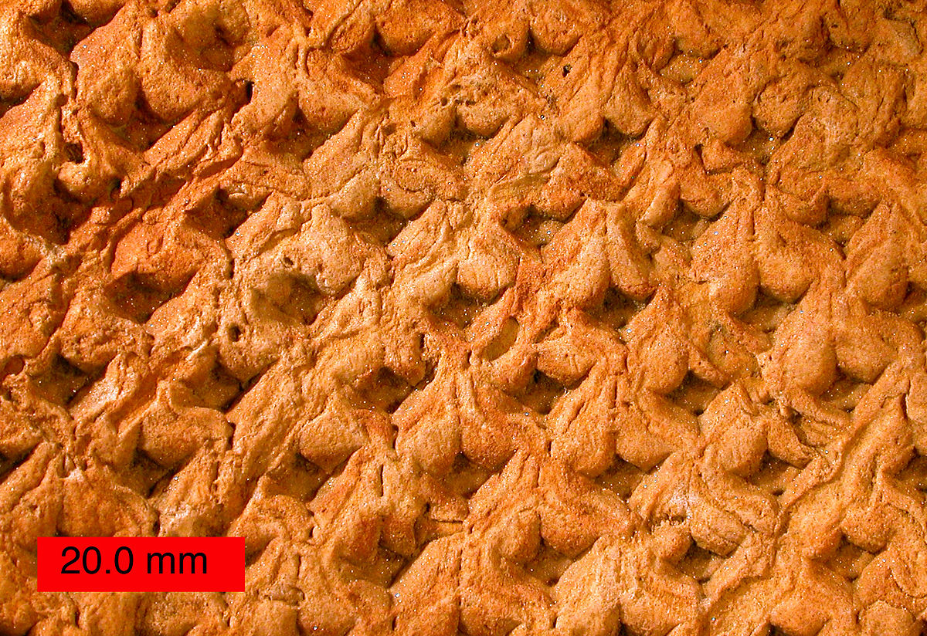
Identify (hint: it’s a plant) (2); when did specimen live (2)? What type of fossil formation is this (2)? Why is the surface bark notable (2)? What environment did this species grow in (2)?

Slide 19
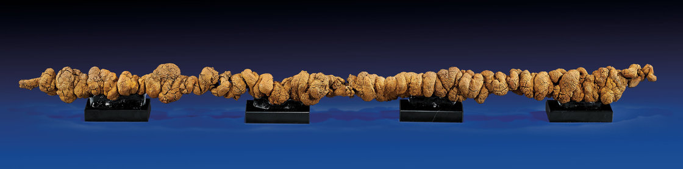
World’s longest coprolite to this day (40 inches!!!) What’s a coprolite, and what can it tell us about the organism it came from (3)? What chemical is it mostly made up of (2)?

Slide 20
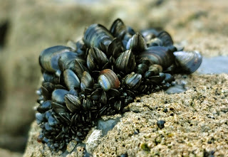
What fossilization phenomenon is this pictures an example of (2)? Explain this phenomenon (4).

Slide 21
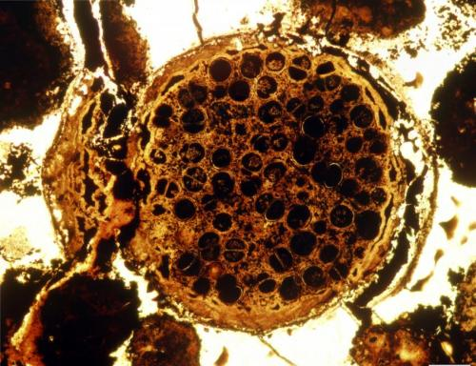
Current events
Sept 25, 2014: “New evidence of ancient multicellular life sets evolutionary timeline back 60 million years” --Phys.org
Why is this surprising (3)?
Picture: A multicelled specimen with dividing dyads. Specimen about 0.7 mm in diameter. Credit: Lei Chen and Shuhai Xiao

