Slide 1
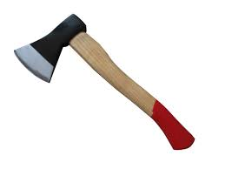

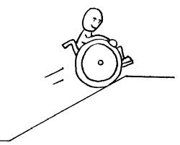


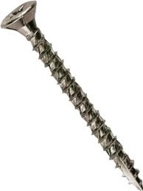
1. Identify the following simple machines by connecting each name with the picture that matches.
Wheel and Axle
Screw
Pulley
Lever
Inclined Plane
Wedge

Slide 2
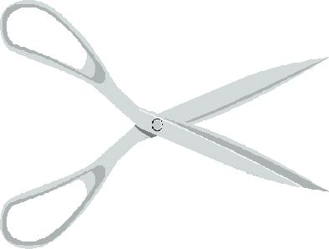
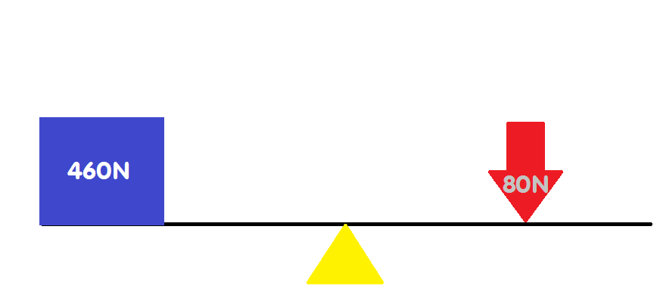
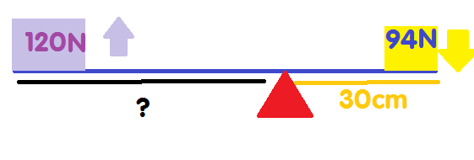
2. Simple machines are
a. Devices that increase force
b. Devices that increase distance
c. Devices that help people to do work faster and easier
d. All of the above
e. None of the above
3.What kind of machine is this?
4. What is the AMA of this lever?
5. Find the unknown.

Slide 3
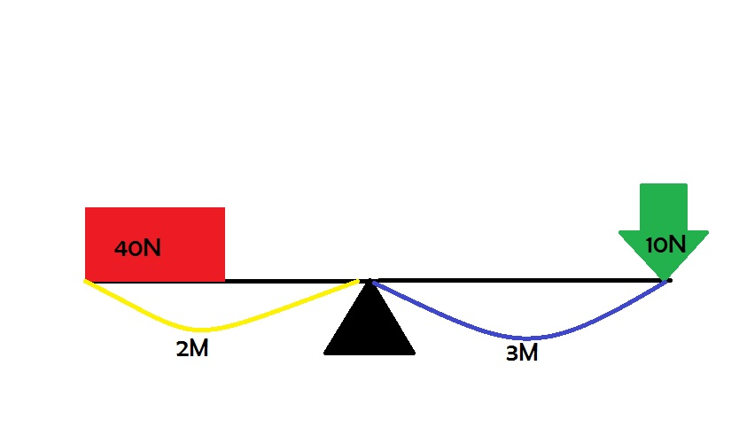
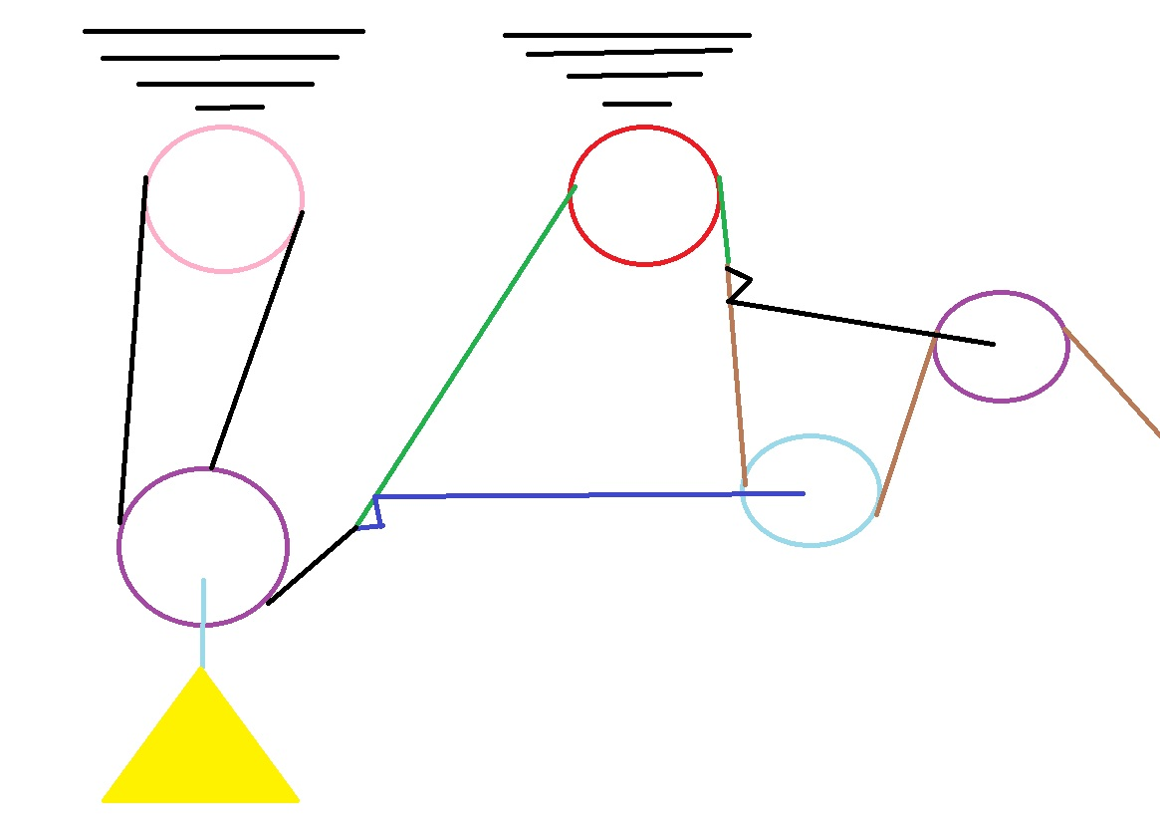
6. Look at the lever below and find:
The IMA:__________________________________________
The AMA:__________________________________________
The efficiency:_____________________________________
7. Find the IMA.

Slide 4

Key:
Wheel and Axle
Screw
Pulley
Lever
Inclined Plane
Wedge
2. C
3. Lever
4. 5.75
5. 23.5 cm
6.a. 1.5
b. 4
c. This is a trick question. This machine ideally would have an efficiency of 266%, which is not correct. So this machine doesn’t have an efficiency.

