Slide 1
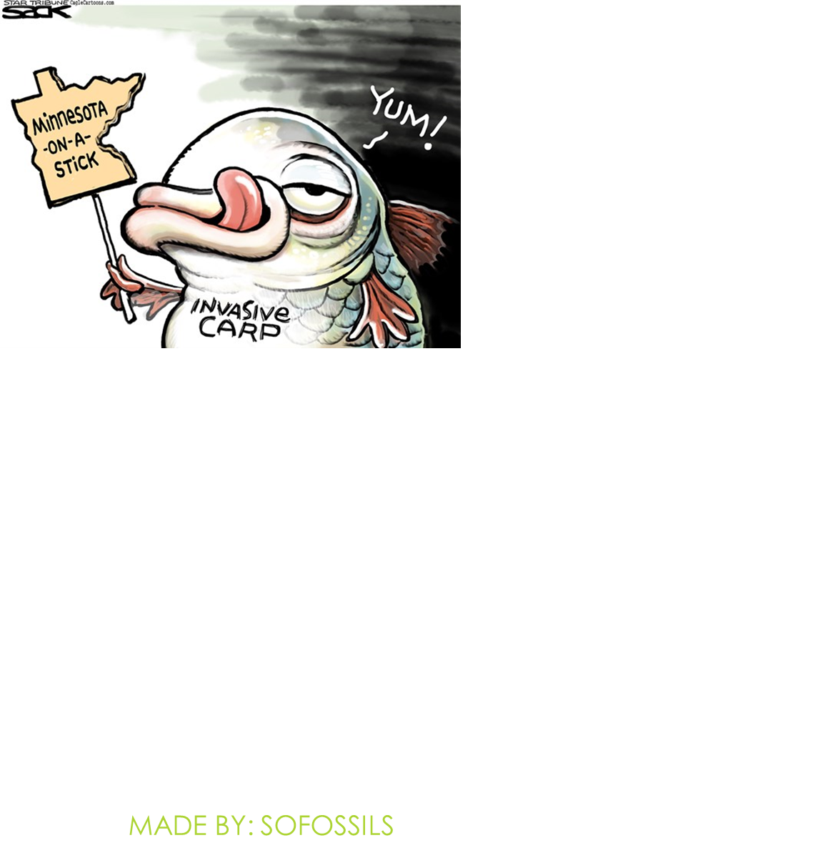
Invasive Species Test
Made by: SOFOSSILS

Slide 2
TESTING PROCEDURE
The slides will advance automatically – no need to click!
All specimens are from the PA list - sorry!
Each identification slide will be up for 30 seconds, then the question slide will be up for 1 minute and 30 seconds
There are 20 stations: each station consists of one identification slide and one question slide (40 test slides in total)
This slide will be up for 30 seconds

Slide 3
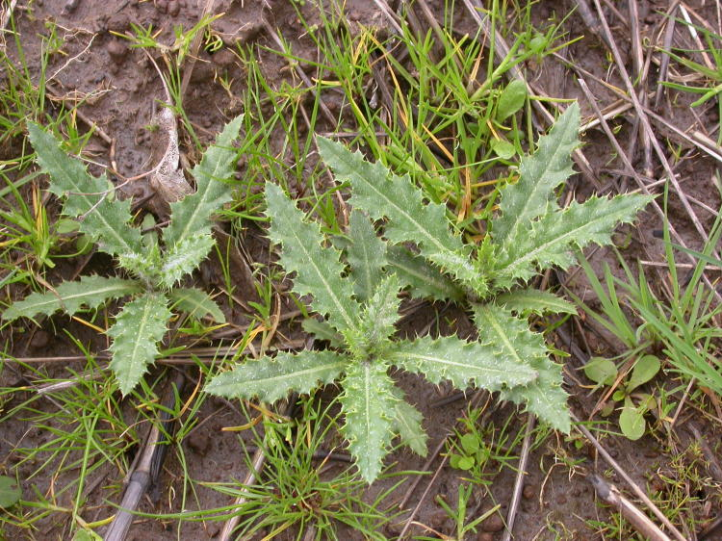
1. Identify with Common Name

Slide 4
2. This plant is important to what industry?
3. This plant is ____________, whereas other thistles are biennial.
4. Which continent is this plant a native to?

Slide 5
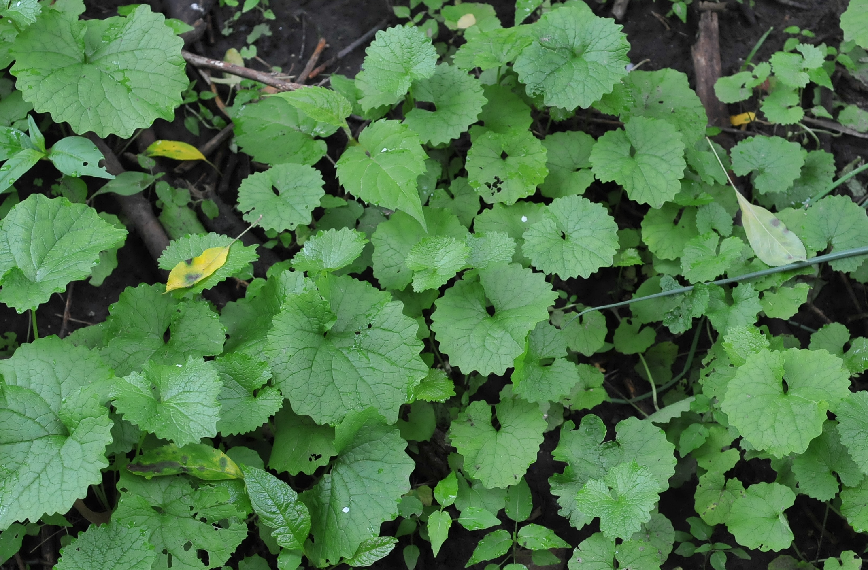
5. Identify by Scientific Name

Slide 6
6. True/False: This plant is self-fertile.
7. Define self-fertile.
8. Roots of this plant are ______ shaped.
(Hint: Letter of the Alphabet like c-shaped)

Slide 7
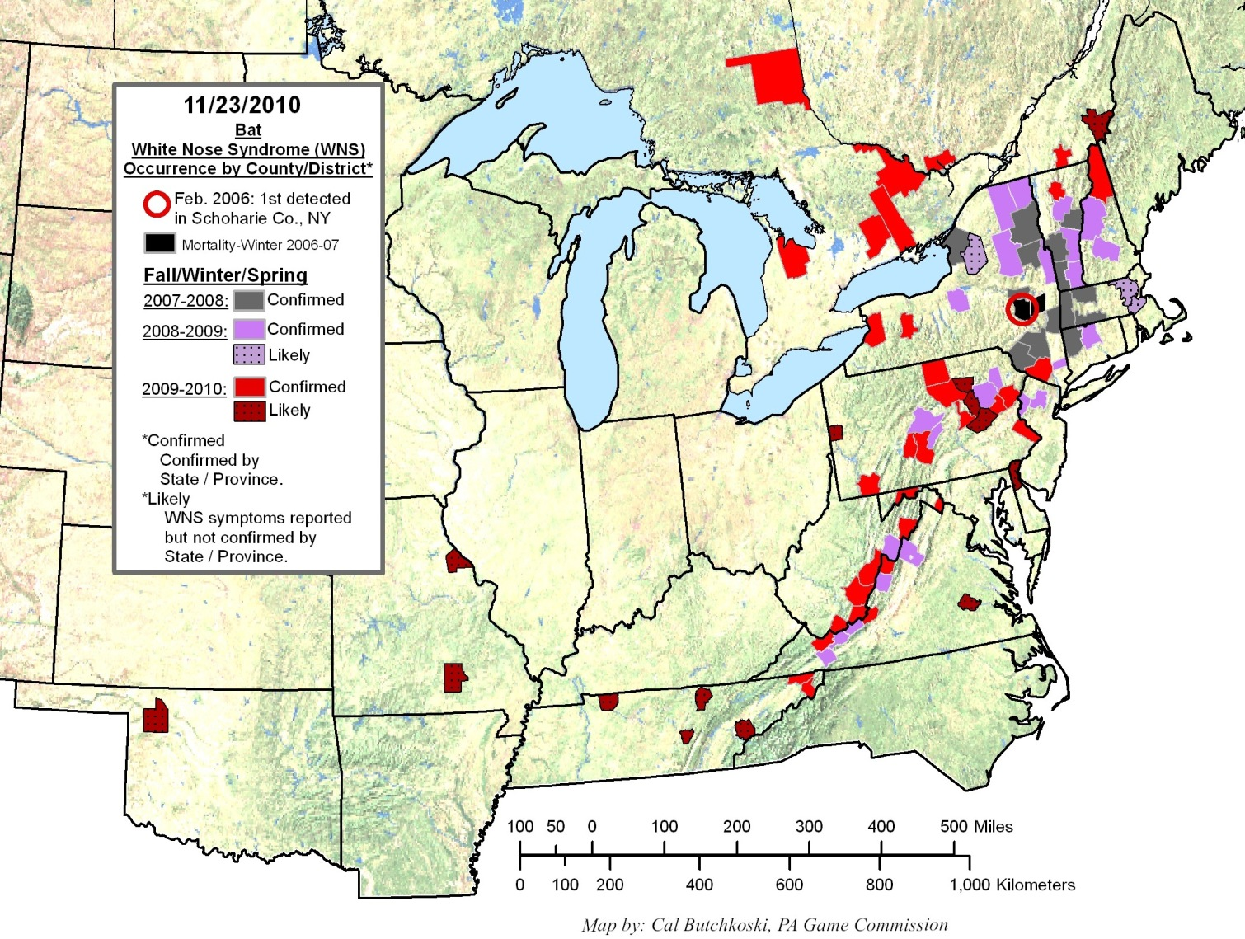
9. Identify fungi by Common Name

Slide 8
10. How many species of mammals are affected with this?
11. True/False: Mortality rates can be as high as 60%.
12. When was this first documented in the U.S.?

Slide 9
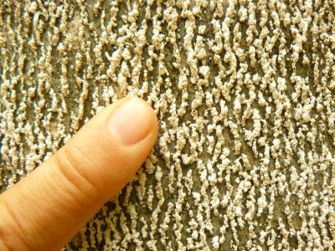
13. Identify by Common Name

Slide 10
14. When was it first documented in Europe?
15. What is Beech Snap?
16. Name the beetle that eats this insect.

Slide 11
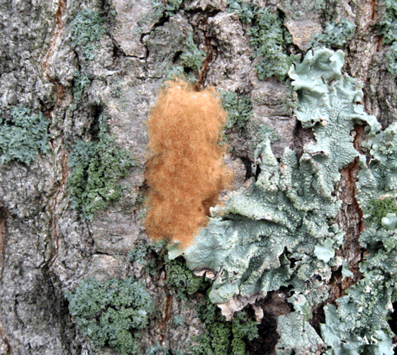
17. Identify by Common Name

Slide 12
18. What is their threat to trees?
19. Why was this brought to the U.S.?
20. What is an STS program?

Slide 13
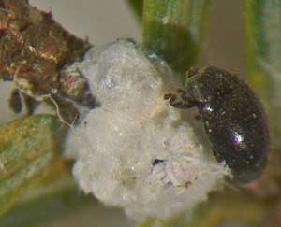
21. Identify white organism by Common Name

Slide 14
22. Where was it found first in the U.S.?
23. True/False: In its native range, it is a huge problem.
24. True/False: This can be found in Kentucky

Slide 15
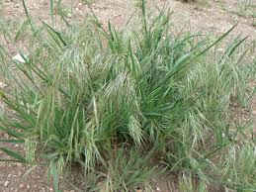
25. Identify by Common Name

Slide 16
26. What was this plant’s method of introduction?
27. True/False: This plant is cleistogamous.
28. Define cleistogamous.

Slide 17
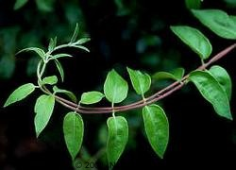
29. Identify by Common Name

Slide 18
30. Why was this introduced to the U.S.?
31. Which continent is this native to?
32. True/False: The nectar is poisonous to humans.

Slide 19
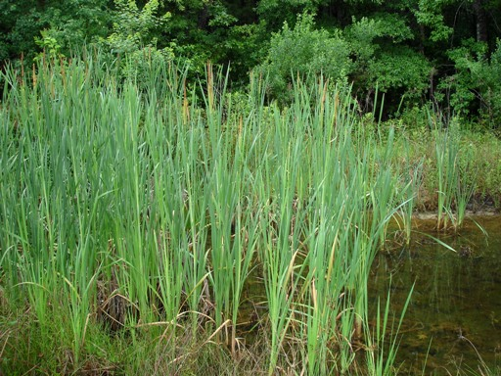
33. Identify by Common Name

Slide 20
34. How many seeds can this plant produce at one time?
35. Cattails can reproduce asexually with ___________.
36. This plant prefers brackish waters. Define brackish.

Slide 21
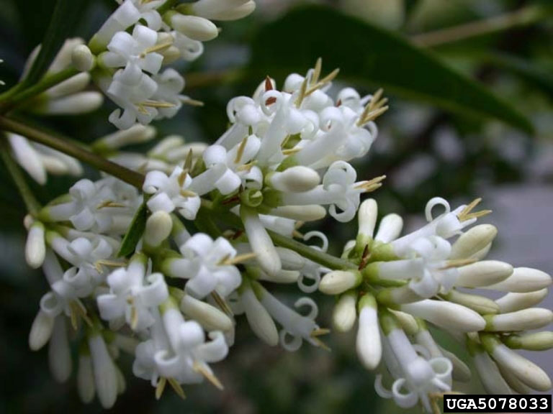
37. Identify by Common Name

Slide 22
38. True/False: This is native to North Africa.
39. This can be used to treat _________.
40. This plant has an OPALS rating of 9/10. What does this mean?

Slide 23
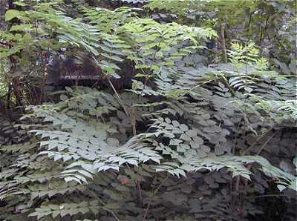
41. Identify by Common Name

Slide 24
42. In what year was this plant introduced to the U.S.?
43. What color are the flowers of this plant?
44. What part of the plant is eaten in Asia as a delicacy?

Slide 25
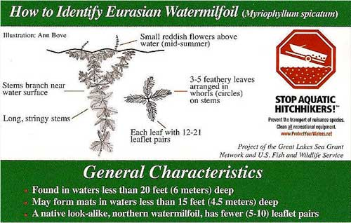
45. Identify by Common Name

Slide 26
46. How many leaves are in a “whorl”?
47. This plant _________ oxygen levels in the water.
48. How was this introduced to the U.S.?

Slide 27
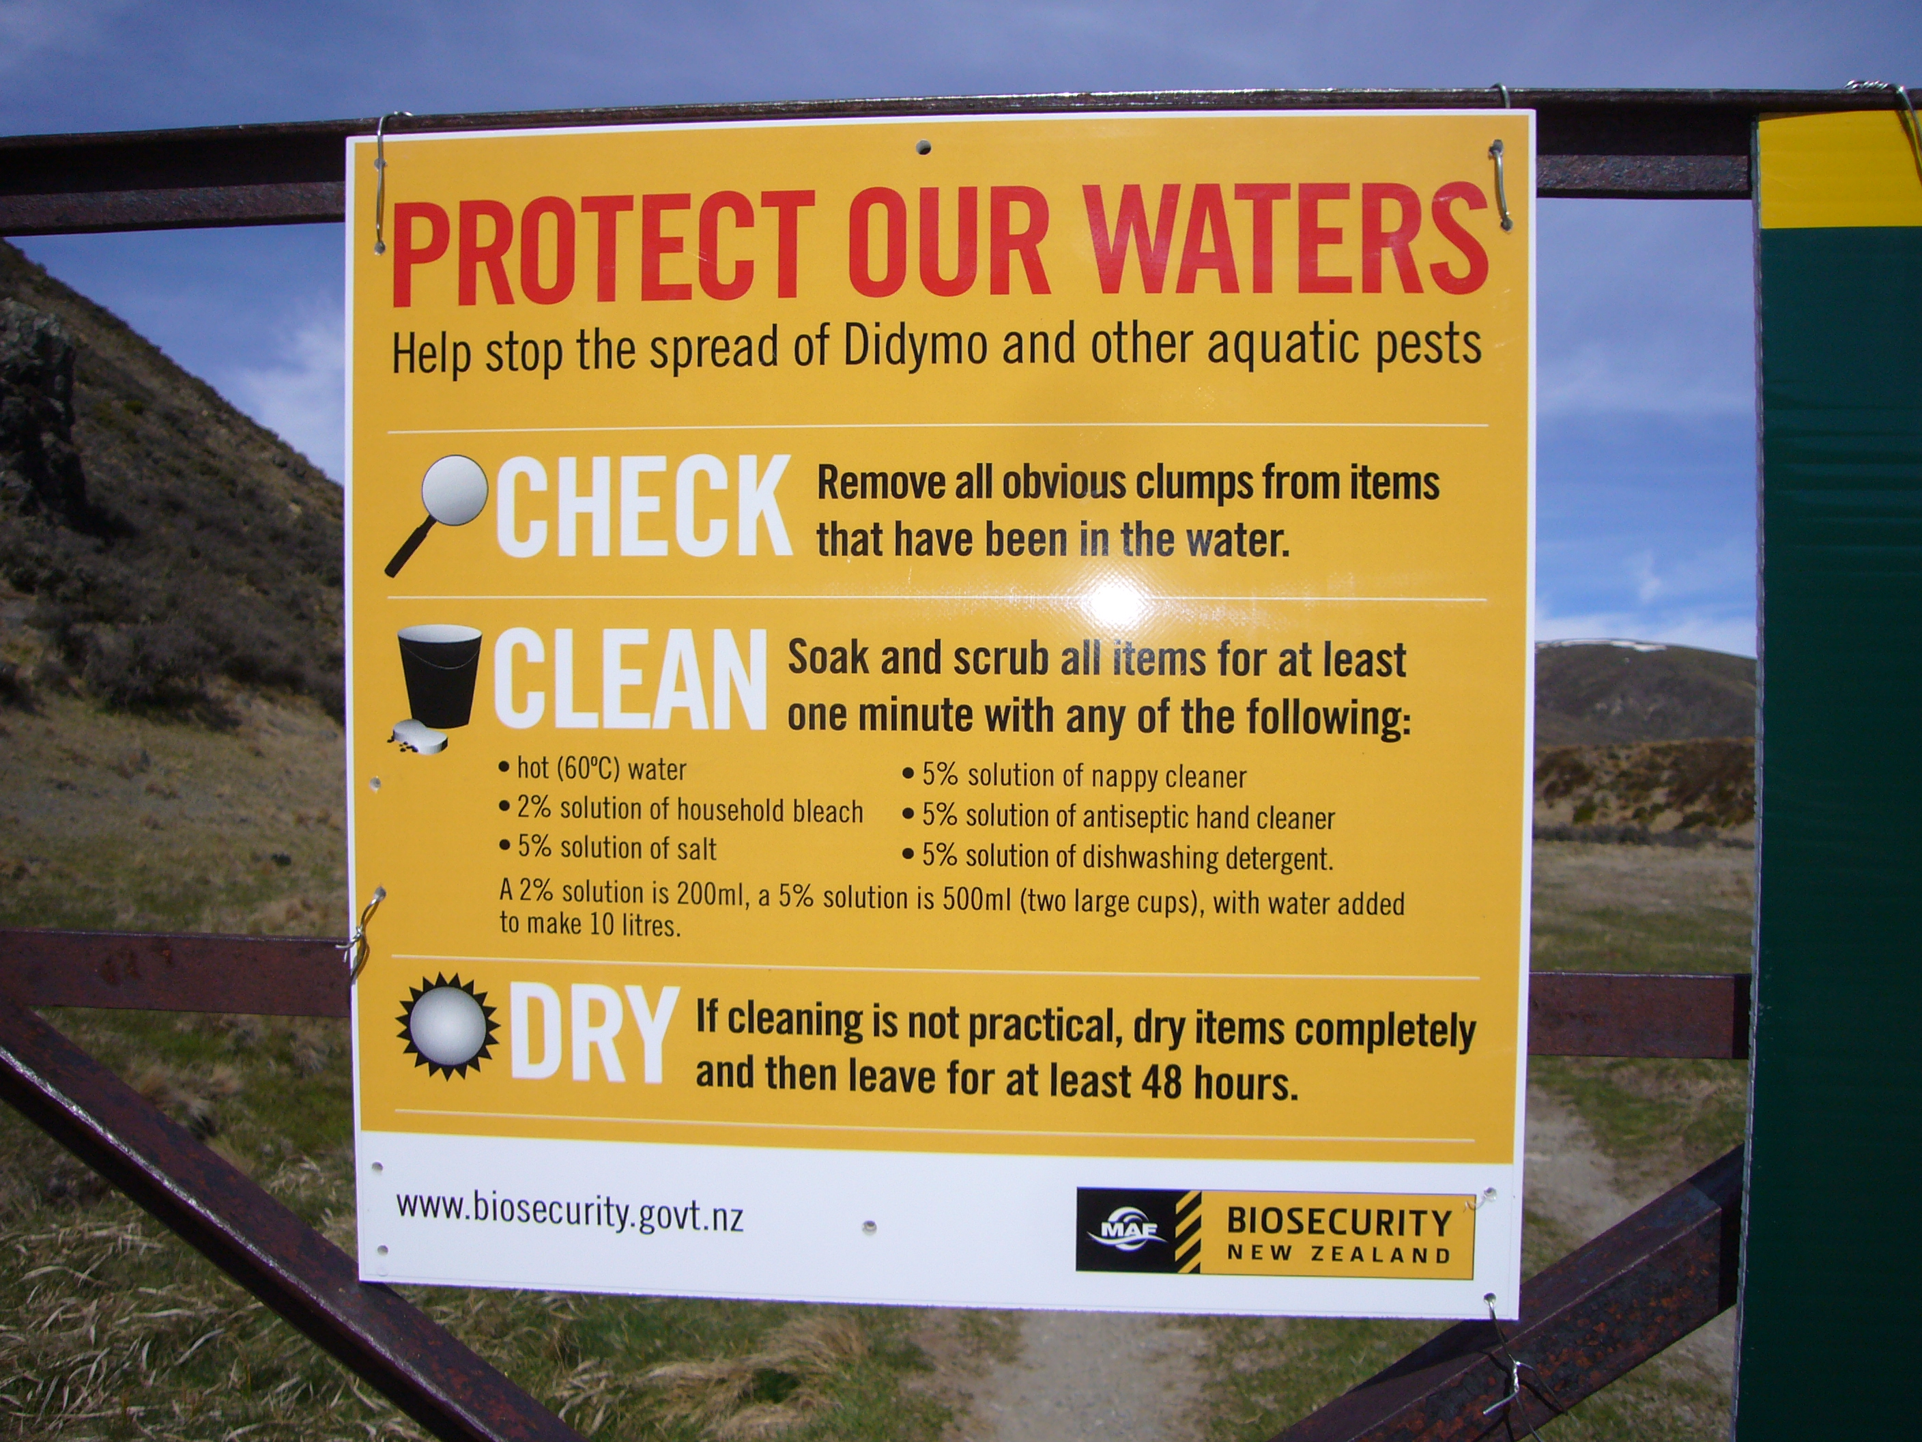
49. Identify by Common Name

Slide 28
50. What is the common nickname of this plant?
51. This is caused by _________, single-celled aquatic organisms.
52. True/False: Boats should be stored in slightly moist environments to kill this plant.

Slide 29
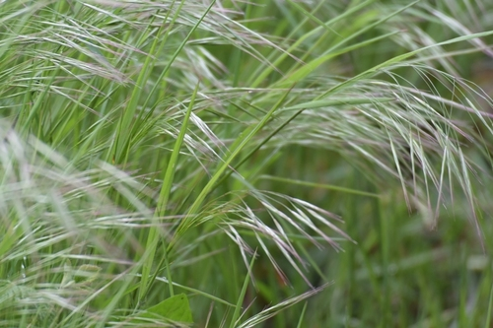
53. Identify by Common Name

Slide 30
54. True/False: This can be found in California
55. Describe the leaves of this plant.
56. True/False: This is native to South America

Slide 31
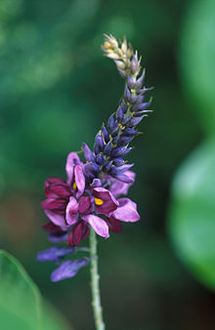
57. Identify by Common Name

Slide 32
58. When was this introduced to the U.S.?
59. Why was this introduced to the U.S.?
60. True/False: Kudzu has been used to treat hangovers.

Slide 33
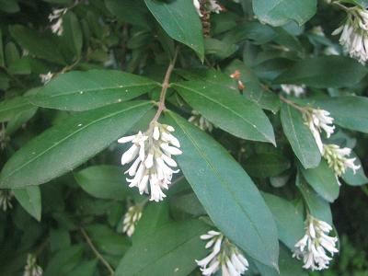
61. Identify by Common Name

Slide 34
62. Why was this introduced to the U.S.?
63. True/False: The flowers smell like lavender
64. What is the expected height of this plant?

Slide 35
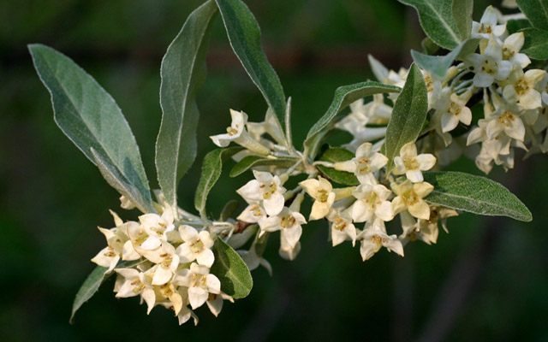
65. Identify by Common Name

Slide 36
66. How does it outcompete natives?
67. What animal scatters the seeds?
68. Name a distinguishing characteristic of the leaf.

Slide 37
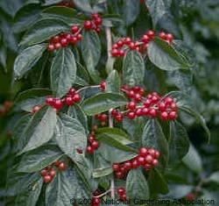
69. Identify by Common Name

Slide 38
70. This plant is native to which part of Russia?
71. True/False: This plant can form thickets
72. When was it introduced to the U.S.?

Slide 39
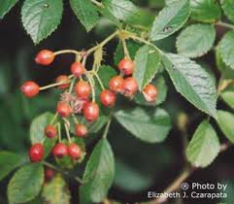
73. Identify by Common Name

Slide 40
74. True/False: Pruning the plant is an effective control method
75. What is its relationship to goats?
76. This is also known as the _______-sisters rose.

Slide 41
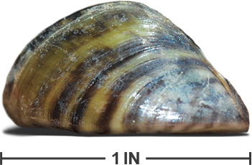
77. Identify by Common Name

Slide 42
78. This is native to what country?
79. Is it the size of a book, can, pack of gum, or fingernail?
80. How did it get its name?

Slide 43
That wasn’t so hard, was it?

