Slide 1
Entomology Test
Created based on the list used during the 2014-2015 season.

Slide 2
Section 1: Identification
Part 1: Tricky Taxons
  In this section, for each picture, list the lowest taxon required by the list (order or family, depending on the specimen shown).
  Answers can and will be repeated.
  Scientific names only; No credit for common name
  Wrong spelling is ½ point off
  Each slide in this test will last for 54.7368421053 seconds (except instruction slides, they last for 20 seconds)

Slide 3
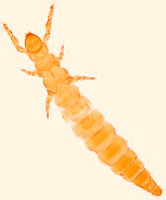
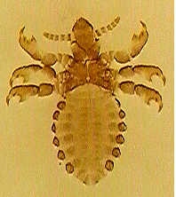
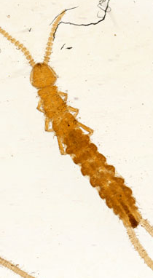
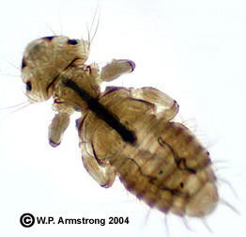
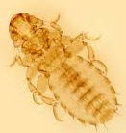
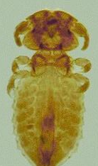
1)
2)
3)
5)
6)
4)

Slide 4
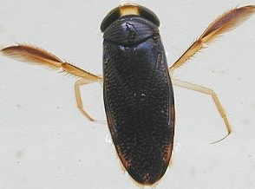
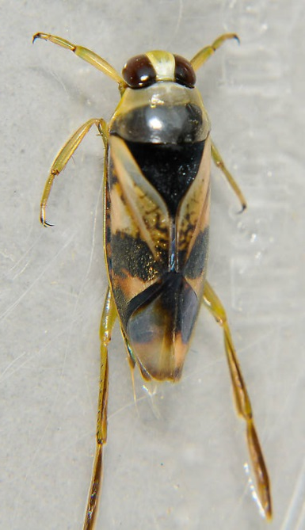
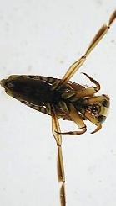
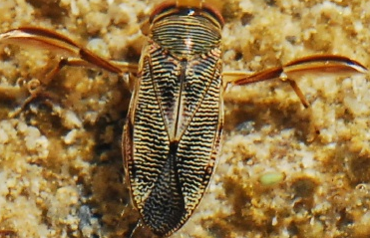
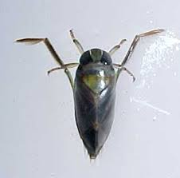
7)
8)
9)
10)
11)

Slide 5
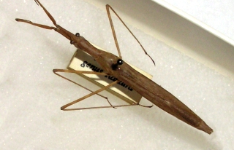
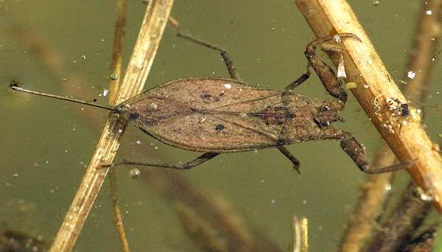
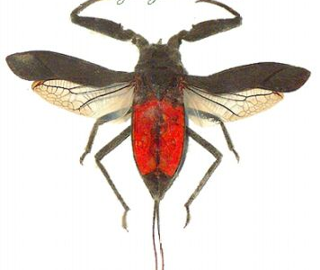
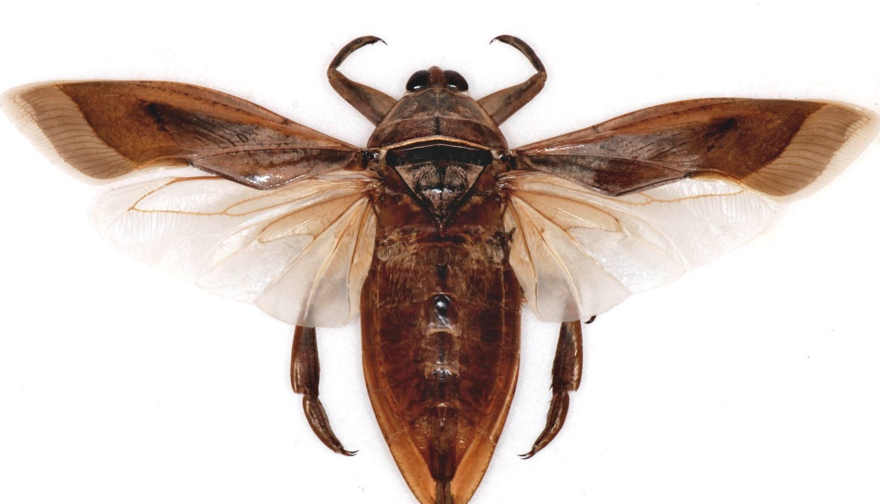
12)
13)
14)
15)

Slide 6
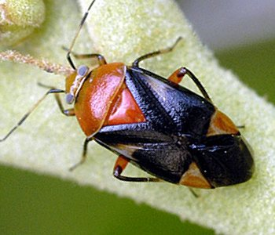
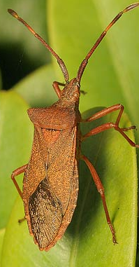
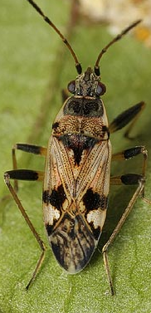
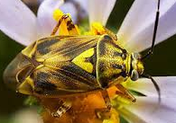
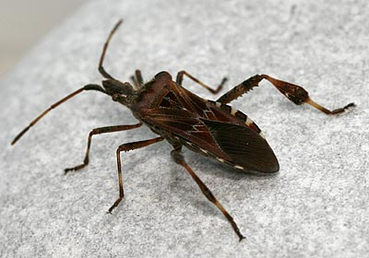
16)
17)
18)
19)
20)

Slide 7
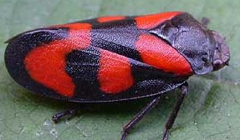
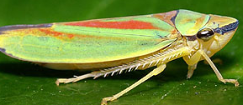
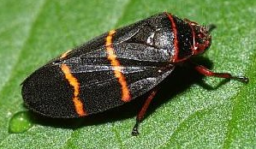
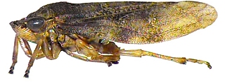
21)
22)
23)
24)

Slide 8
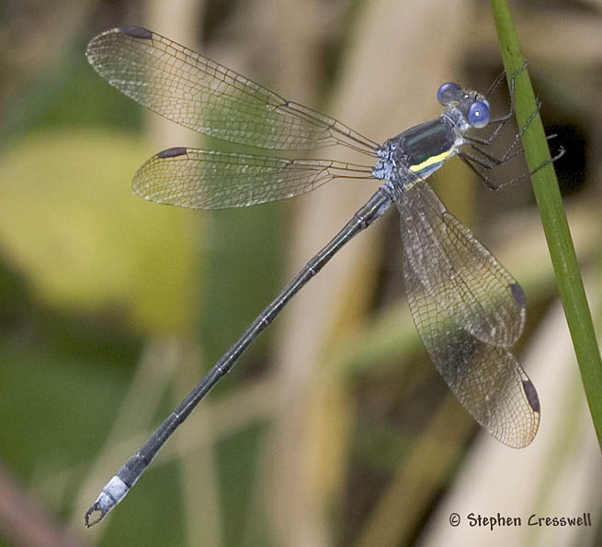
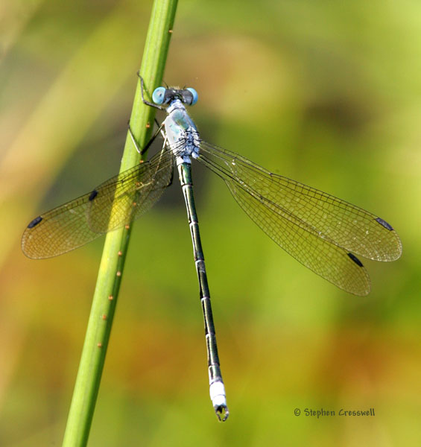
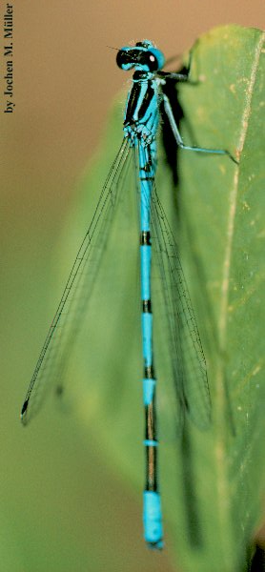
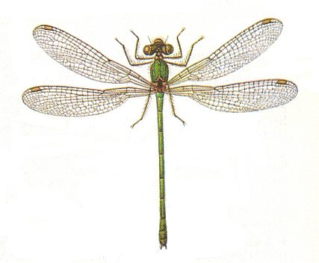
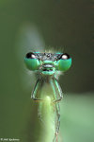
25)
26)
27)
28)
29)

Slide 9
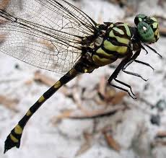
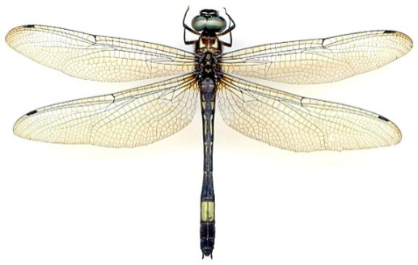
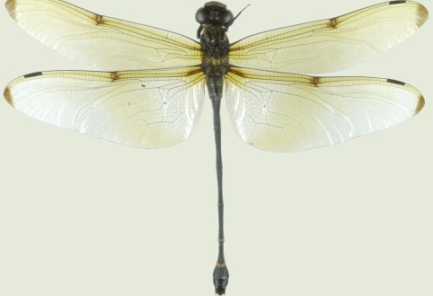
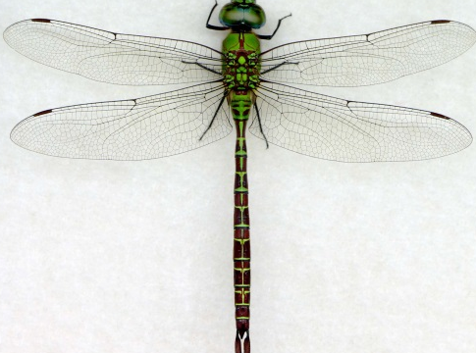
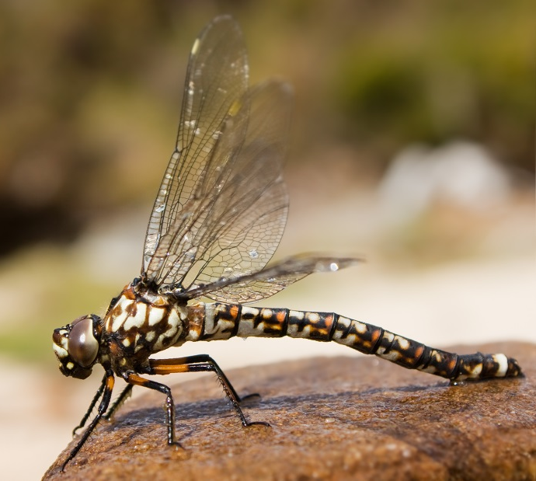
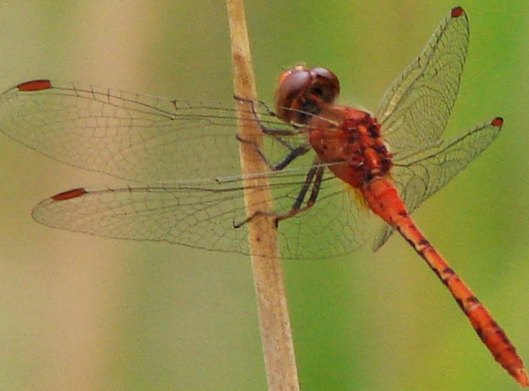
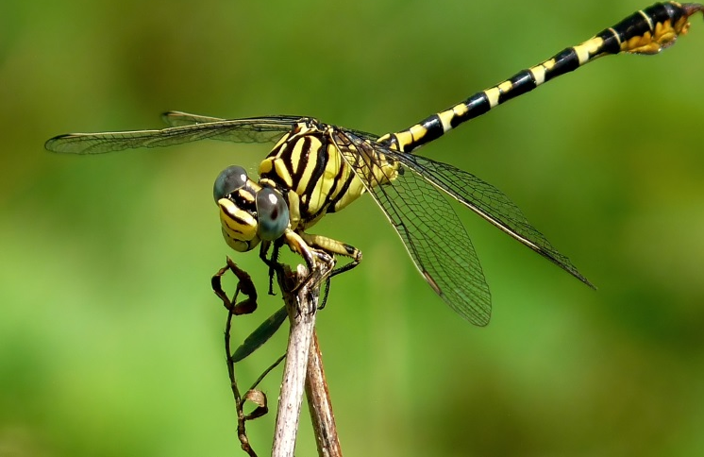
30)
31)
32)
33)
34)
35)
36)

Slide 10
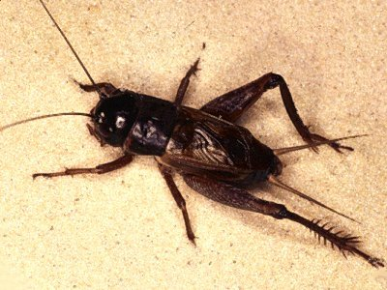
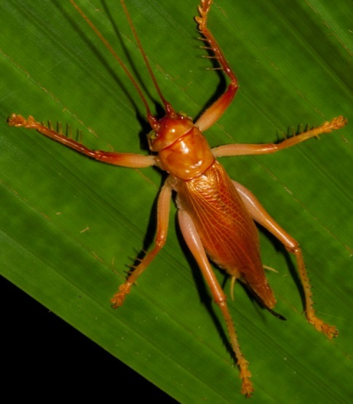
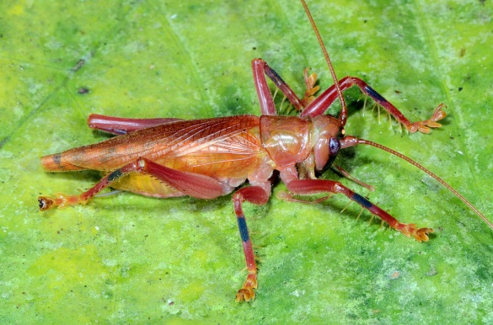
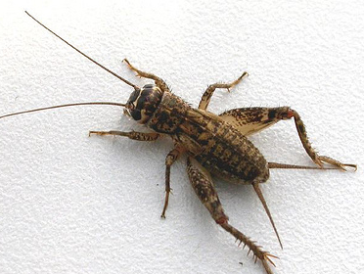
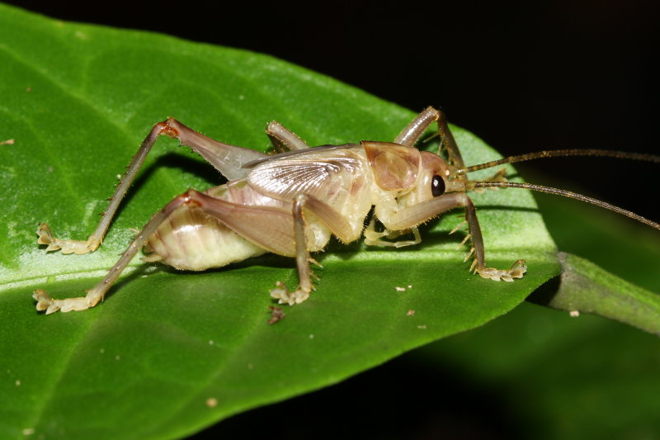
37)
38)
39)
40)
41)

Slide 11
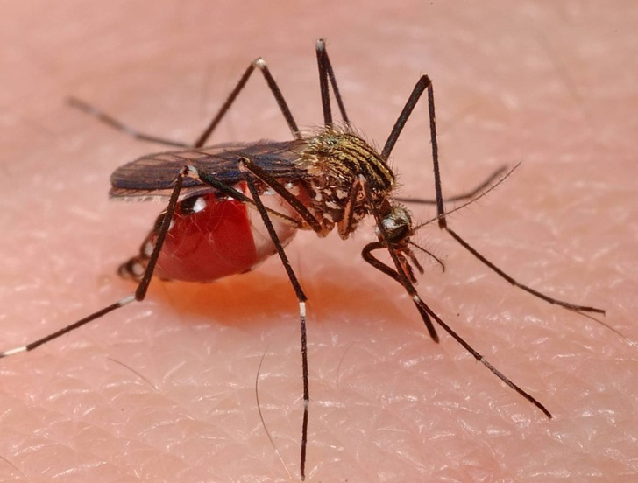
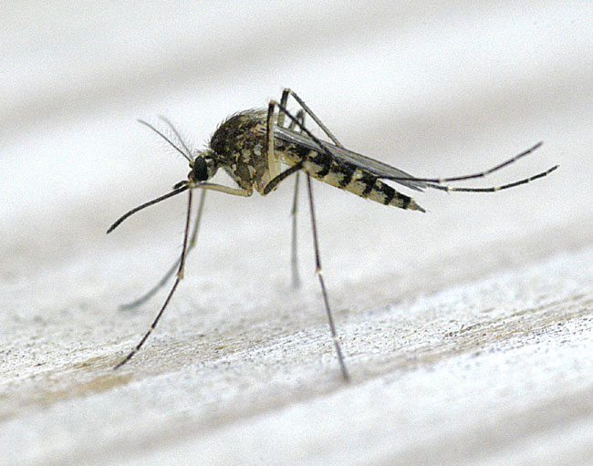
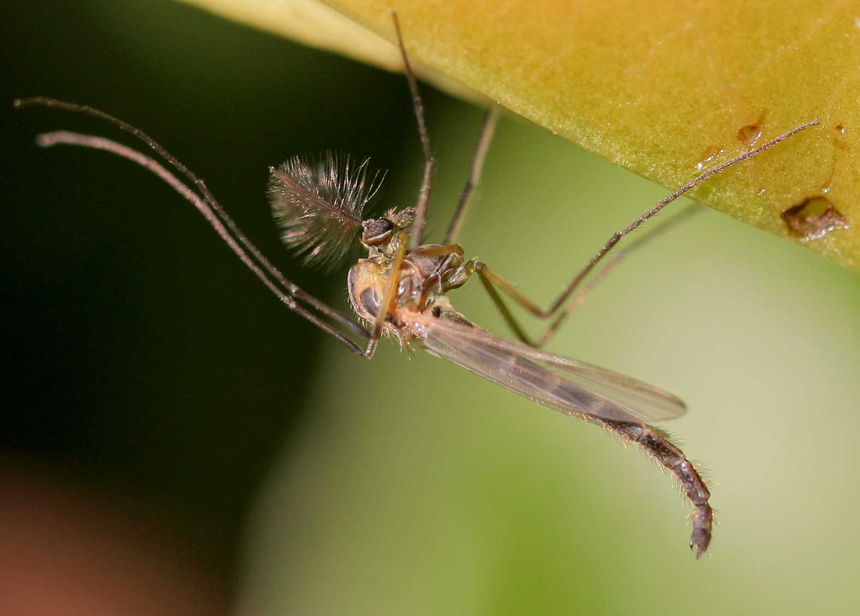
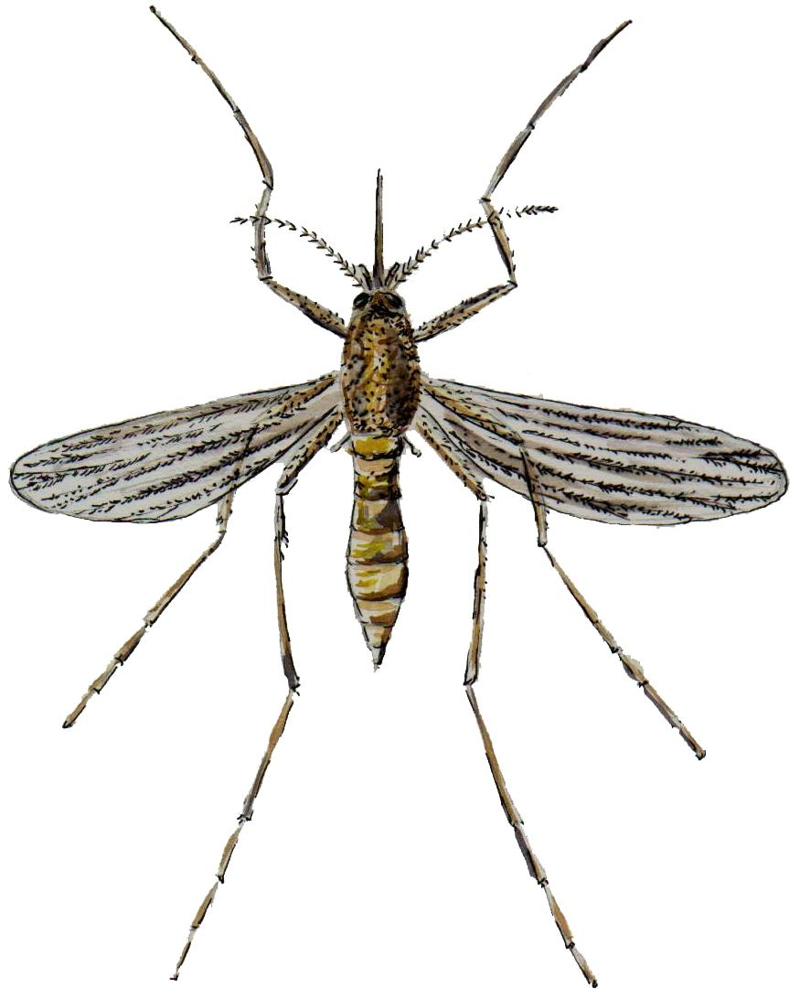
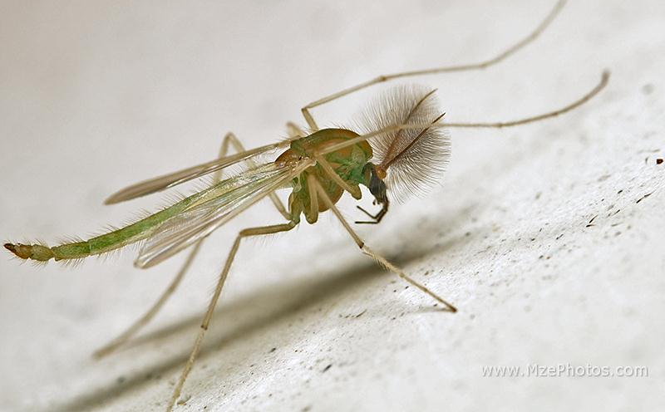
42)
43)
44)
45)
46)

Slide 12
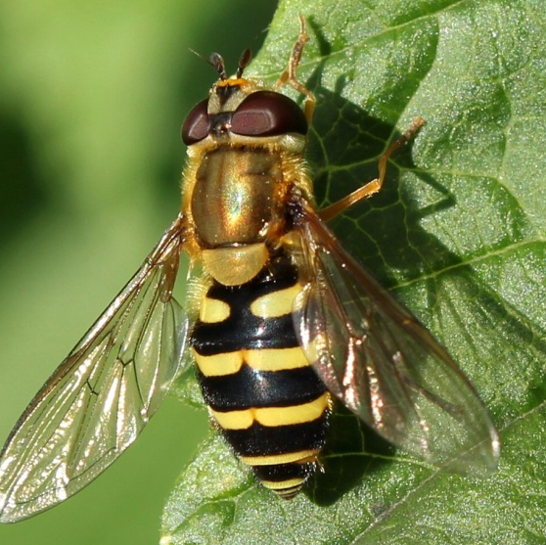
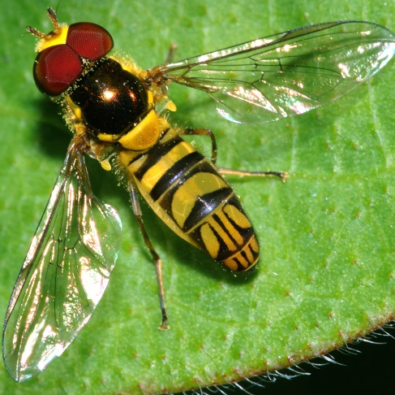
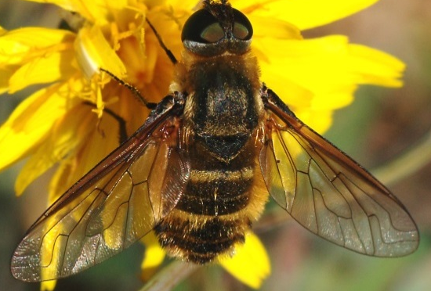
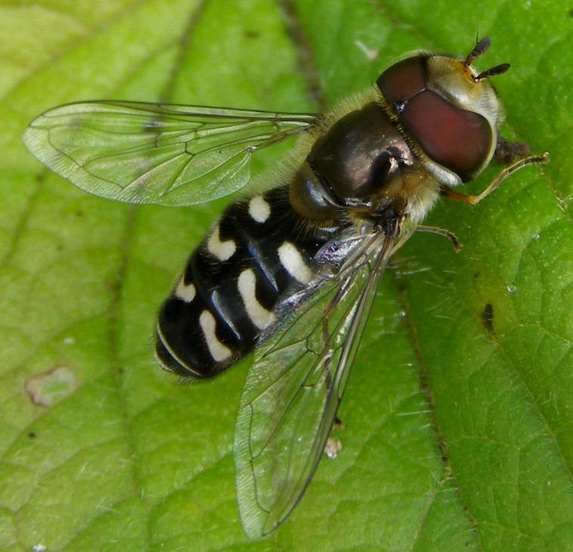

42)
49)
47)
48)
50)
51)

Slide 13




52)
53)
54)
55)

Slide 14




56)
57)
58)
59)

Slide 15






60)
61)
62)
63)
64)
65)

Slide 16





66)
67)
68)
69)
70)

Slide 17





71)
72)
73)
74)
75)

Slide 18





76)
77)
78)
79)
80)

Slide 19





81)
82)
83)
84)
85)

Slide 20





86)
87)
88)
89)
90)

Slide 21






91)
92)
93)
94)
95)
96)

Slide 22




97)
98)
99)
100)

Slide 23




101)
102)
103)
104)

Slide 24






105)
106)
107)
108)
109)
110)

Slide 25





111)
112)
113)
114)
115)

Slide 26
Section 1: Identification
Part 2: Traditional- Slides and Questions
  This part is simple: Just answer the questions. Make sure you’re on the correct line on your answer sheet ☺

Slide 27

116. Order
117. How do these insects attract each other for mating?
118. Can these insects fly well?
119. What do these insects generally feed on as adults?
120. What do these insects do during the day?

Slide 28


A B
121. Order of insects A and B
122. Family of insect A
123. Family of insect B
124. How does insect A hold its wings while resting?
125. In what season does insect B mate?
126. List at least three animals that prey on insect A
127. Describe the forelegs of both insects.

Slide 29


128. Order
129. Family (common & scientific)
130. Describe the way these insects move. Do they jump or hop?
131. Do most of these insects have wings?
132. What liquid do these insects secrete from their anus?
133. What is the name of the structure circled in the diagram?
134. Define parthenogenesis and explain how it relates to this group of insects.

Slide 30


135. Order (common and scientific)
136. Explain the joke behind the cartoon above. Why is it funny?
137. What are the front legs of this insect adapted for?
138. Describe the cerci of insects in this group.
139. What is the difference between a male member of this order and a female member of this order?

Slide 31

140. Order
141. Family
142. These insects are sessile. What does sessile mean?
143. Where do these insects live?
144. What color do these insects turn when crushed?
145. How many generations do these insects produce each year?
146. How many instars does the female experience? Male?
147. Do these insects have legs? If so, how many?
148. Do males in this family have wings?

Slide 32

148. Order
149. Family
150. Do these insects have ocelli?
151. How many antennae segments do these insects have?
152. Name one disease transmitted by these insects.
153. Do the wings of these insects have scales?
154. Which sex is considered to be more harmful?
155. When do these insects “attack”?

Slide 33


A
B
What is the order of insect A?
What is the order of insect B?
Which specimen of insect B is male? Which is female? (use left/right or yellow/brown) How do you know?
What are insect A’s mouthparts adapted for?
Can insect B transmit diseases? If so, list them.
Does insect B show maternal care?
Does insect A have a significant human impact? If so, describe.
What type of metamorphosis does insect A display? Insect B?
What are the structures at the end of insect B’s abdomen called? What are they used for?

Slide 34

165. What is the order of this insect?
166. What caste is this insect from? How can you tell?
167. These insects are closely related to cockroaches. Are the similarities based on appearance, diet, ecology, or behavior? (choose two)
168. Name one way in which these insects can benefit the environment.
What type of metamorphosis does this insect display?
Can these insects digest wood fibers?

Slide 35

171. What is the order of this insect?
172. Is this insect a male or female? How can you tell?
173. What are the mouthparts of this insect primarily used for?
174. Do these insects have a big impact on humans? If so, please explain.
175. How long do these insects live?
176. Are these antennae bristle-like or fan-like?
177. How many millimeters long are these insects?

Slide 36


B
A
178. What order are these insects from?
179. What is the family of insect A?
180. What is the family of insect B?
181. Does insect A usually have wings?
182. What does insect B feed on?
183. What is the elongated “beak” of insect A known as?
184. Which insect is usually bigger- A or B?
185. How many claws do the tarsi of these insects have?
186. Do either of these insects have a pronounced human impact? If so please explain. If not, why not?

Slide 37


B
A
187. What is the order of insect A? Family?
188. What is the order of insect B? Family?
189. Is insect A an adult, nymph, larva, or adult?
190. Is insect B an adult, nymph, larva, or adult?
191. Is insect B generally a good flier?
192. What type of antennae does insect A possess?
193. Where does insect A live?
194. Where is insect B usually found?

Slide 38

195. What is this insect’s order?
196. What is this insect’s family?
197. Does this insect have antennae?
198. What does this insect eat?
199. Where is the most diverse population of this insect found?
200. What animal does this insect resemble in appearance and hopping habits? (hint- look at the common name of this insect)

Slide 39
Section 1: Identification
Part 3: Immature Forms
  Identify each specimen to the order or family (whichever is specified)
  Answers can be repeated

Slide 40






201)
202)
Family
Family
204)
203)
Family
Family
205)
206)
Family
Order

Slide 41






207)
208)
Order
Family
210)
209)
Family
Family
211)
212)
Family
Family

Slide 42




213)
214)
Family
Family
216)
215)
Family
Family

Slide 43
Congratulations!
You are now finished with the PowerPoint part of this test.
You have the rest of the time to work on the questions found on your answer sheet.
When you finish, turn your test in. Make sure your school’s name and team number are on it

