Slide 1
SilverNight’s Forestry Practice Test (NJ)
Directions: Each slide is timed. You will have 35 seconds to identify each tree and 1 minute to answer the related questions. Mark your answers on the answer sheet. There will be general tree ecology questions at the end. Those slides are each 2 minutes long. The entire test should take approximately 40 minutes. Good luck.
This slide is 20 seconds long

Slide 2
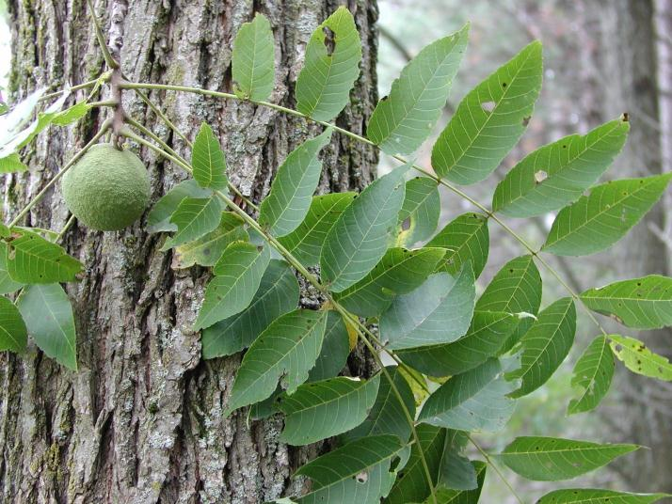
1. Identify This Specimen

Slide 3
Which of the following describes this tree’s leaves?
Opposite and entire
Alternate and entire
Opposite and serrated
Alternate and serrated
Why can’t many garden plants grow under this tree?
The thick canopy of leaves on this tree completely blocks all sunlight from reaching any plants below
Its roots secrete a toxic substance that prevent other plants from growing near it
Its spreading roots absorb all the nutrients from the soil
Its roots seek out and take in lots of sulfur, making other plants deficient in this essential element
None of the above

Slide 4
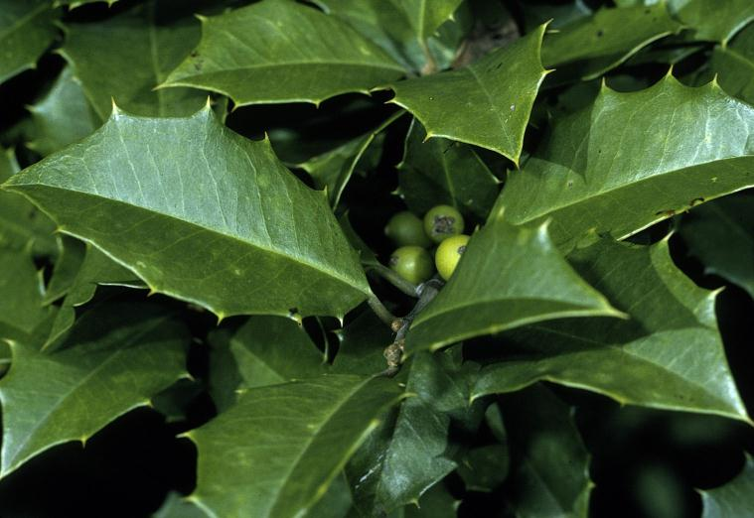
2. Identify This Specimen

Slide 5
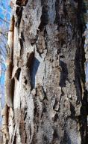
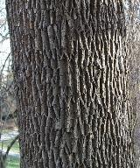
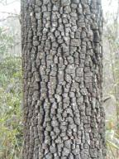
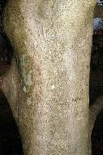
Which of the following is an image of the bark of this tree?
It is the state tree of:
Delaware
Connecticut
Massachusetts
New Jersey
Maryland
a) b) c) d)

Slide 6
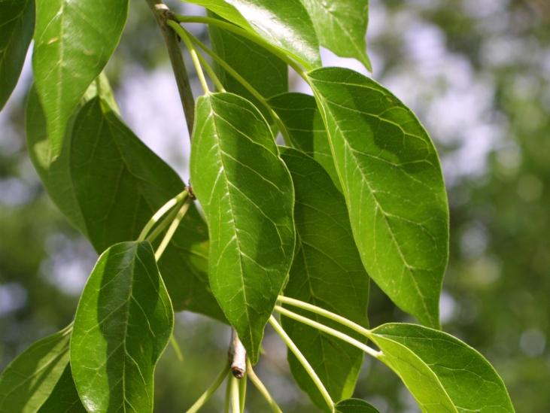
3. Identify This Specimen

Slide 7
Which of the followings statements about the fruit of this tree is false?
It has a pleasant and mild odor
It is edible for the most part
Few native animals make use of it as a food source
Eating it may cause vomiting
Native Americans used the wood to make
Swords
Shoes
Medicine
Bows

Slide 8
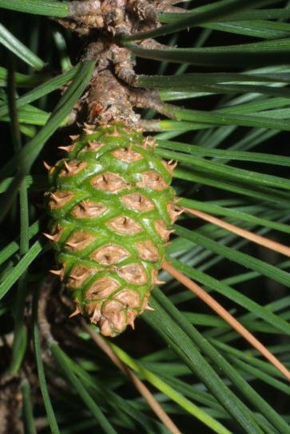
4. Identify This Specimen

Slide 9
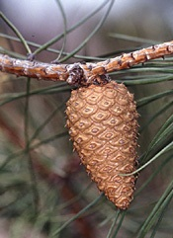
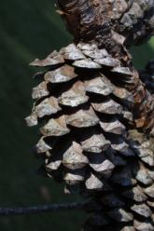
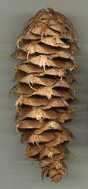
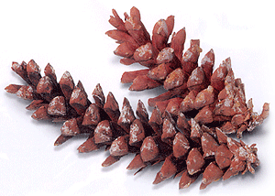
Which of the following is an image of a mature cone of this tree?
This tree prefers which type of soil?
Well-drained, dry soils
Wetlands and marshes
Mountainous, rocky soil
a) b) c) d)

Slide 10
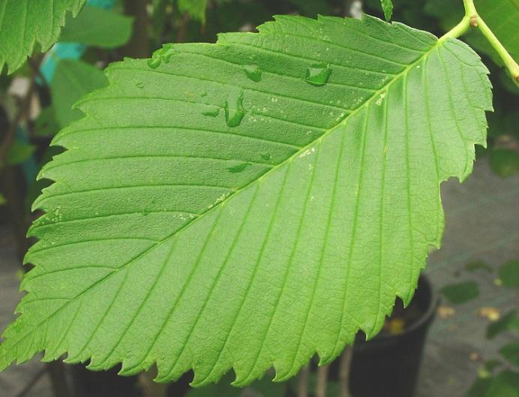
5. Identify This Specimen

Slide 11
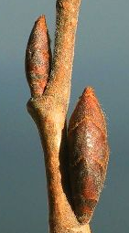
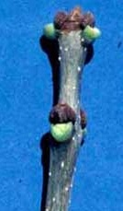
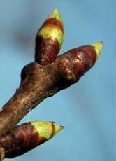
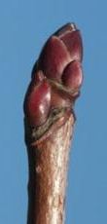
Which of the following pictures show this tree’s buds?
It is highly susceptible to
Elm Leaf Beetle
Japanese Elm Beetle
Dutch Elm Disease
Elm Leaf Disease
a) b) c) d)

Slide 12
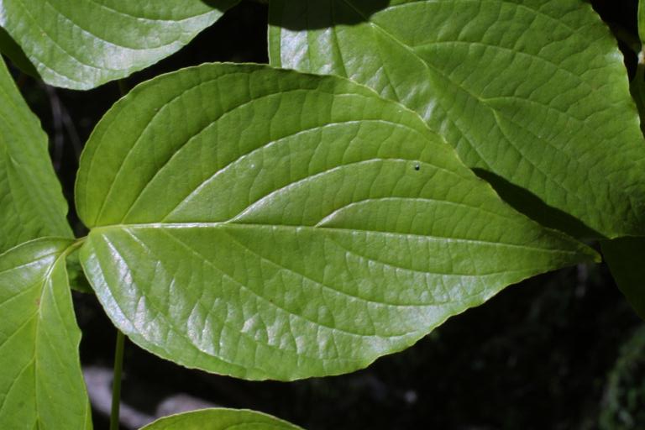
6. Identify This Specimen

Slide 13
Which of the following is false?
The fruit is a shiny, oval red drupe.
The leaf is arcuately veined.
The red berries are edible.
Its bark is among the thinnest of all eastern trees.
None of the above.
This tree’s flowers are
Monoecious
Dioecious
Perfect
Both (a) and (b)

Slide 14
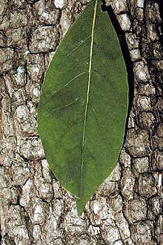
7. Identify This Specimen

Slide 15
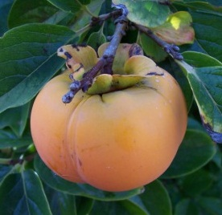
Which of the following is false about this tree’s fruit?
It is a globular berry.
It is sour when unripe.
Molasses can be made from the fruit pulp.
It is high in Vitamin C.
Which part is the calyx?
a)
d)
b)
e)
c)

Slide 16
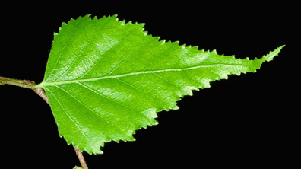
8. Identify This Specimen

Slide 17
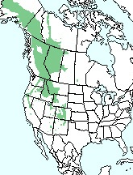
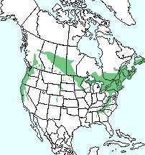
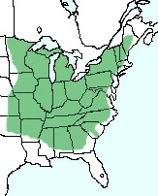
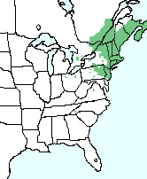
Which of the following shows the correct range map for this tree?
Its leaves are:
Undulate
Incised
Serrulate
Doubly Serrate
a) b) c) d)

Slide 18
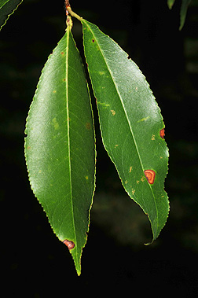
9. Identify This Specimen

Slide 19
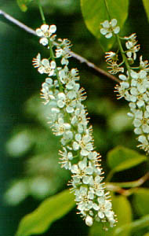
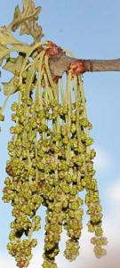
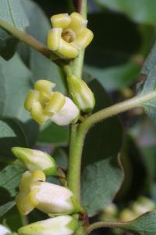
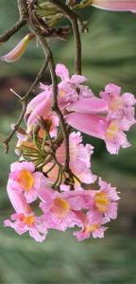
Which of the following shows a picture of this tree’s flowers?
The young bark of this tree has horizontal ____________ on it.
a) b) c) d)

Slide 20
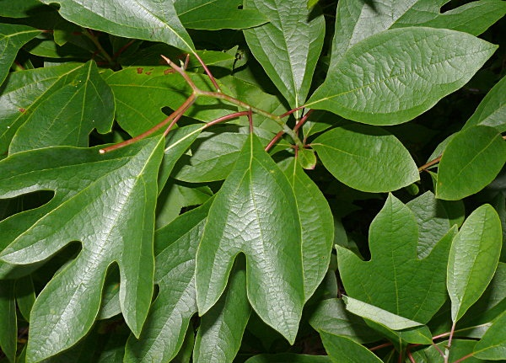
10. Identify This Specimen

Slide 21
Which of the following best describes the fruit of this tree?
Berry
Drupe
Samara
Pome
Pod
Capsule
Other
Name one way that the oil of this tree is used.

Slide 22
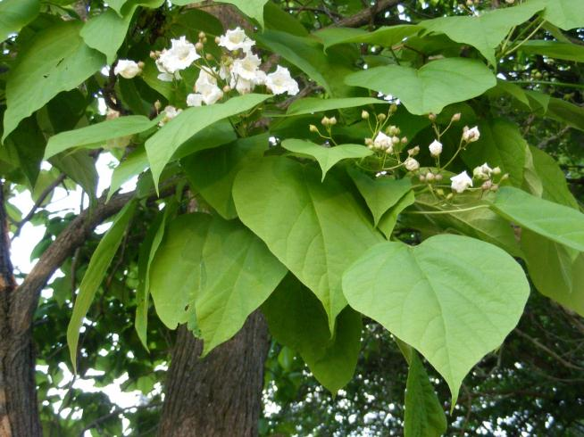
11. Identify This Specimen

Slide 23
Which of the following best describes the flowers of this tree?
Arranged in salverform corollas of 3 lobes
Arranged in salverform corollas of 5 lobes
Arranged in campanulate corollas of 3 lobes
Arranged in campanulate corollas of 5 lobes
List 2 uses for the bark of this tree

Slide 24
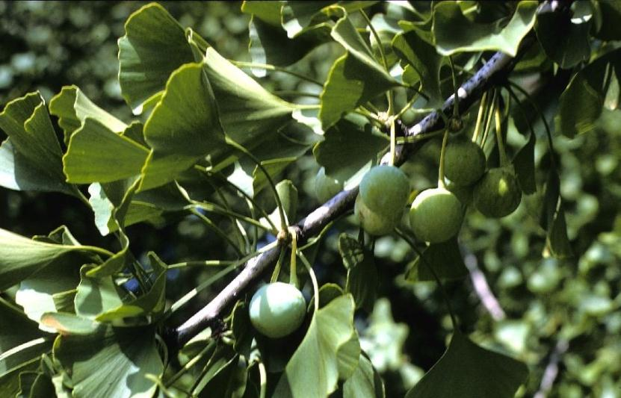
12. Identify This Specimen

Slide 25
The soil that it inhabits has approximately what pH range?
3.5 – 4.0
4.0 – 4.5
4.5 – 5.0
5.0 – 5.5
5.5 – 6.0
Why are male trees more popular in cities?

Slide 26
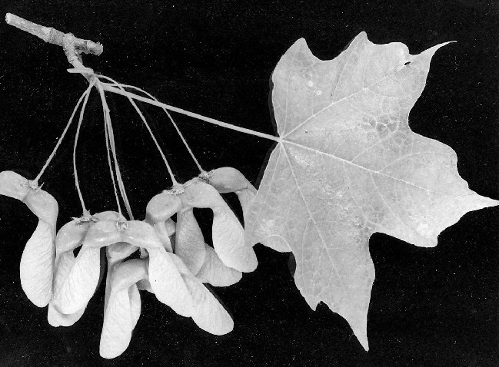
13. Identify This Specimen

Slide 27
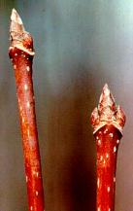
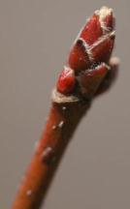
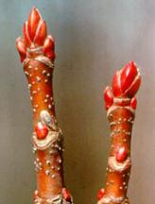
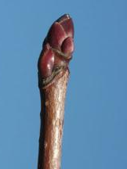
Which of the following shows a picture of this tree’s twig?
This tree is the primary source of what popular (edible) substance?
a) b) c) d)

Slide 28
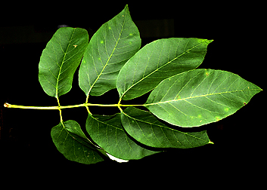
14. Identify This Specimen

Slide 29
Which of the following describes the fruit of this tree?
Berry
Drupe
Samara
Pome
Pod
Capsule
Other
List 2 things the wood of this tree is used for.

Slide 30
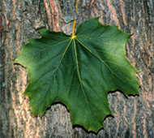
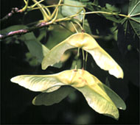
15. Identify This Specimen

Slide 31
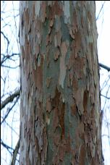
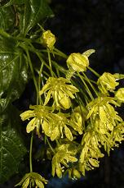
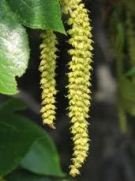
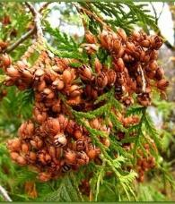
Which of the following pictures belong to this tree?
List one way to tell the difference between this tree and tree #13
a) b) c) d)

Slide 32
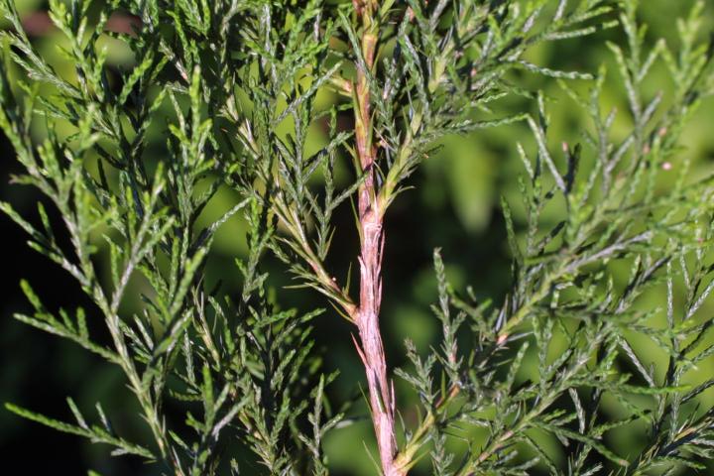
16. Identify This Specimen

Slide 33
What kinds of land does this tree grow best in?
Barren soils
Acidic wetlands
Snowy mountains
Deciduous forests
What is the name of the bird that was named after this tree because it eats its berries?

Slide 34
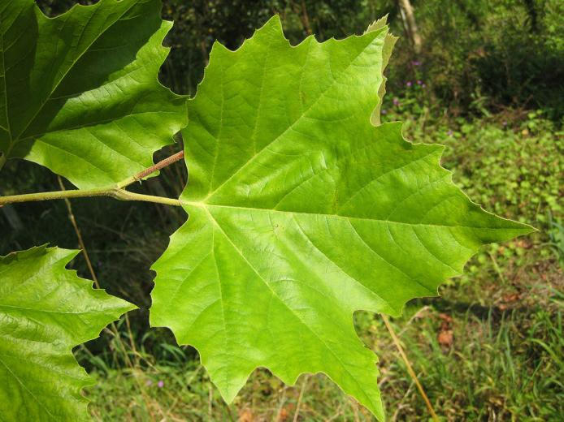
17. Identify This Specimen

Slide 35
This tree is ____________ and its fruit is a multiple of _______________.
Monoecious, capsules
Monoecious, achenes
Dioecious, capsules
Dioecious, achenes
The leaves are the sole food source for larvae of which rare butterfly?

Slide 36
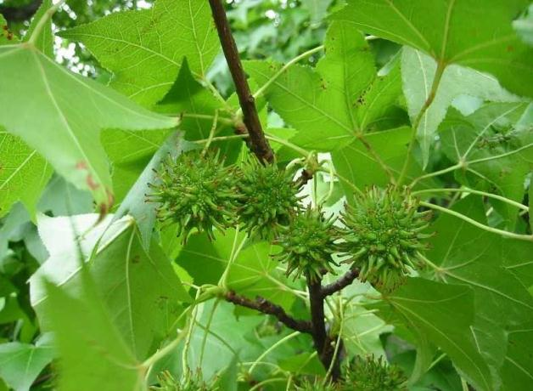
18. Identify This Specimen

Slide 37
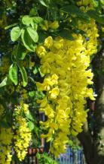
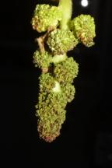


Which of the following pictures show a male flower of this tree?
How many seeds does this tree’s fruit release from each capsule?
a) b) c) d)

Slide 38

19. Identify This Specimen

Slide 39
Which of the following statements is true?
The tree grows best on shallow, rocky lowland plains.
It has one of the most useful woods for heavy construction.
It has a very compressed columnar shape.
The cap of its acorn stays firmly attached even at maturity.
How was this tree selected to be the official state tree of Illinois?

Slide 40

20. Identify This Specimen

Slide 41




Which of the following shows a picture of this tree’s bark?
The leaf is very __________ when crushed.
a) b) c) d)

Slide 42

21. Matching (6 points)
A.
D.
Deltoid
Elliptical
Lanceolate
Linear
Obovate
Ovate
B.
E.
C.
F.

Slide 43

22. Fill-In (10 points)
A.
B.
G.
H.
C.
D.
I.
E.
F.
J.

Slide 44
23. Matching (7 points)
Dioecious
Hermaphrodite
Monoecious
Petals
Pistals
Sepals
Stamens
Usually green and leaf-like
Usually brightly-colored
The male reproductive structures
The female reproductive structures
Female and male on the same tree
Female and male on separate trees
Female and male organs on the same flower

Slide 45


24. Fill-In (8 points)
A.
B.
C.
D.
E.
G.
F.
H.

Slide 46






25. Matching (7 points)
D.
Auxiliary Bud
Conical
Narrowly Conical
Ovoid
Rounded
Superposed
Terminal Bud
B.
E.
C.
F.
G.

