Slide 1
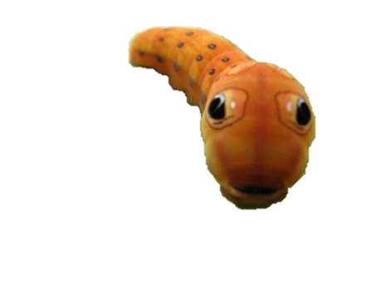
2014-2015 Entomology Qualifier
William P. Clements High School
(I hope there are no problems with this powerpoint.)

Slide 2
Directions
You are allowed to use the following:
Any insect field guide
One front-and-back notes sheet
Magnifying glass (but this is a PowerPoint, so…)
Pencils, pens, and erasers
Your wonderful brain
You are not allowed to go back to previous slides.
Click when finished reading the directions.

Slide 3
Test Format
155 Questions with a few bonus questions
1 point for everything.
90 seconds per slide, but last slide is 30 seconds
Write your answers on the answer sheet
This test is meant to be long, strenuous, and fast. The worse you do on this, the more you’ll be prepared for the future.
Do not touch the enter key or the arrow keys. In fact, I will unplug the keyboard.
Click when finished reading this slide.

Slide 4
This is the timer. It’s Pacman.
5
4
3
2
1
The yellow circle will completely fade after 59 seconds. The red circle will fade after another 30 seconds. A 5 second countdown will appear to signal that there are 5 seconds left.
The timer may change positions depending on the slide.

Slide 5
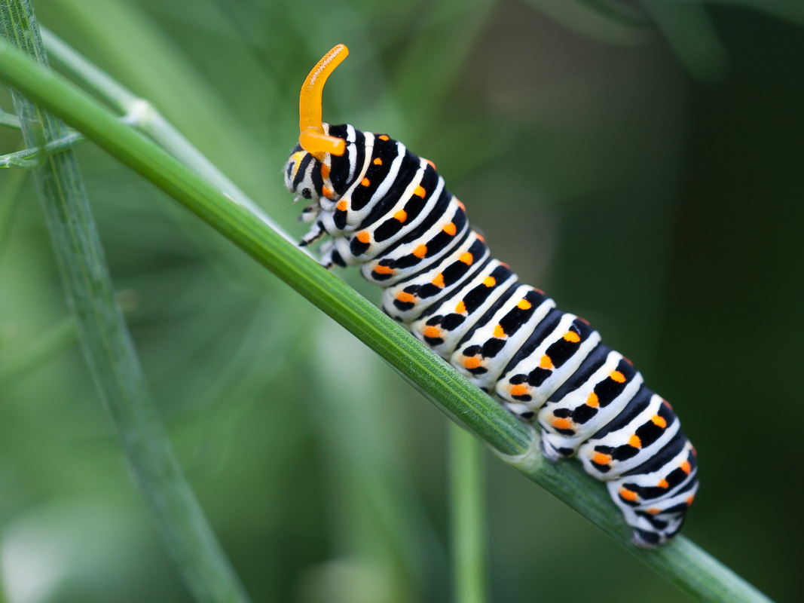
5
4
3
2
1
Identify the order name.
Identify the family name.
Identify the family’s common name.
What is the name of the feature the red arrow is pointing at? (I hope you’re not colorblind for this…)
What does the feature from question 4 emit?

Slide 6
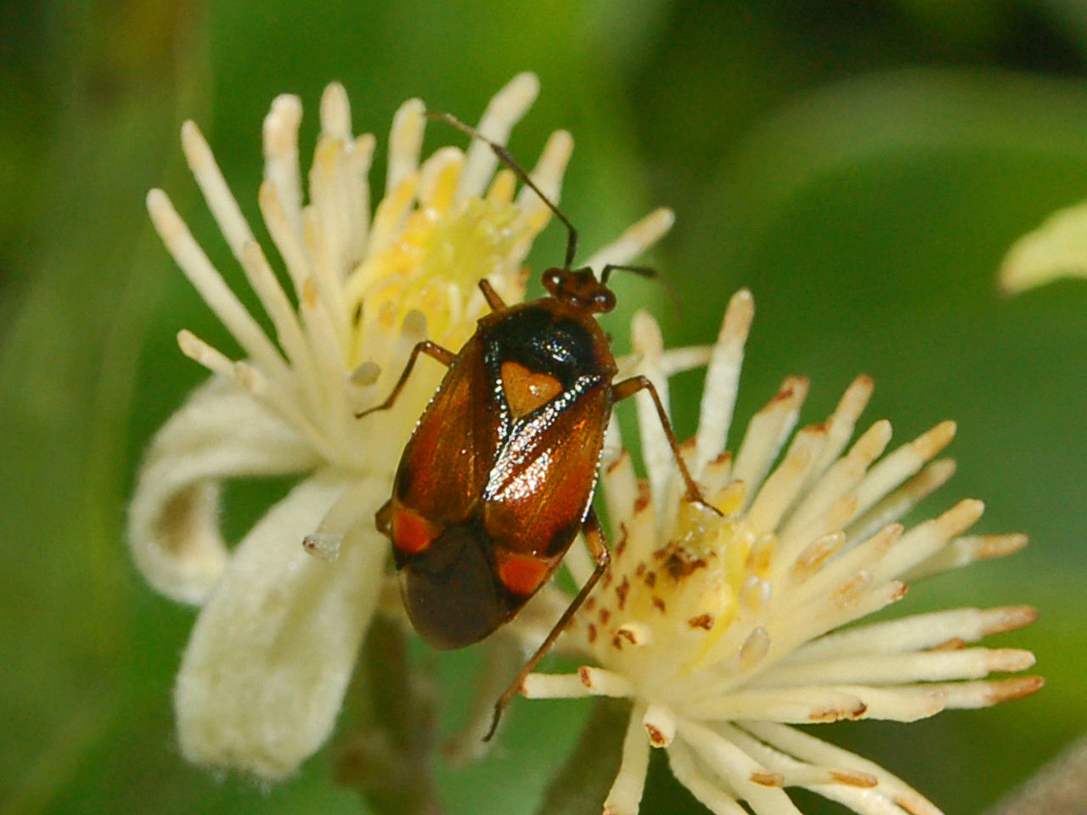
5
4
3
2
1
Identify the order name.
Identify the family name.
What is the name of the feature encircled by the red circle?
What is the specific name give to the leathery forewings of this order?

Slide 7
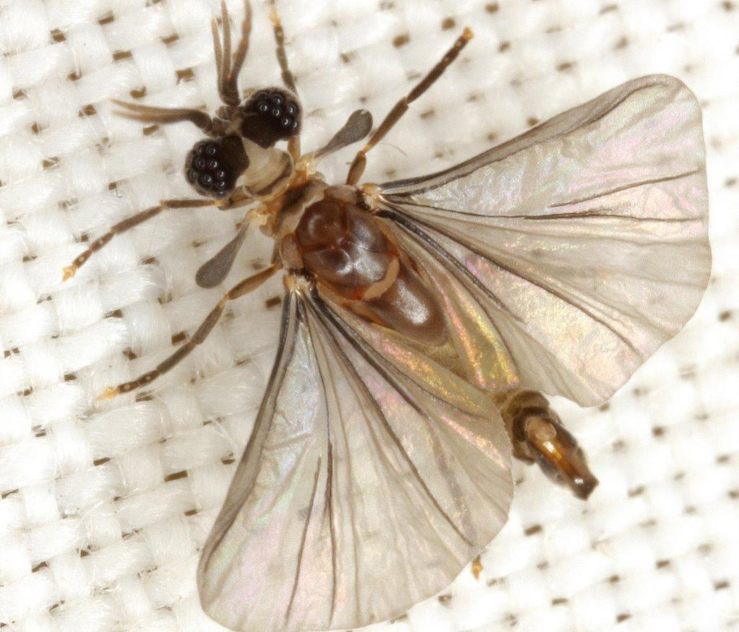
5
4
3
2
1
Identify the order name.
Is this a male or a female?
Are the wings shown forewings, hindwings, or both?

Slide 8
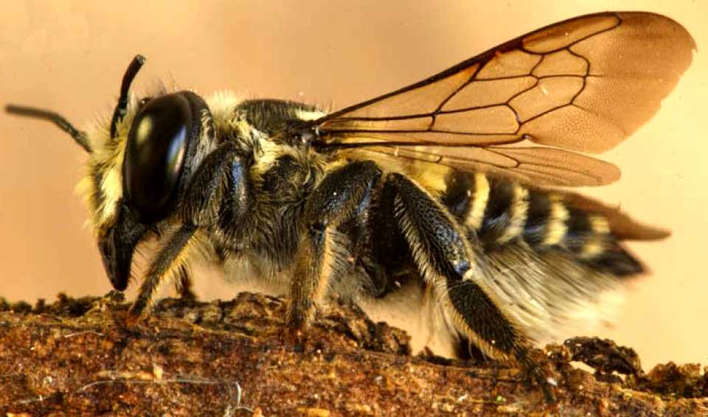
5
4
3
2
1
Identify the order name.
Identify the family name.
Identify the common name.
Some species of this family steal and feed on pollen collected by other species. What are these “robbers” called?
What is the general name for a bee’s pollen-carrying structure?
Where is this pollen-carrying structure found in this family?

Slide 9
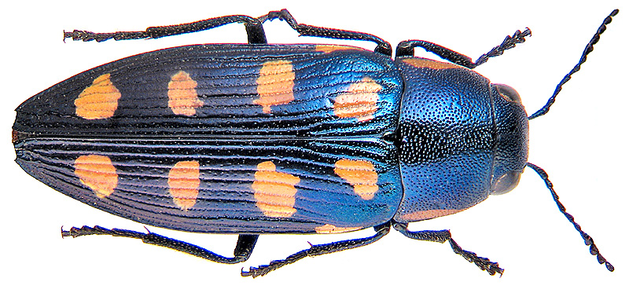
5
4
3
2
1
Identify the order name.
Identify the family name.
Identify the common name.
What is the specific term given to the hardened forewings of this order?

Slide 10
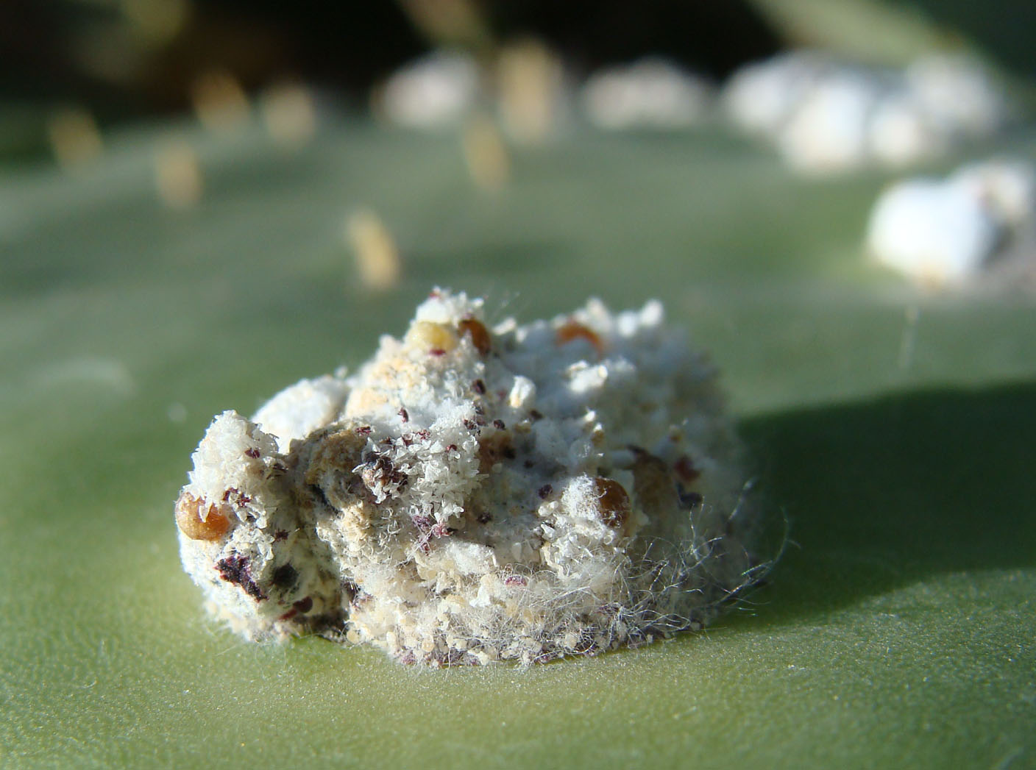
Identify the order name. (yes, this represents an insect)
Identify the family name.
Identify the common name.
What do Native Americans and pharmacists use these insects for?
5
4
3
2
1

Slide 11
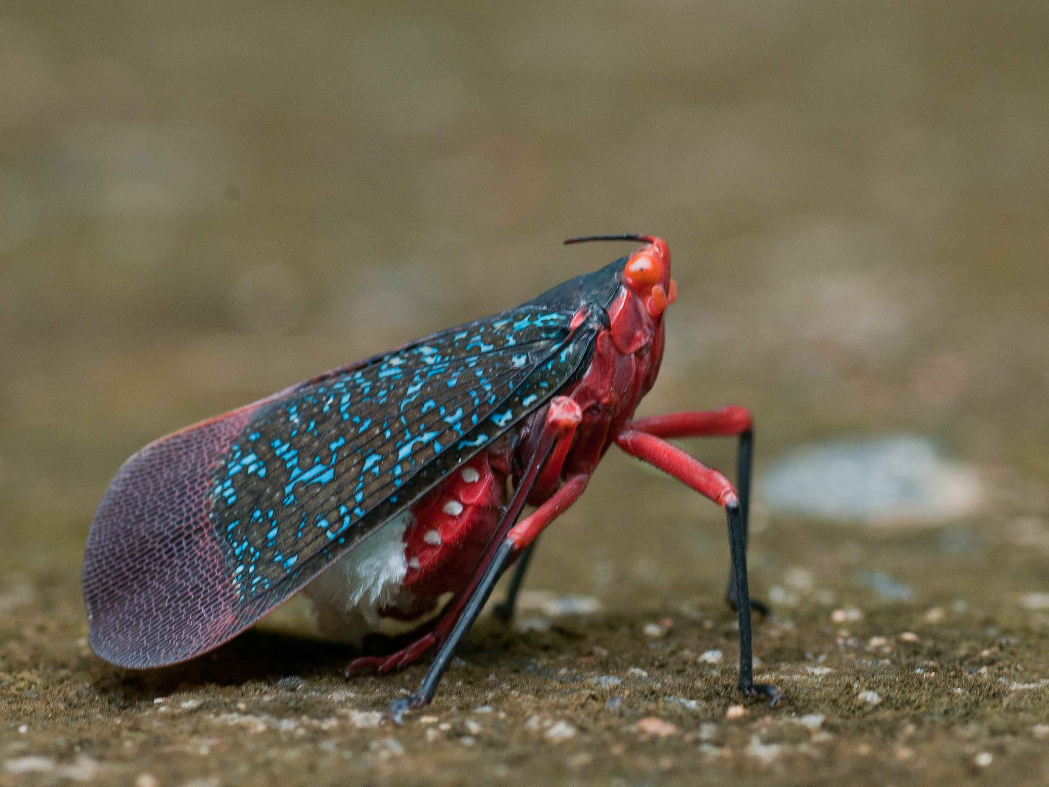
Identify the order name.
Identify the family name.
Identify the common name.
What name is this family sometimes referred by?
5
4
3
2
1

Slide 12
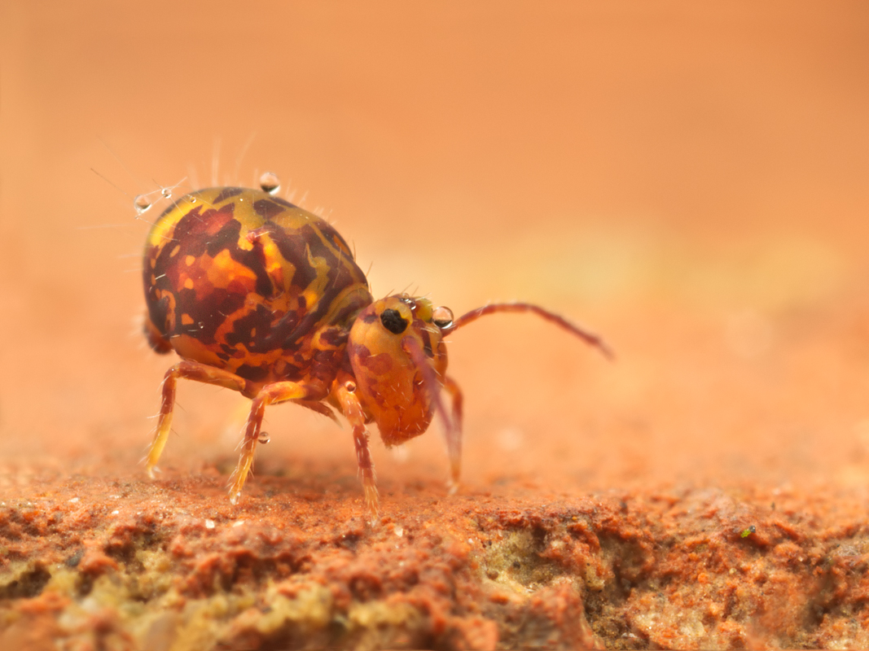
Identify the order name.
What is the name of the leaping organ characteristic of this order?
What is the name of the “catch” that holds the organ from question 32 in place?
5
4
3
2
1

Slide 13
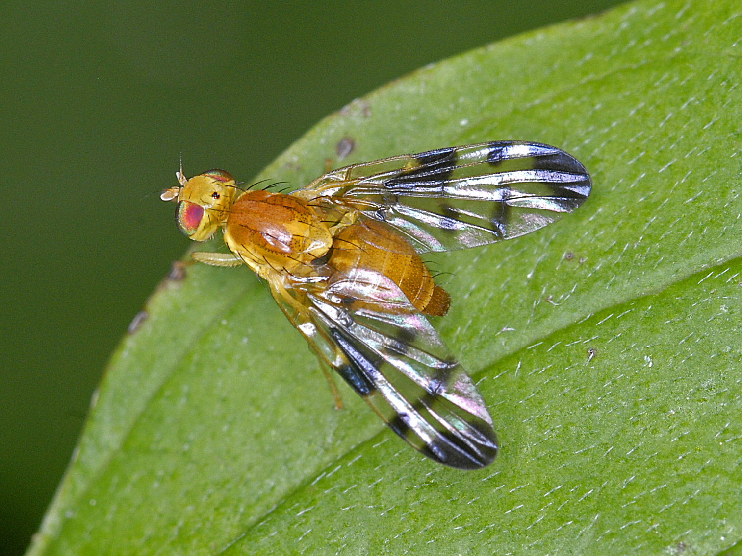
5
4
3
2
1
Identify the order name.
Identify the family name.
Identify the common name.
What happened to the hindwings of this order? What are they used for?

Slide 14
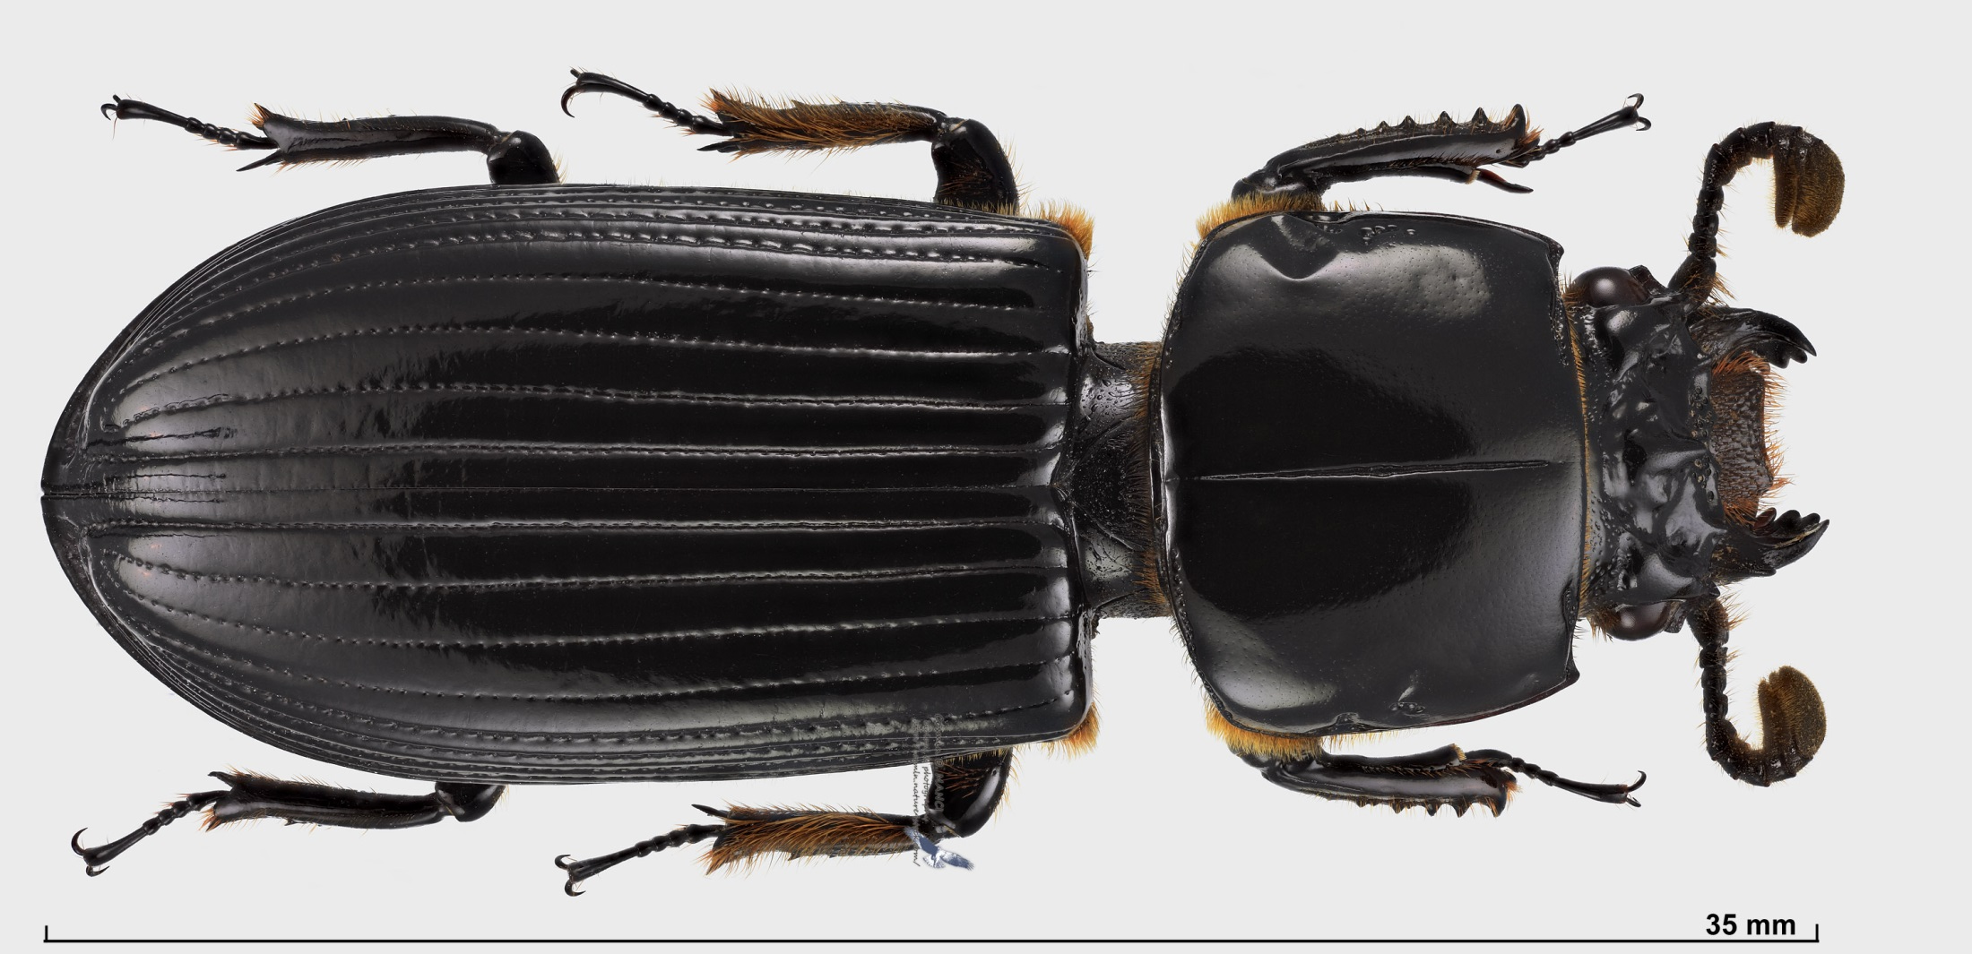
5
4
3
2
1
Identify the order name.
Identify the family name.
Identify the common name.
What kind of antennae does this family have?
How do these insects make squeaking sounds?

Slide 15
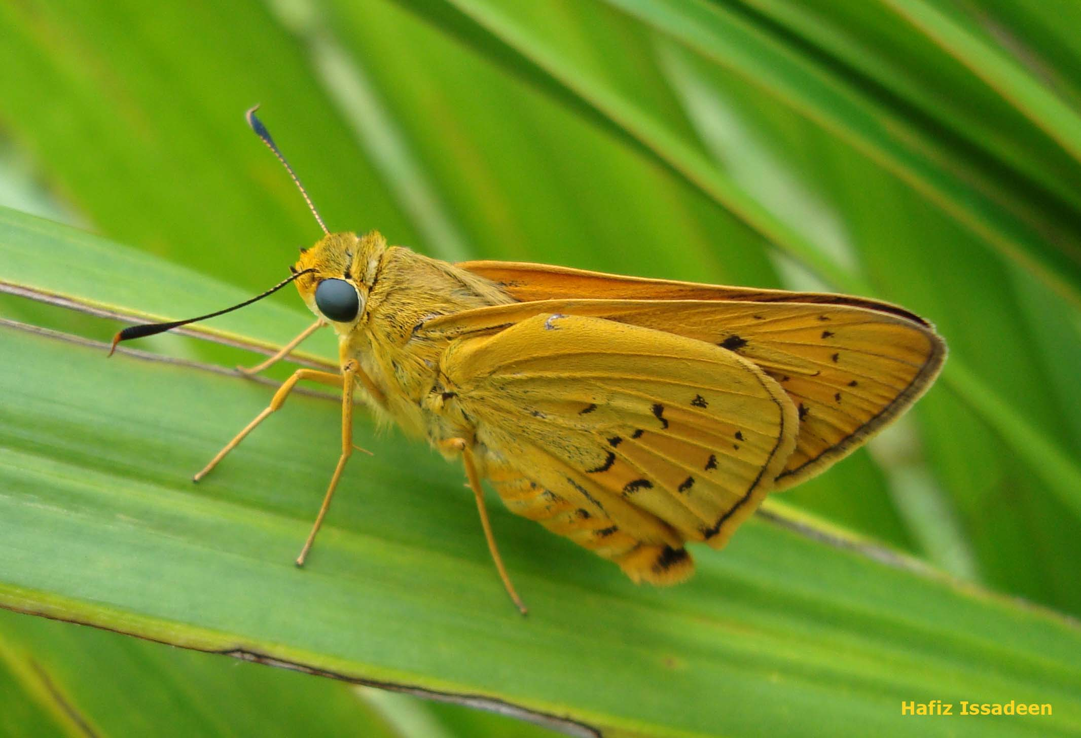
Identify the order name.
Identify the family name.
Identify the common name.
At what angle do insects of this family usually hold their forewings at rest?
What are the cocoon’s of this family made of?
5
4
3
2
1

Slide 16
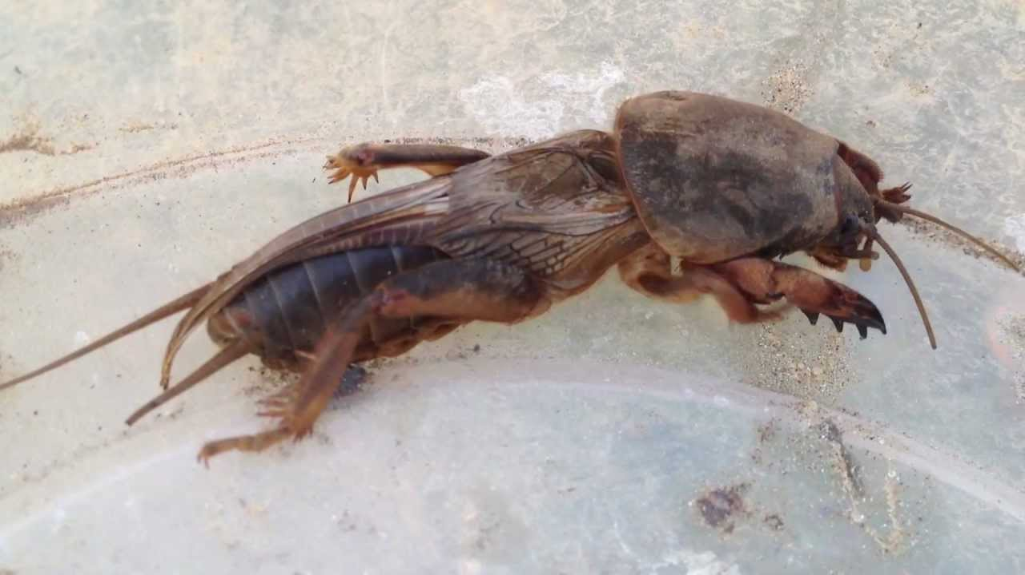
5
4
3
2
1
Identify the order name.
Identify the family name.
Identify the common name.
What type of legs do insects of this family have?

Slide 17
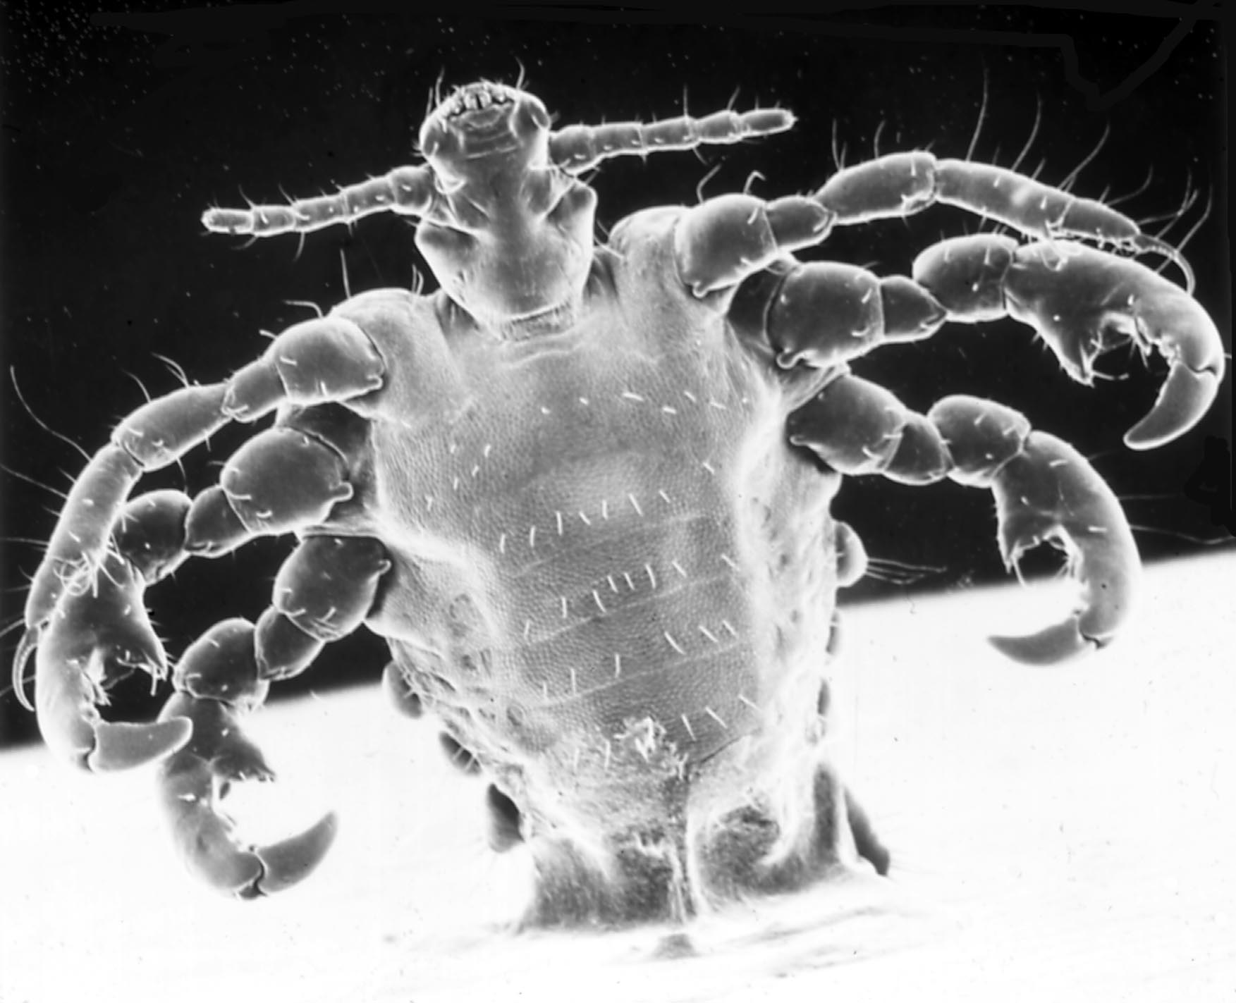
5
4
3
2
1
Identify the order name.
Identify the common name.
This order is parasitic. What do insects of this order usually feed on?
What disease does this order transmit?

Slide 18
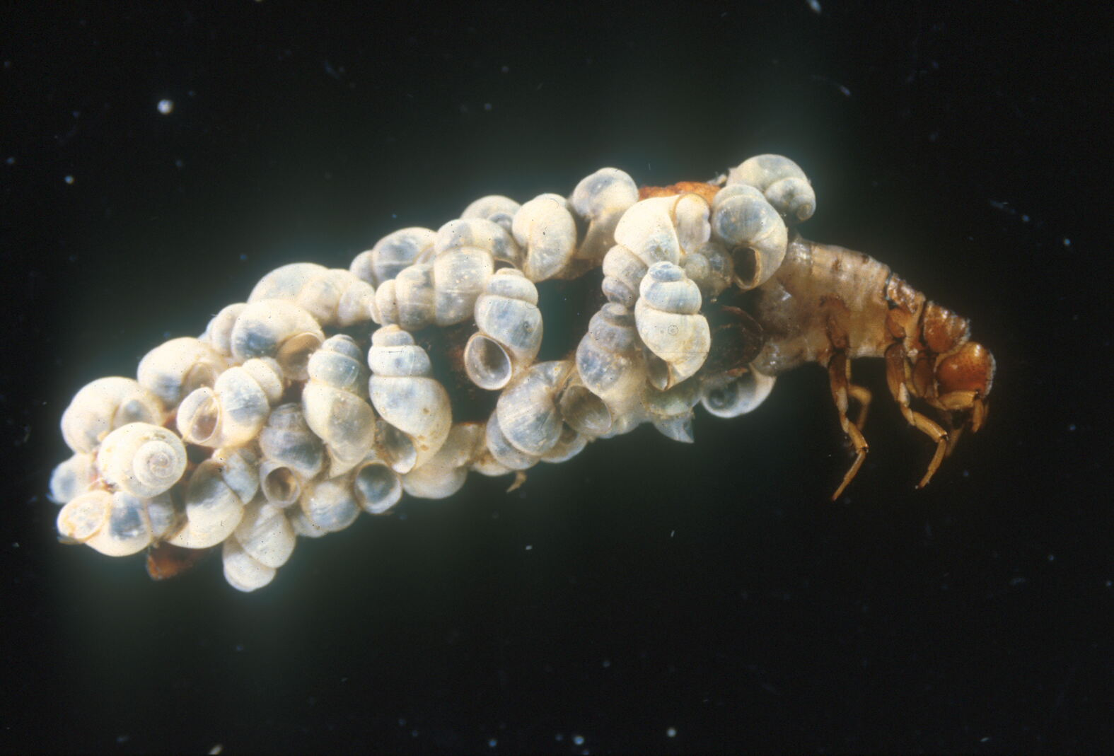
5
4
3
2
1
Identify the order name.
Identify the common name.
What are the larvae of this order called?
What kind of environment do the larvae of this order live in?

Slide 19
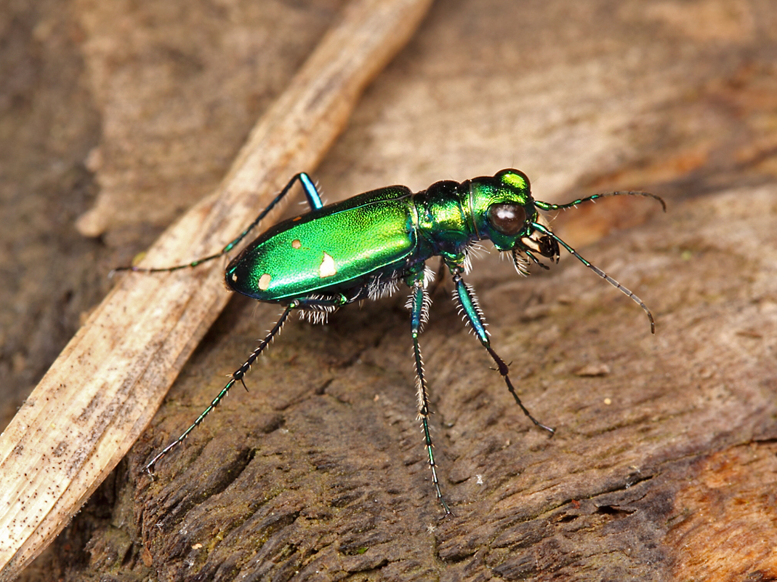
Identify the order name.
Identify the family name.
Identify the common name.
What kind of legs do insects of this family have?
5
4
3
2
1

Slide 20
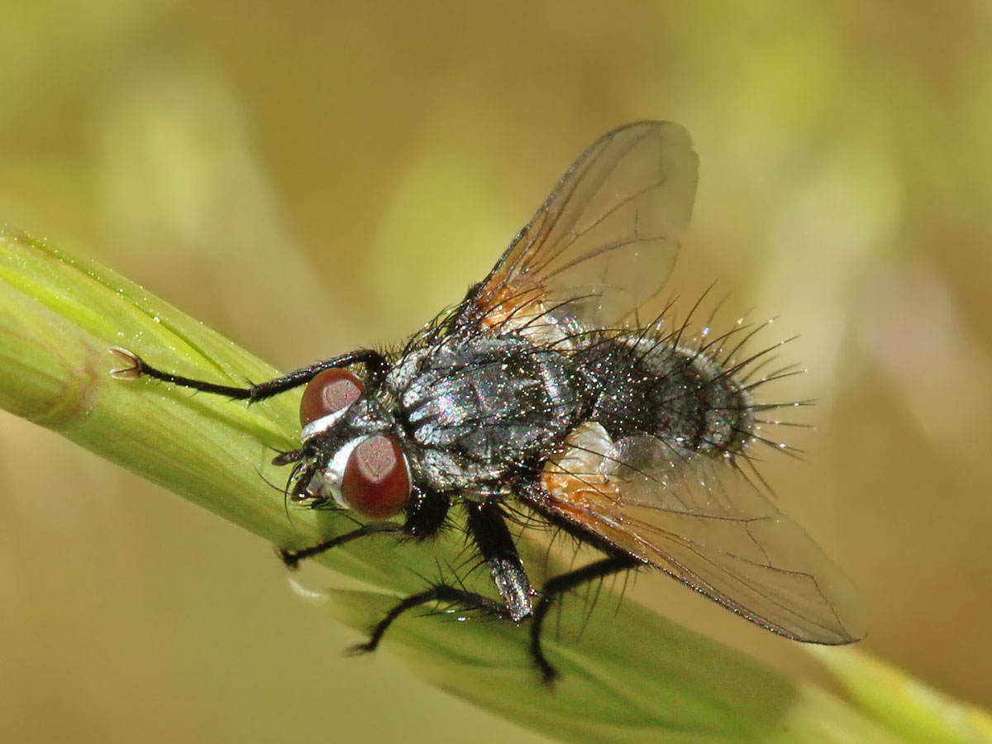
Identify the order name.
Identify the family name.
What anatomical feature of this order is uniquely large and conspicuously swelled?
What is the bristle-like tip of fly antennae called?
5
4
3
2
1

Slide 21
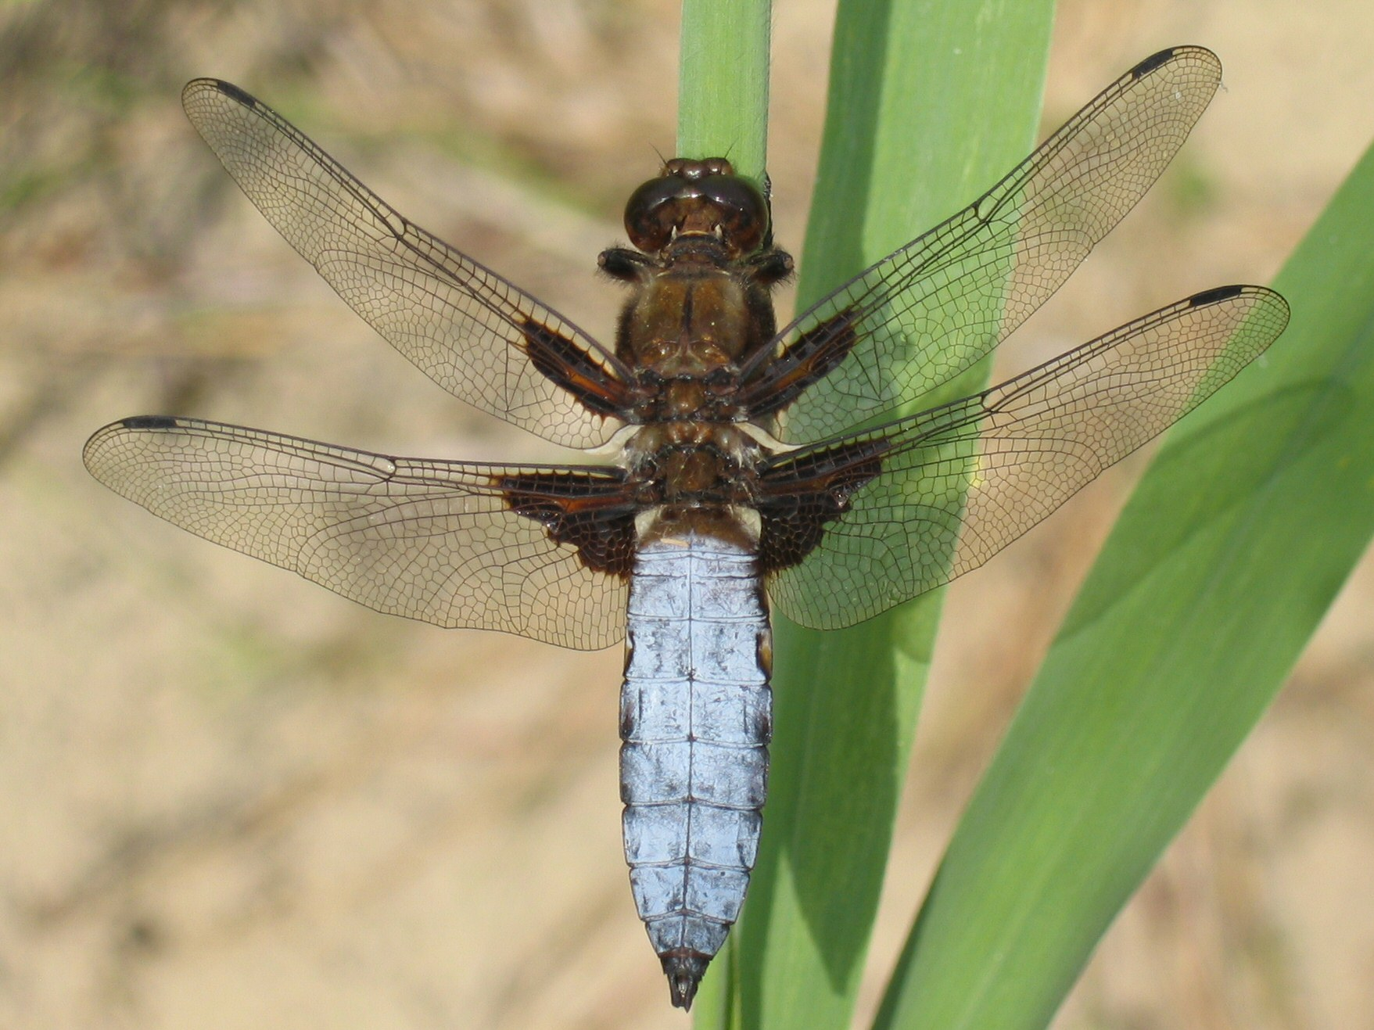
5
4
3
2
1
Identify the order name.
Identify the family name.
What is the name of the feature the red arrow is pointing at?
What is the name of the point the yellow arrow is pointing at?

Slide 22
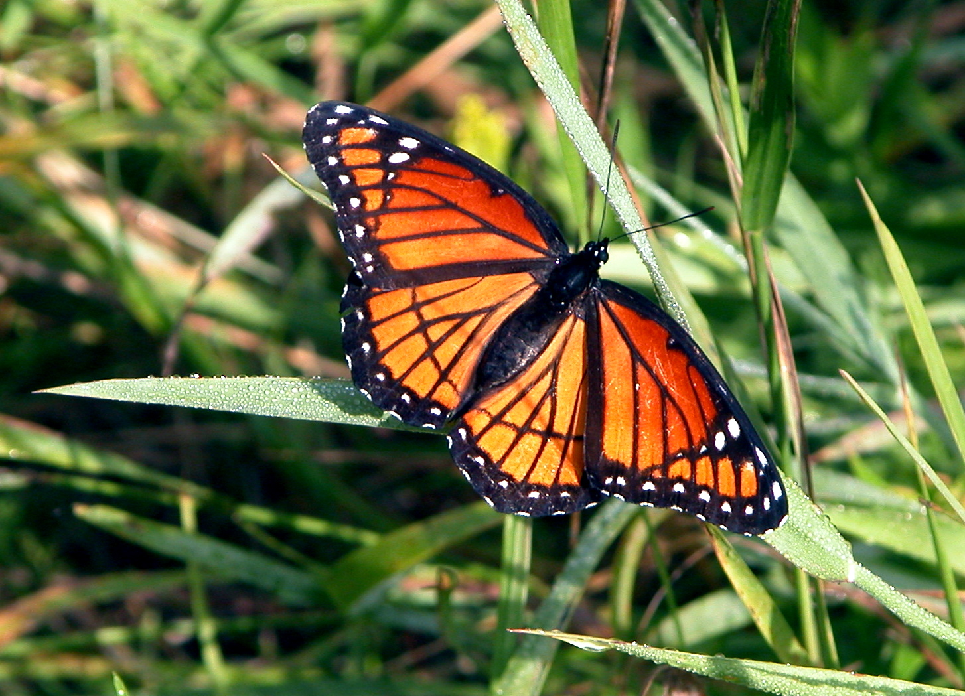
5
4
3
2
1
Identify the order name.
Identify the family name.
Identify the common name.
______ mimicry occurs when a harmless species imitates the warning signals of a harmful species to avoid a common predator.
Bonus: Identify the common name of this species.

Slide 23
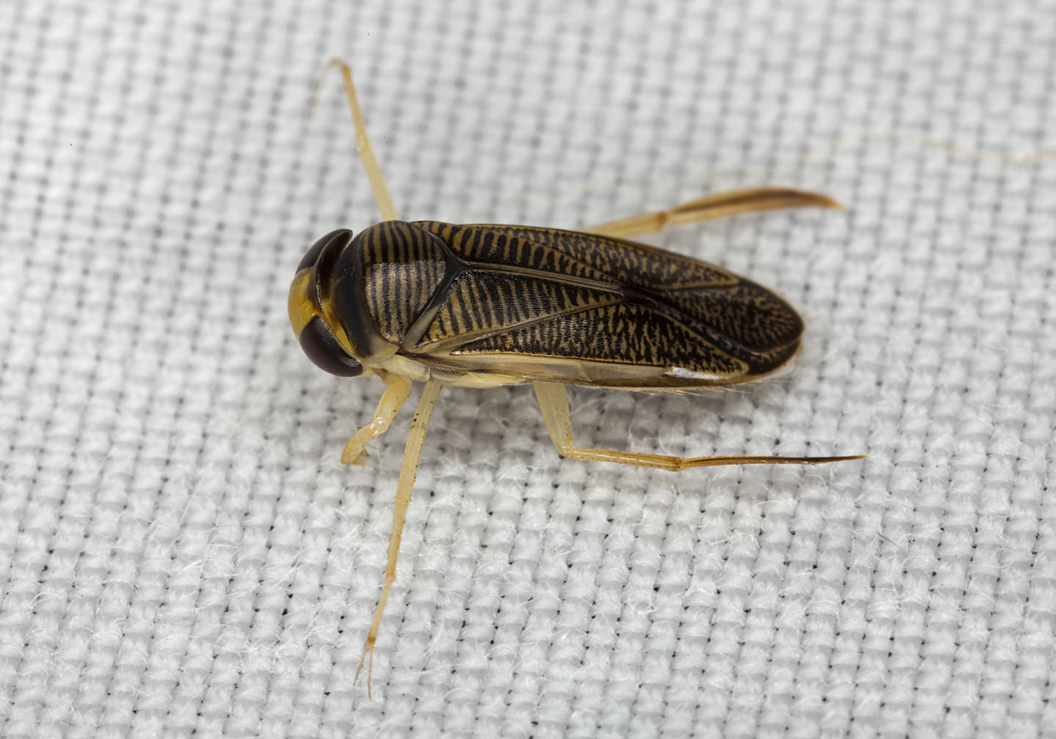
5
4
3
2
1
Identify the order name.
Identify the family name.
Identify the common name.
What type of back legs does this family have?
This family swims right-side up/upside-down near the surface/bottom of a body of water. (choose one from each of the bolded options)

Slide 24
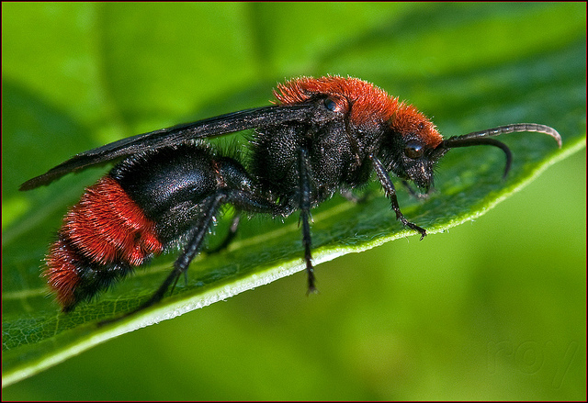
5
4
3
2
1
Identify the order name.
Identify the family name.
Identify the common name.
Is the specimen pictured a male or a female? How do you know?

Slide 25
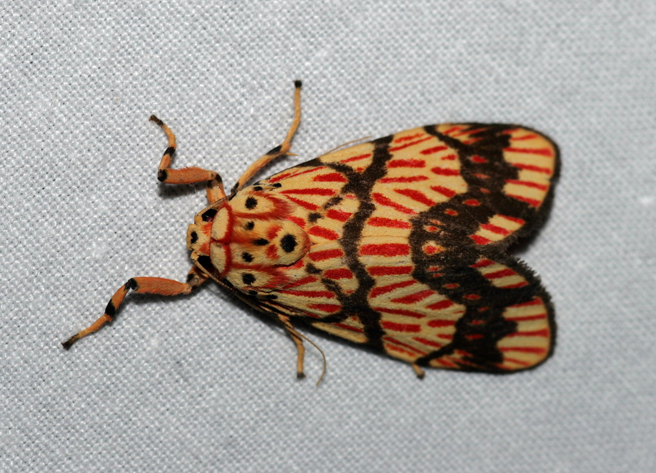
Identify the family name.
Identify the common name.
What is the name of the hearing organ found on each side of the thorax?
What are the cocoons of this family made of?
5
4
3
2
1

Slide 26
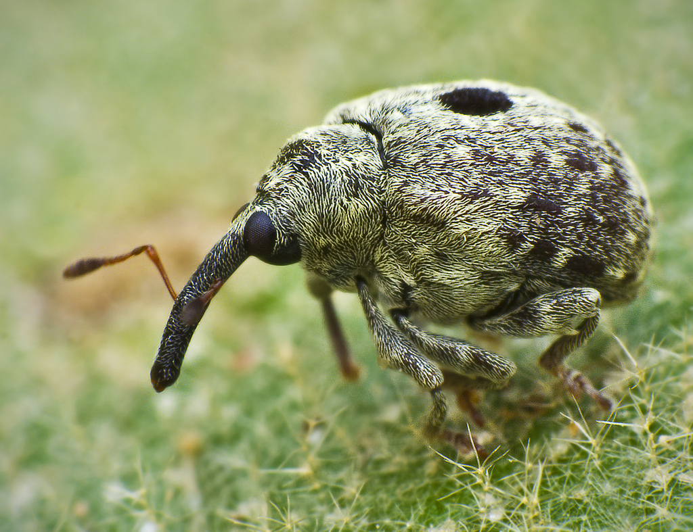
5
4
3
2
1
Identify the family name.
What type of antennae do true insects of this family have?
What is the name of the feature the red arrow is pointing at?

Slide 27
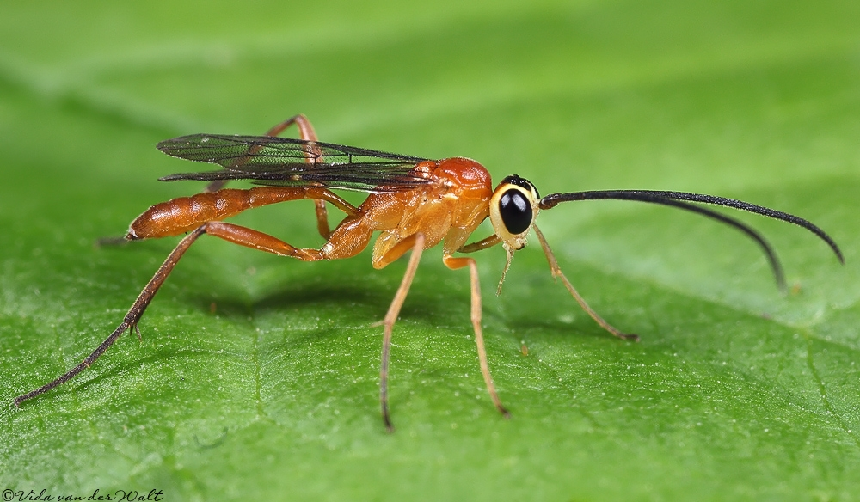
5
4
3
2
1
Identify the family name.
What do the adults of this family consume?
What is the name of the anatomical feature that is unique to this order in the yellow circle?
How are the larvae of this family beneficial?

Slide 28
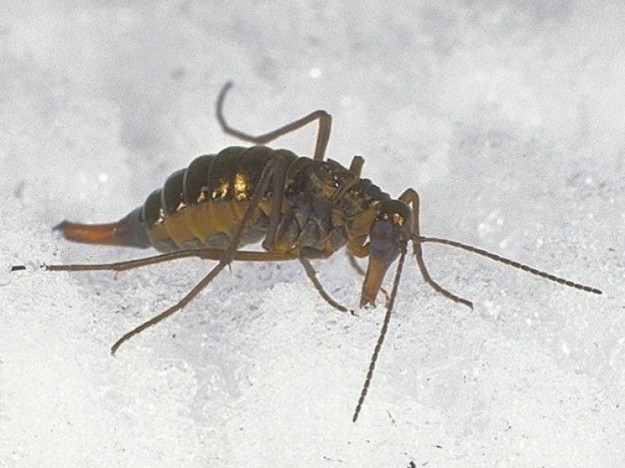
Identify the order name.
Identify the family name.
Where do insects of this family spend most of the year?
5
4
3
2
1

Slide 29
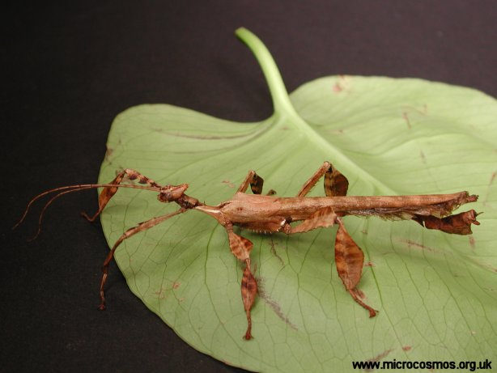
Identify the order name.
What is the term for the reproduction of females without mating?
5
4
3
2
1

Slide 30
General Trivia
5
4
3
2
1
List the kingdom, phylum, and class for all insects.
What is an insect’s exoskeleton mostly made of?
List two benefits of insects.
List two harmful effects of insects.
List a disease that Culicidae transmits.
List a disease that one species of Reduviidae transmits.
Bonus: List the species of Reduviidae that transmits the answer to 106.

Slide 31
Matching not all answers will be used!
5
4
3
2
1
Insects that never develop wings
Insects that develop wings internally
Incomplete metamorphosis
No metamorphosis
Complete metamorphosis
Ametabolous
Hemimetabolous
Holometabolous
Apterygota
Pterygota
Exopterygota
Endopterygota

Slide 32
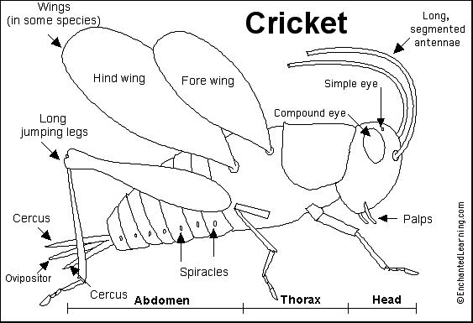
Label all the parts of this female cricket!
5
4
3
2
1
Question 116
Question 112
Question 113
Question 115
Question 114
Question 119
Question 117
Question 118

Slide 33
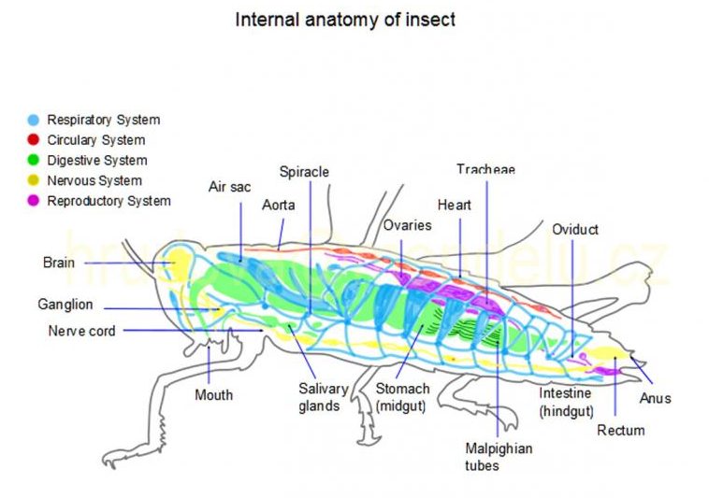
Label all the anatomical parts!
5
4
3
2
1
122.
125.
120.
121.
124.
123.
126.
127.
128.
129.
130.
131.
132.
135.
134.
133.

Slide 34
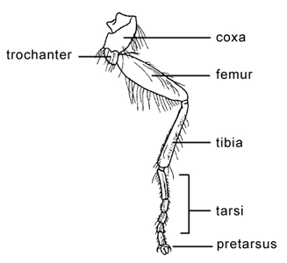
Label all the parts of the leg!
5
4
3
2
1
137.
136.
138.
139.
140.
141.

Slide 35
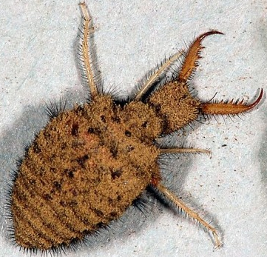
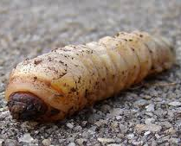
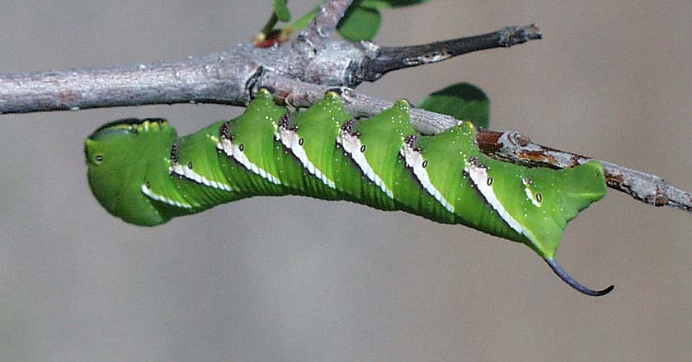
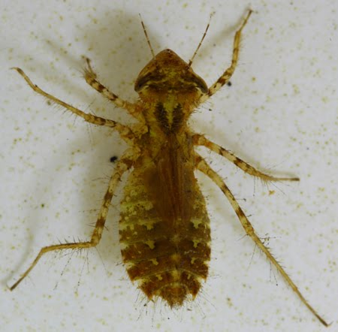
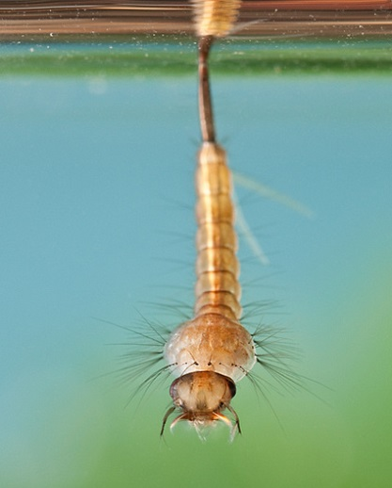
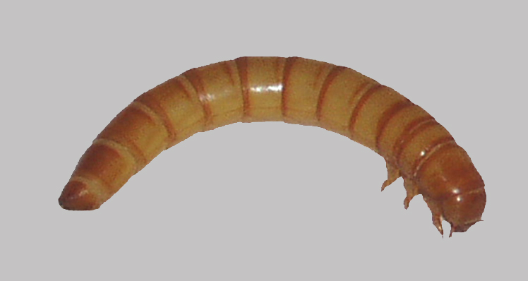
Identify the larvae! If the most specific scientific name is the family, give the family. Otherwise, give the order.
5
4
3
2
1
142.
143.
144.
145.
146.
147.

Slide 36
Almost at the Finish Line…
5
4
3
2
1
List the 6 types of legs (hint: running, jumping, swimming, walking, preying, digging).
What is the process of shedding of the outer cuticle called?
What is the function of the Malpighian tubules?
What is hemolymph?

Slide 37
Sort of…
5
4
3
2
1
What are the individual light receptor units of a compound eye called?
List two advantages of the development of flight.
_______ is the resting stage induced by environmental signals or extreme seasonal conditions.
How many cells thick is the midgut?

Slide 38
There we go…ish
5
4
3
2
1
Bonus: Define tegmina.
Bonus: How do haustellate insects consume food?
Bonus: Define apolysis.
Bonus: Define poikilotherm.
Bonus: What is the function of the Johnston’s organs?
Bonus: List three uses for insect appendages.

Slide 39
Drop your pencils!
You’re finally done!
Sorry not sorry for the test.
Now move on.
Bye.
If you have any comments, questions, concerns, or insults about the test, please consult Regina.

