Slide 1
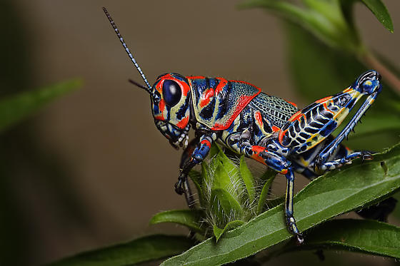
2014 Entomology Practice Test
By: Sonerd
(Originally created for the SSSS 2014)

Slide 2
Instructions
This test is in PPT format (duh!). On each slide, there will be 1-2 insects to identify, and a few questions about each insect
Use scientific names unless otherwise indicated
You may only use your 8.5 by 11” cheat sheet and your field guide
If you wish, you can put this PPT into presentation mode; I have the slides on timers of 30-45 seconds, depending on the question types.
This is my first test, so please bear with me ☺
Please PM me and let me know of any typos or if I did anything incorrectly…

Slide 3
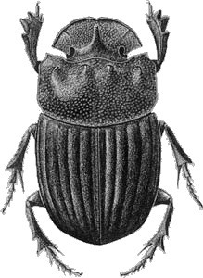
Slide 1, Questions 1-3
What is the order of this insect?
What is the family of this insect?
What is unique in the way these insects transport their food?

Slide 4
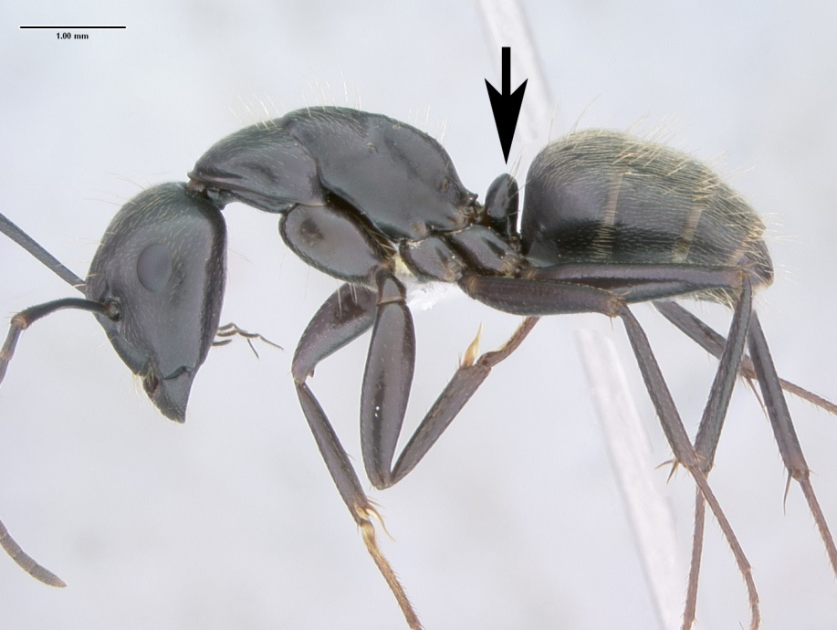
Slide 2, Questions 4-7
4. What is the order of this insect?
5. What is the family of this insect?
6. What anatomical feature (indicated by the arrow) is a defining characteristic of this insect’s family?
7. Where are most species found?

Slide 5
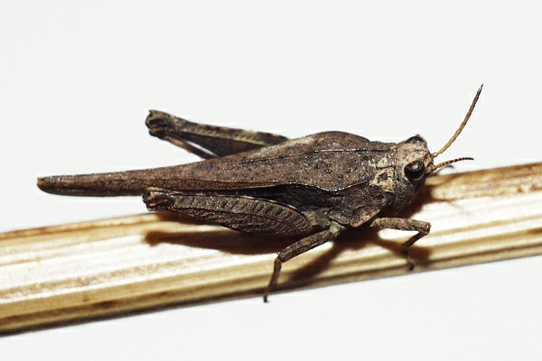
Slide 3, Questions 8-10
What is the family of this insect?
Name one defining characteristic of this family.
What do insects of this family eat?

Slide 6
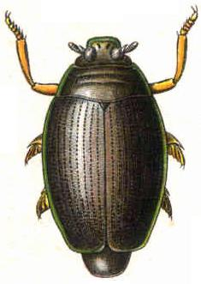
Slide 4, Questions 11-13
11. What is the order of this insect?
12. What is the family of this insect?
13. Describe this insect’s compound eye. (How is it unique?)

Slide 7
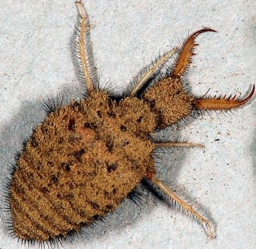
Slide 5, Questions 14-18
What is the order of this insect?
What is the family of this insect?
Is this insect an adult or an immature?
What is the nickname given to larvae of this family?
Why is that nickname given?

Slide 8
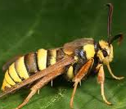
Slide 6, Questions 19-22
19. What is the order of this insect?
What is the family of this insect?
What other insect can this be confused with?
Describe any health/economic impact.

Slide 9
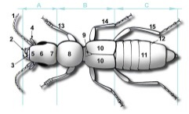
Slide 7, Question 23 (i-xv)
23. Please label each part of this insect, using the numbering on your answer sheet.
*Disregard the light blue “A,B, C” on the diagram*

Slide 10
Slide 8, Questions 24-26
All insects are considered members of…
a) Kingdom _______
b) Phylum_______
c) Subphylum__________
d) Superclass___________
e) Class_________
25. Name 3 ways in which insects can benefit humans and 3 ways in which they can harm humans.
26. Name 3 diseases insects can transmit (include the common name of the transmitting insect)

Slide 11
Slide 9, Questions 27-28
27. For the chart on your answer sheet, fill in the missing information about each wing adaptation.
28. For the chart on your answer sheet, fill in the missing information about each leg adaptation.
(This is exactly the same as the last question, just with legs)

Slide 12
Slide 10, Questions 29-31
29. Define the vocabulary words on your answer sheet. Use as much detail as possible.
30. What is the difference between a chrysalis and a cocoon?
Name and describe the 3 (main) types of insect metamorphosis.
(Use a, b, and c for each of the 3 types)

Slide 13
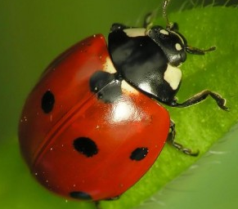
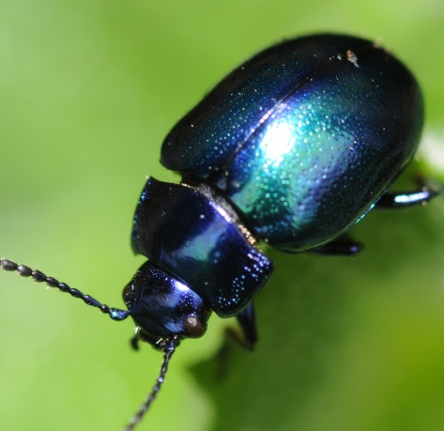
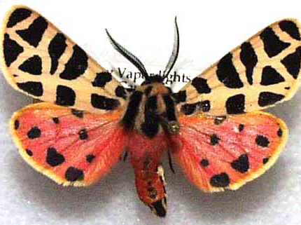
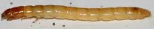
Slide 11, Dichotomous Key
32. Create a Dichtomonous key with the following insects. You may use the template on your answer sheet or flip it over and use the blank sheet.

