Slide 1
Bungee Drop 2015
Supervisor preparation

Slide 2
Introduction
Each team will design one ‘elastic’ cord to conduct two separate drops from given height(s), attempting to drop mass placed in a bottle as close as possible to, but not without touching a planar landing surface.

Slide 3
Before the event preparation
Prepare drop mechanism
Prepare calibration
Prepare landing area
Prepare bottle
Bring supplies

Slide 4
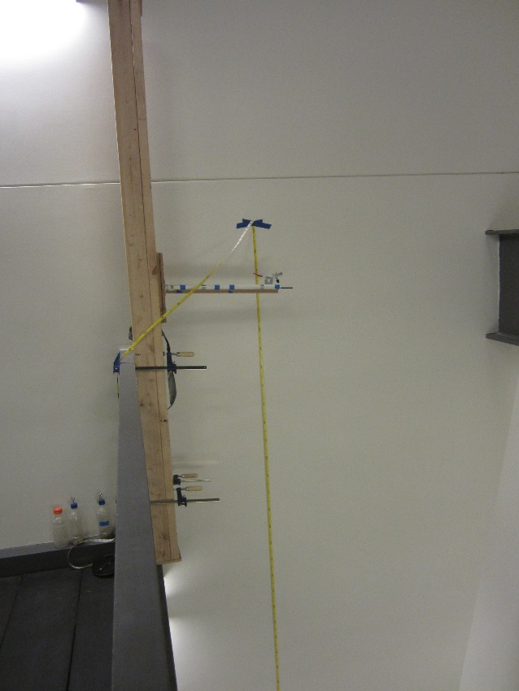
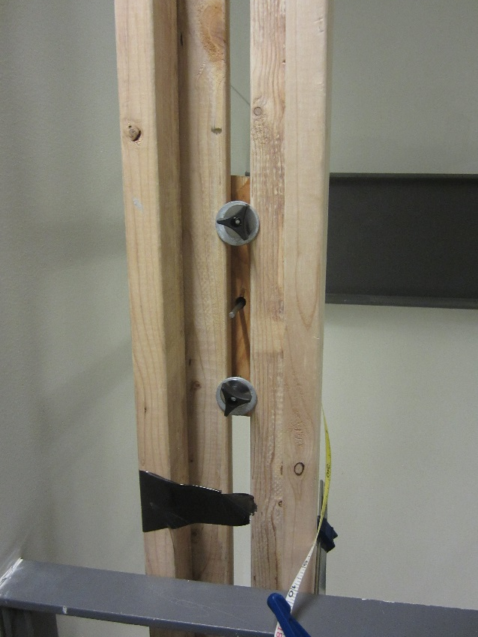
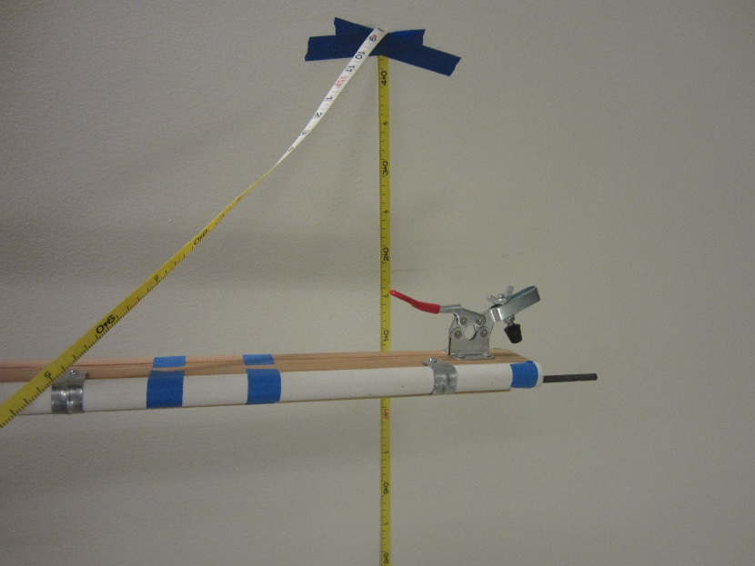
Drop Mechanism
Adjustable height
  2 – 5 m
Release mechanism
Adjustable height
Clamp
Release mechanism
Release mechanism
Overview of
drop mechanism

Slide 5
Calibration area
Camera (or two)
  High frame rate
  Immediate playback
    My students have had great luck with smart phones; Apple 5s and Galaxy IV have a frame rate of 120 fps
    For official tests, I use a stationary webcam attached to my computer.
Tripod
Backdrop

Slide 6
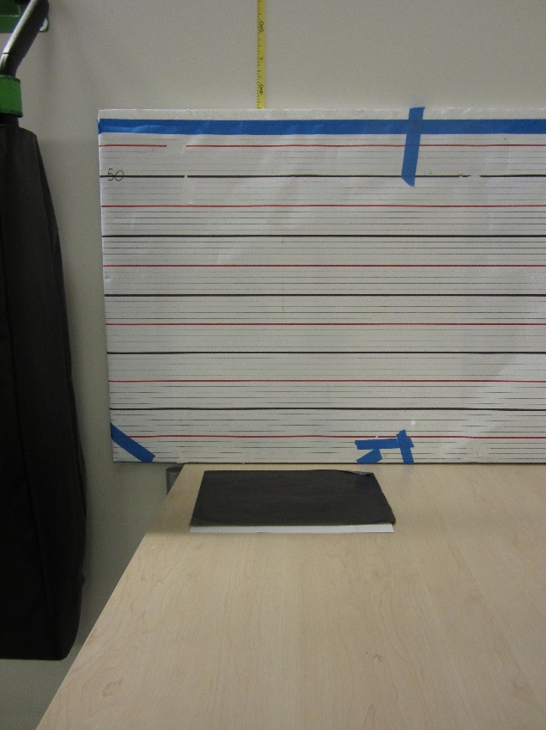
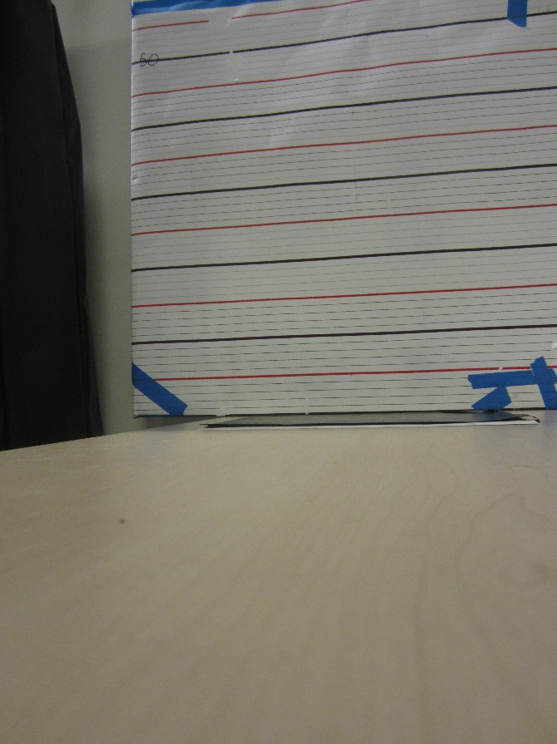
Prepare landing area
Carbon paper, paper
Recruit spotters
Calibrated backdrop
Carbon paper
Camera view situated to minimize parallax for close drops
Clean sheet of paper

Slide 7
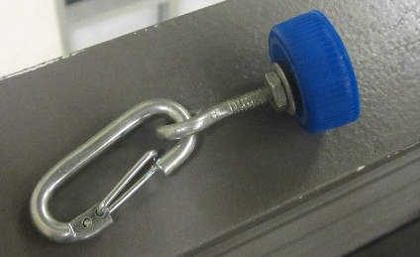
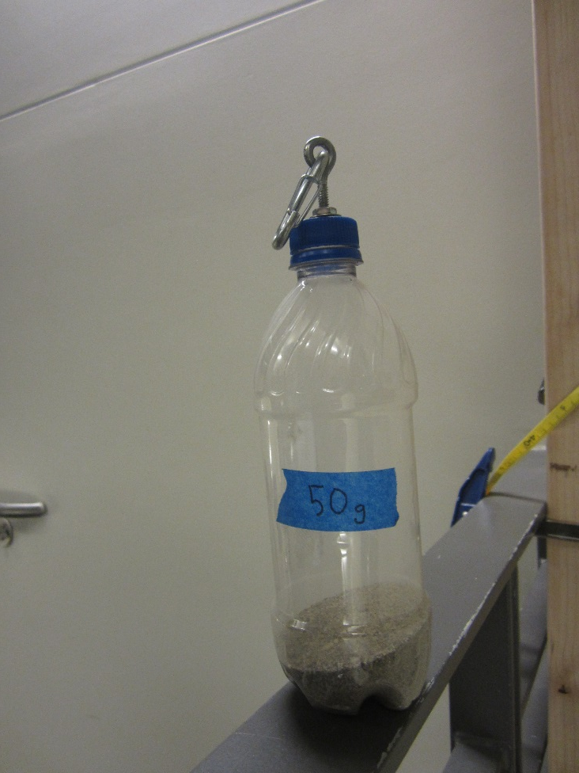
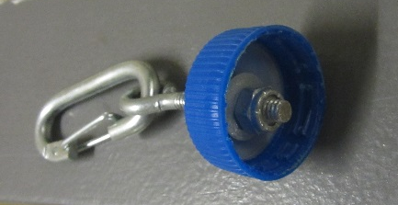
Prepare bottle
500 – 591 mL plastic bottle
Attachment mechanism on lid
  Hook, clasp, carabineer
Weight (between 50 g and 300 g)
  Multiple of 25 g at regional
  Multiple of 10 g at state

Slide 8
Bring supplies
Metric measuring tape (between 2 m and 5 m)
Scale (up to 300 g) to verify mass
Supplies for impound
  Cups or bins or baggies
  Index cards
500 g mass
Flip chart paper x2
Stop watch or other timer
Marker
Score sheets and spreadsheet
  Available on www.soinc.org or from tournament supervisor

Slide 9
Day of the event: Impound
By 0800, be prepared to accept students’ devices during impound
Students will drop off their elastic cords by 0900.
When they do,
  Instruct them to label the cups or bins with their names and the name of their team.
  Ask them to sign up for a time to test their device if they have not already done so
    See sample sign-up and scoring sheet
Make a note of which teams have submitted their cords before 0900.
Insert pictures of cups with names

Slide 10
Day of the event:
Announcing mass, height of drop, length of bottle
On the flip chart paper,
  Indicate the mass of the bottle (and attachment)
  Indicate the drop height(s)
  Indicate the length of the bottle
    Including attachment mechanism
Post the flip chart in a conspicuous location

Slide 11
Confirm devices meet specifications
Design specifications
  Closed ring at one end, ~1/2 – ~1” diameter
  No separate, parallel, non-elastic ‘braking’ strand
Elasticity
  Measure original length of cord
  Cord stretches >1.25 m when 500 g mass is added
  Re-measure length of cord
    Verify cord length returns to 5 cm of its original length when weight is removed

Slide 12
Device testing: preparation
When teams arrive, start the timer; they have five minutes to prepare their device prior to testing.
They may mark but not otherwise make physical alterations to their devices.

Slide 13
Device preparation: drop
After teams have finished their preparation, restart the timer; teams have 5 minutes to complete both drops.
Prepare to record the drop.
  Set a clean sheet of blank paper under the carbon paper
  Set camera on tripod or other stable surface.
    Field of view needs to be wide enough to accommodate drops that do not go very far
Say or show students’ names and team name while recording prior to launch.
  e.g., cups from impound
At your signal, students release bottle
Play back the video in slow-motion.
Determine and record distance from landing plane.

Slide 14
Scoring
Use the scoring spreadsheet to record pertinent information
Optional: post scores for competitors to compare progress over the course of the day

Slide 15
Sample schedule and scoring
Participants’ names | School & team name | Drop 1 |  | Drop 2 |  | Overall
 |  | Touched? | Distance? | Touched? | Distance?
 |  | Yes No |  | Yes No
 |  | Yes No |  | Yes No
 |  | Yes No |  | Yes No
 |  | Yes No |  | Yes No
 |  | Yes No |  | Yes No

Slide 16
For more information
This set of slides was prepared by Scott McComb, WA State Science Olympiad Board Member.
For more information, you may contact him at scott.mccomb@highlineschools.org

